Slide 1
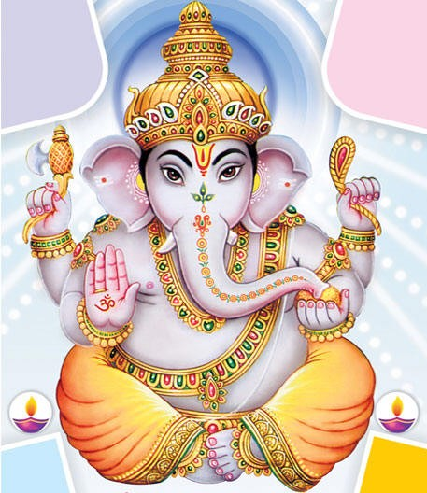
Hinduism

Slide 2
Origin of Hinduism
Hinduism developed thousands of years ago in Ancient India
There is no single founder or single sacred text for Hinduism
Hinduism traces its beginnings back to the Aryans conquering the Indus River Valley Civilization

Slide 3
Brahman
Brahman is the all powerful spiritual force that controls all things
The gods and goddesses of Hinduism are used to explain and represent the force of Brahman
The sacred texts of Hinduism are referred to as Vedas.

Slide 4
Important Terms of Hinduism
The ultimate goal of Hinduism is to achieve moksha which is the union with the spiritual force, Brahman.
In order to achieve moksha, a person has to free themselves of selfish wants and desires

Slide 5
Achieving Moksha
Moksha is believed to be difficult to achieve
Hindus believe in reincarnation or rebirth.
In order to achieve moksha, people must obey the laws of Karma. Karma is all of the actions of a person’s life that affect their fate in the next life

Slide 6
Reincarnation
Karma influences what a person will come back as in their next life. Those who are bad come back as a lower form. Those who are good come back as a higher form.
HUMANS
ANIMALS
PLANTS
OBJECTS

Slide 7
Achieving Moksha
In order to achieve moksha, Hindus must perform their religious and moral duties which is known as dharma.
The Aryans introduced the caste system where each person in society served a different role in life.
The actions required for dharma was dependent on a person’s position in the caste system.

Slide 8
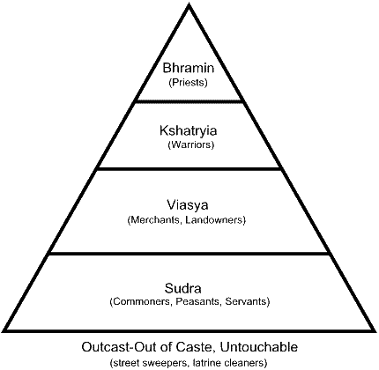
Castes – social stratification

Slide 9
REVIEW
What is the ultimate goal of Hinduism?
What is dharma?
What are the collection of sacred texts called?
How does reincarnation work in Hinduism?
What is the record of all good/bad things a person has done that affect their fate?
What is the Hindu term for nonviolence?

Slide 10
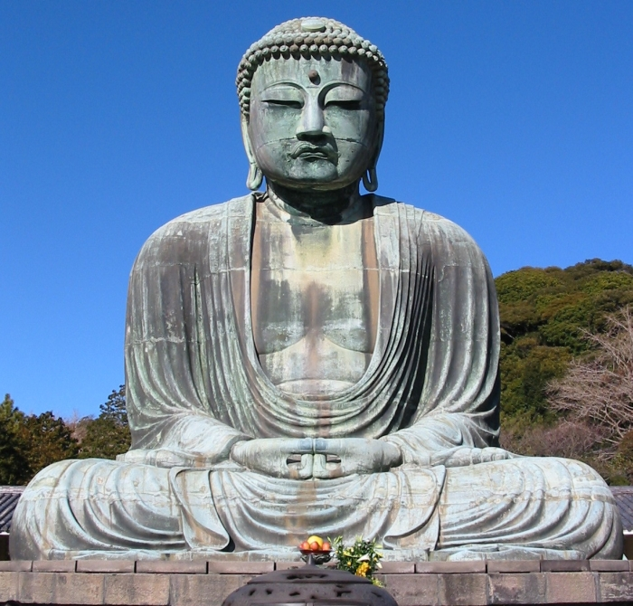
Buddhism

Slide 11
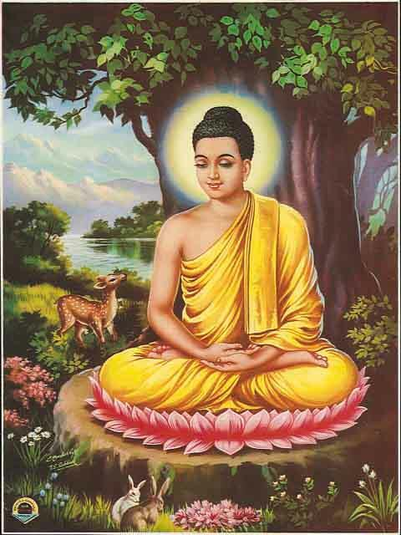
Buddhism
The religion of Buddhism developed out of Hinduism in the 6th century BC (BCE)
An Indian prince named Siddhartha Gautama determined that life was full of human suffering
He left his life of luxury to
find the place between a life
of suffering and death. This
place came to be known
as Nirvana
Notes:
Nirvana ends the reincarnation cycle

Slide 12
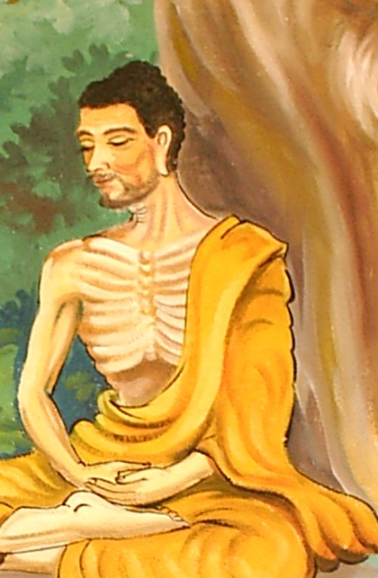
Buddhism
Siddhartha wandered,
meditated and fasted until
he understood the cause
and cure for human suffering
He became known as Buddha, the Englihtened One
Buddha developed the Four Noble Truths and how to follow the Eightfold Path to achieve Nirvana

Slide 13
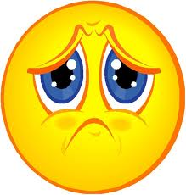
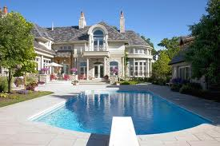

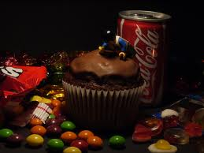
Four Noble Truths
All life is suffering, pain and sorrow
The cause of suffering is nonvirtue
or selfish desires or negative deeds
To cure suffering, a person
must overcome nonvirtue
The way to overcome nonvirtue is by following the Eightfold Path

Slide 14
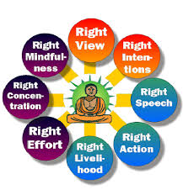
Eightfold Path/Middle Path
The Eightfold Path is the right way
to live life
View/Belief- Know the 4 Noble Truths
Intentions- Commit to living by the 4 Noble Truths
Speech- No gossip or bad language
Action- Do good deeds and treat others with respect
Livelihood- Get a job that is good for you and can help you live by the 4 Noble Truths
Effort- Have a good attitude
Mindfulness- Self control
Concentration- Meditate and reflect

Slide 15
Eightfold Path
By following this Eightfold Path
and reaching Nirvana, a person
could escape the cycle of reincarnation
Nirvana was not limited based on class or status and could be achieved by anyone as long as they understood the Four Noble Truths and followed the Eightfold Path

Slide 16
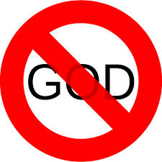
Teachings of Buddha
Buddhism is considered to be a religion with no gods because the inspiration
for the religion came from
the teachings of a human
being
Tripitaka – sacred books

Slide 17
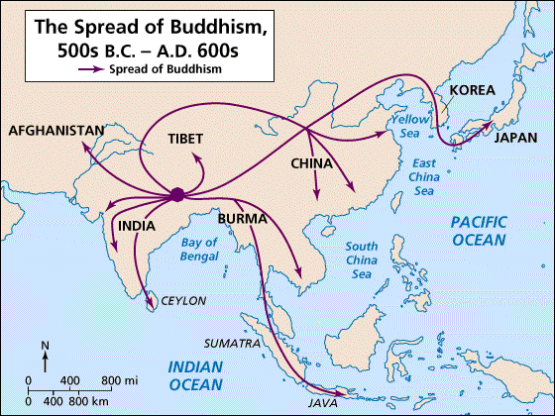
Spread and Influence of Buddhism
Buddhism spread from India outward across Asia

Slide 18
REVIEW
Who is considered the founder of Buddhism?
What is the ultimate goal of Buddhism?
What does someone have to overcome in order to reach Nirvana?
How many folds are there on the path to Nirvana?

Slide 19
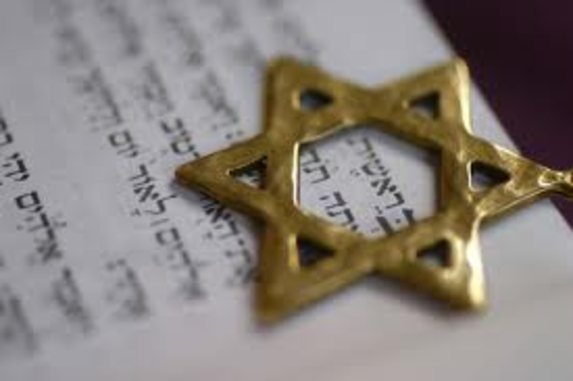
Judaism

Slide 20
Judaism
The oldest of the world’s monotheistic religions
Began approximately 4,000 years ago and was developed by the Israelites (between 600-800 BC)

Slide 21
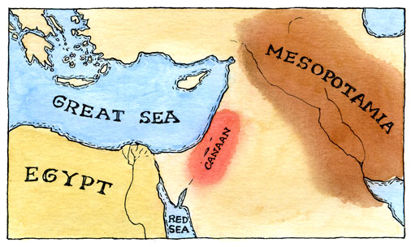
Abraham and his Covenant
Began with a man named Abraham.
Abraham was from the town of Ur, located in Mesopotamia.
Abraham migrated his family and animals to a region called Canaan.

Slide 22
Abraham and his Covenant
Abraham made a covenant with God.
The covenant declared:
  1) Abrahams descendants would view themselves as “the chosen people” because of their special relationship with God
  2) The land in which Abraham lived would be known as “the promised land”
Abraham is considered a prophet because he was chosen by God to speak to people and pass on a message or teaching

Slide 23
Leaving Israel
Drought and famine made decedents of Abraham leave Israel for Egypt.
When the Israelites arrived in
Egypt, they were enslaved by the
pharaoh, the ruler of Egypt

Slide 24
Escape from Egypt
The Israelites lived as slaves in Egypt for many years
A descendant in the line of Levi (one of Jacob’s sons), was named Moses
Moses freed the enslaved Israelites from the Egyptians in what is known as the exodus

Slide 25
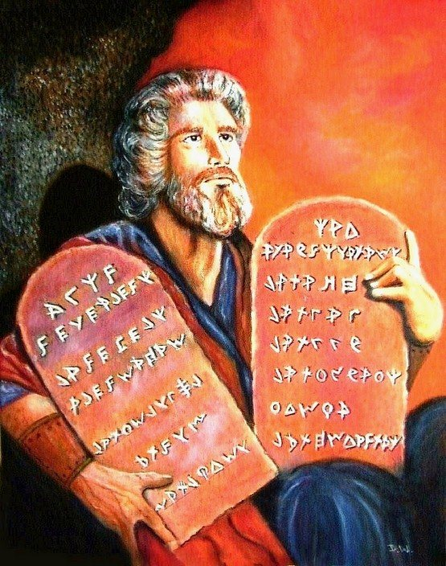
Escape from Egypt
After escaping from Egypt,
and reaching Mt. Sinai,
God spoke to Moses and
gave him laws to follow
known as
The Ten Commandments

Slide 26
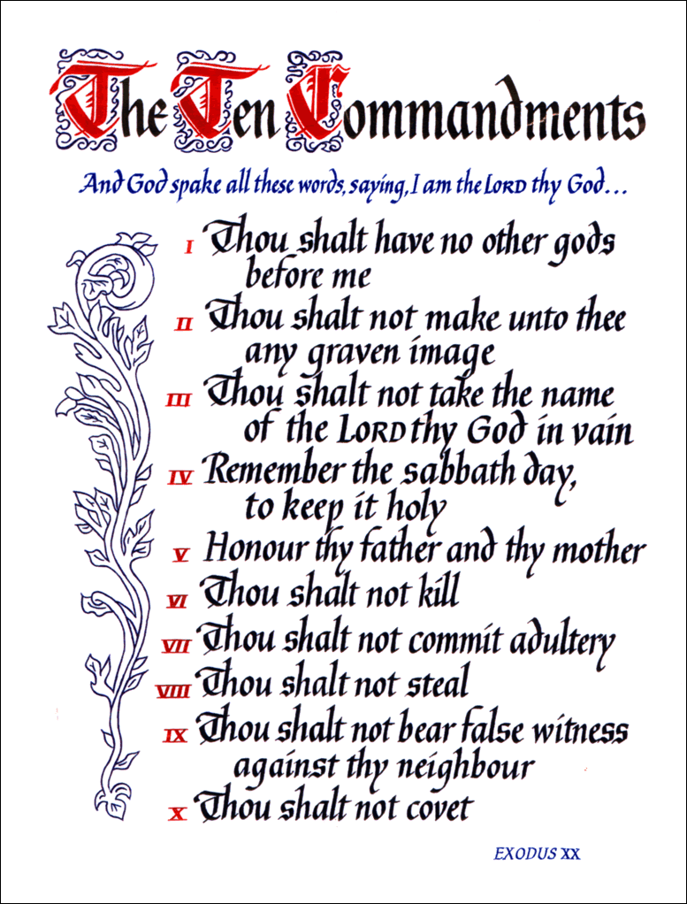

Slide 27
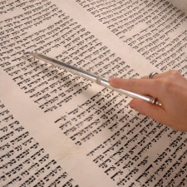
Torah
The Torah is the most sacred text of Judaism.
The Torah contains the 5 books revealed to Moses on Mt. Sinai The books are:
  Genesis
  Exodus
  Leviticus
  Numbers
  Deuteronomy
These books also make up the first 5 books of the Old Testament in the Holy Bible for Christianity (We’ll get to Christianity next!)
The Torah is so special that no one is allowed to
touch it. They must use a yad, which is a special
pointer used to follow the words when reading it.

Slide 28

Jewish Belief
Jews believe in an all-knowing God. Each member of the Jewish faith believes they can have an individual and personal relationship with God.
Jewish people worship God in
a synagogue where men an
woman sit separately. Men
cover their heads with a yamika
Jewish spiritual leaders are
known as rabbis

Slide 29
Review
Who made a covenant with God and began what we know as Judaism?
What are the laws from God that the Jewish people needed to follow called?
What is the most sacred text of Judaism?
Is this a monotheistic or polytheistic religion?

Slide 30
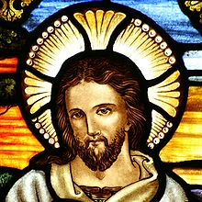
Christianity

Slide 31
Life of Jesus
Almost everything we know about Jesus comes from the Gospels.
The Gospels are the first four books of the New Testament in the Bible.
The Gospels were written stories from 4 of Jesus’ followers: Matt, Mark, Luke and John

Slide 32
Life of Jesus
Jesus was born in Bethlehem
Jesus grew up Jewish in the small town of Nazareth and worked as a carpenter as a young man
Stories of Jesus report that he performed miracles to heal the sick
Jesus had 12 disciples or close followers that traveled with him to help spread his message

Slide 33
Teachings of Jesus
Jesus believed in the idea of monotheism (One God)
He supported the 10 Commandments given to Moses and supported many teachings of Judaism
Many people believed Jesus was the messiah or savior of people
Jesus called himself the Son of God
His goal was to bring spiritual salvation and eternal life to those that followed him

Slide 34
Death of Jesus
Many people believed that Jesus was a troublemaker
One of Jesus’ disciples, Judas, betrayed him and Jesus was arrested by the Romans
He was sentenced to death by crucifixion
It is believed by Christians that Jesus rose from the dead and went to heaven

Slide 35
Life After Jesus
After Jesus died, many of his disciples or apostles continued to spread his teachings
Two of the most important people to spread Christianity were Peter and Paul
Peter was one of Jesus’ disciples and supporters
Paul was not a believer of Jesus at first, but began to believe and spread the teachings to the gentiles or Non-Jews
This mass spread of the teachings of Jesus helped Christianity become one of the main religions of the world

Slide 36
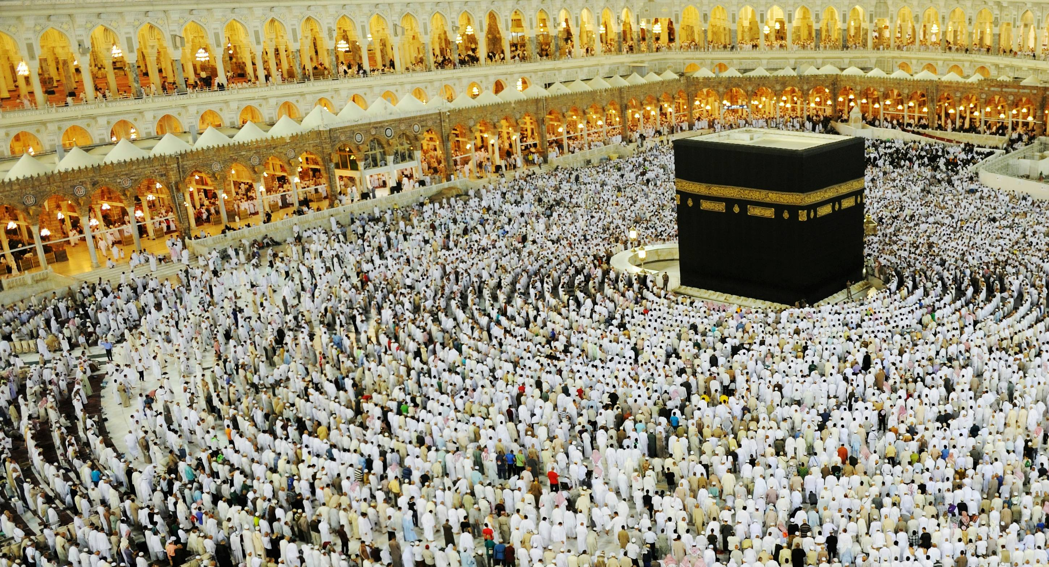
Islam

Slide 37
Life of Muhammad
The founder of Islam was a man named Muhammad
Muhammad was born in a town called Mecca in A.D. 570
Muhammad worked for a tribe called the Bedouins. He worked as a shepherd who led caravans of people and animals across across the desert.

Slide 38
Life of Muhammad
Muhammad was a successful merchant as he brought caravans across the desert
Muhammad did not like the greediness of people in his city of Mecca
One day, in his escape from the city to meditate, Muhammad was spoken to by the angel Gabriel who asked him to be a messenger for God
He dedicated his life to worshipping and spreading the word of God, known as Allah

Slide 39
Spread of Islam
Muhammad began teaching the word of God around Mecca and asked people to give up their polytheism, or many Gods to worship Allah
Muhammad was threatened by merchants in Mecca that he would be killed if he continued to spread this message
Muhammad and his followers left Mecca for the city of Yathrib
The journey out of Mecca to Yathrib is known as the hijra
The city of Yathrib is now known as Medina which means the “city of the Prophet”

Slide 40
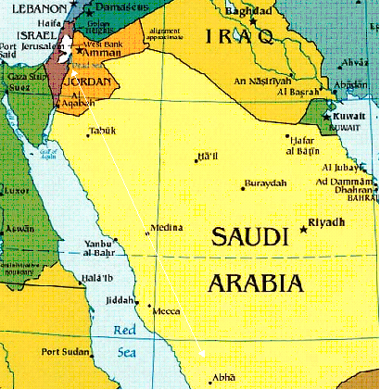

Slide 41
Return to Mecca
Muhammad gained many followers in Medina and eventually went to war with Mecca
Muhammad returned to Mecca in 630 AD
Muhammad rededicated the Kaaba or temple in Mecca to worship Allah
Muhammad died in 632 AD while trying to unite the Arab peninsula under Islam

Slide 42
Islam & the Qu’ran
Islam is another monotheistic religion like Judaism and Christianity
Islam also believes in prophets like Abraham, Moses and Jesus, but believes Muhammad to be the last and greatest prophet
The most sacred text of Islam is the Qu’ran which contains the words said to Muhammad by God
Beliefs outlined in the Qu’ran are honesty, generosity and justice
The Qu’ran also states that God is all powerful and compassionate
The Qu’ran is written in the original texts so almost all Muslims learn Arabic

Slide 43
5 Pillars of Islam
1) Declare your faith in Allah and Islam
2) Pray five times daily while facing the city of Mecca. Many Muslims pray in their place of worship known as the mosque
3) Give charity to the poor

Slide 44
5 Pillars of Islam
4) Fast from sunrise to sunset during the holy month of Ramadan
  Ramadan is when Muhammad first heard the word from God
  In 2016, Ramadan took place in June 5- July 5
5) Make a hajj or pilgrimage to Mecca. People must go to Mecca, if possible financially, at least one time in their life

Slide 45
Jihad
Jihad is a word for struggle in God’s service.
Many Muslims treat this as a personal duty to overcome immorality in their own life – internal struggle
Other, more extreme Muslims, take this to mean a Holy War to defend Islam – this is a VERY small percentage of Muslims
Notes:
Watch video

