Slide 1
1. Get out your NCFE review 2. Turn in missing work to the back
Happy Monday

Slide 2
NCFE Review

Slide 3
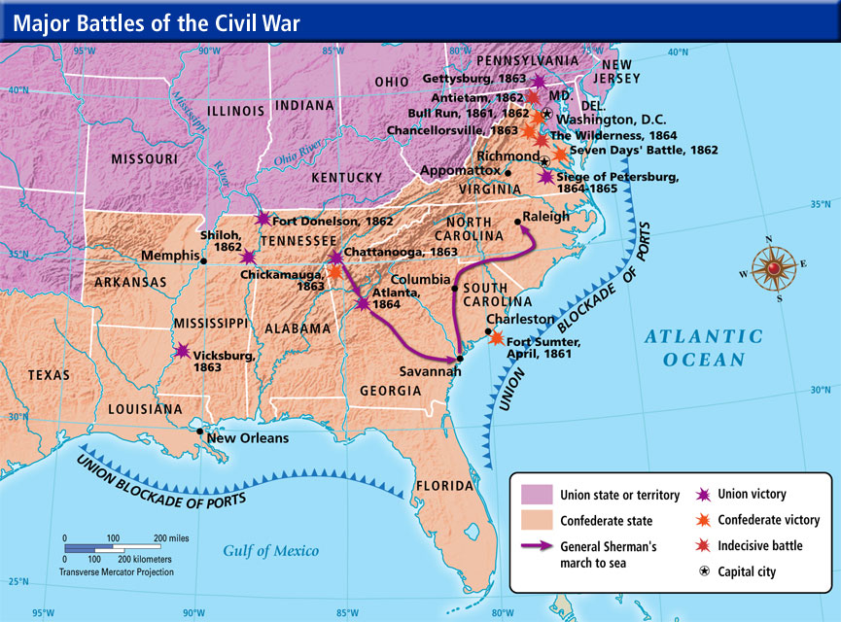

Slide 4
Significant Events
Fort Sumter – first battle of the Civil War
Emancipation Proclamation – end of slavery
Gettysburg – important battle for the North
Gettysburg Address – inspired Union soldiers
Appomattox Courthouse – end of the Civil War

Slide 5
Fort Sumter
First battle of the Civil War in SC
Union was forced to surrender – Confederacy WIN
Effect: Lincoln begins to gather troops to fight the Confederacy.

Slide 6
Emancipation Proclamation January 1863
Why did Lincoln write the Emancipation Proclamation?
Answer this question as you watch the video

Slide 7
Gettysburg
Confederate army pushed north and when they reached Gettysburg, Pennsylvania, the Union army was ready to stop them.
Confederate leader Robert E. Lee and his army fought the Union army for three days.
As the Confederates continued to fight, more Union soldiers joined the battle against them.
Finally on day 3, as over 150 cannons were shot on each side of the battle, the Confederate troops marched towards the Union troops.
This resulted in a disastrous attack with over 5,000 Confederates killed or wounded.
The North won this battle and forced the Confederacy to retreat into Virginia.

Slide 8
Gettysburg Address November 1863
Answer questions 1-3 as you watch the video clip
Listen and follow along with the text of the Gettysburg address.
Answer questions 1 – 5 independently using complete and detailed sentences

Slide 9
Gettysburg Address November 1863
What 1776 events is Lincoln referring to? Why would be bring this up?
What is Lincoln implying are the reasons for fighting the Civil War?
What is the “unfinished” work or “great task remaining before” the American people?
Who benefitted in 1776? What about after the Emancipation/Civil war?

Slide 10
Gettysburg Address November 1863
Do you think we have lived up to the message in the Gettysburg Address as a nation? Examples?
Do you think Lincoln believed the Civil War was worth fighting for?

Slide 11
Homestead Act of 1862 Watch the clip, be ready to discuss
What did the Homestead Act do?
When did the Homestead Act end?
How did it impact Westward expansion during/after the Civil War?
Notes:
Encouraged westward migration by providing up to 168 acres of free public land
1976
Expanded west with free land, moved people west, more opportunity

Slide 12
Requirements for homestead:
Step 1
21 years old or head of household
U.S. citizen or declare intentions to become a citizen
Could not have been a Confederate soldier
Acknowledge that you did not already own over 320 acres of land
Committed that the land would be for your exclusive use
Pay $12 fee
Step 2
Move to the land and live there for 5 years
Farm it and make improvements
Step 3 – Prove up
2 witnesses had to swear they had known you were on the land for 5 years
Prove you were head of the household/citizen
Prove that you were farming the land and had crops, gardens, and/or livestock
Prove that a house was built
Pay $6 for the final proof check

Slide 13
Homestead Act
Lincoln felt that this was necessary
He grew up poor, wanted to provide opportunities to those like him
Help connect the North to the West
Strengths
More people settling in the west
Small farmers received land for free
Railroad was built to connect the west to the north
Brought in immigrants
Weaknesses
Not all farmers had access or could afford livestock, seeds, and tools to be successful
Land had not been plowed = more work
More land actually went to businessmen than farmers

Slide 14
Time to work on Unit 7 vocab or Unit 5/6/7 study guide
Unit 7 vocab due Wednesday
Unit 5/6/7 study guide due Friday! You can use it on the test and it is for a grade.

