Slide 1
Get out your NCFE Review Turn in Unit 6 vocab to the back Considered late if turned in after I have collected them from the basket

Slide 2
NCFE Review

Slide 3
Why did the U.S. civil war happen?
Differing ideologies about slavery
New political parties
Compromises
New laws
Court Cases
Debates and elections
Economics

Slide 4
Presentation Order
1. Nat Turner Rebellion
2. Compromise of 1850
3. Uncle Toms Cabin
4. Fugitive Slave Act
5. Underground Railroad
6. Kansas-Nebraska Act
7. Bleeding Kansa
8. Sumner Brooks Incident
9. Dred Scott V Sanford
10. Lincoln-Douglas Debates
11. Harpers Ferry/John Brown Raid
12. Election of 1860
13. Secession of SC
14. Battle of Fort Sumter

Slide 5
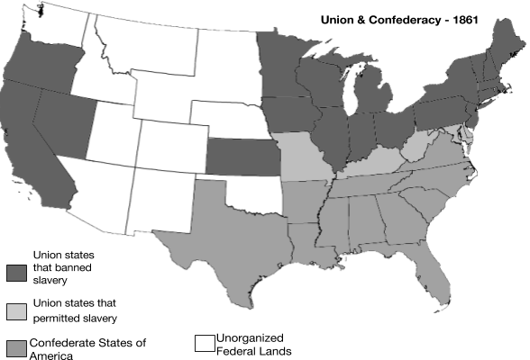
Union VS Confederacy
Notes:
List the states in the Confederate States of America. How many states are in the Confederacy?
List the states in the Union. How many states are in the Union?
Which nation has more states – the Union or the Confederacy? What does this comparison suggest to you about which side might have an advantage in the war? Support your claim with reasoning.

Slide 6
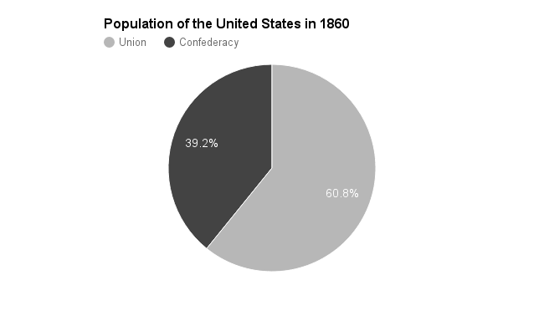
Union VS Confederacy
Notes:
4. Using the data in figure 2a, predict whether the Union or Confederacy will have a larger army. Explain how you arrived at this prediction.

Slide 7
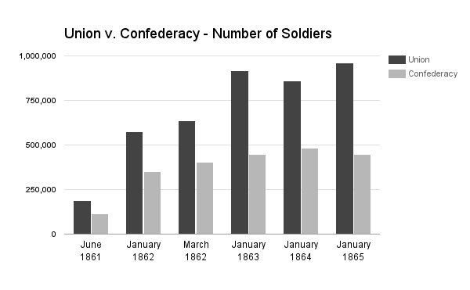
Union VS Confederacy
Notes:
5. Given the information about population in figure 2, are you surprised by the difference in size of the two armies (as represented in figure 2b)? Why or why not?

Slide 8
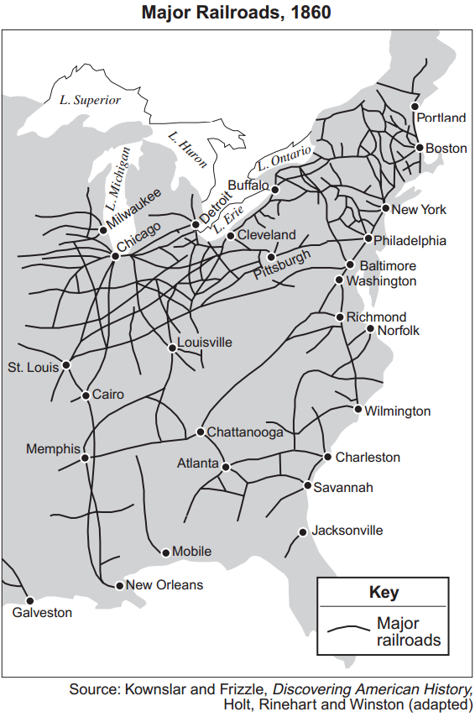
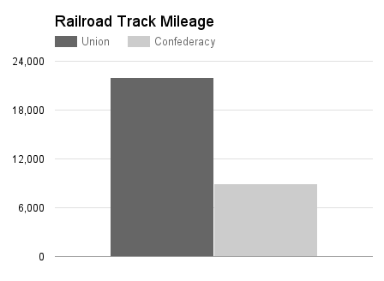
Union VS Confederacy
Notes:
6. How could having more railroad tracks be an advantage during the war?
7. Where are the majority of the railroad tracks?
8. Does the Union or Confederacy have more railroad track miles in 1860?

Slide 9
Union VS Confederacy
#9 and #10

Slide 10
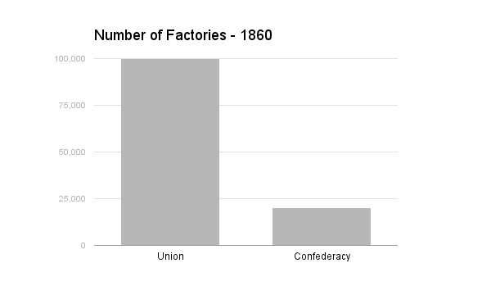
Union VS Confederacy
#11-#13

Slide 11
America the Story of Us: Civil War
Read through the questions so you know what you are looking for.
Do your best!

Slide 12
Unit 7 vocab
Due Wednesday

