Slide 1
Get out your NCFE Review Turn in your Roots questions Turn in the Test recovery

Slide 2
NCFE Review

Slide 3
Roots Debrief
What does Kizzy do to survive her horrible situation?
Why does Mingo trust chickens but not people?
Do you think Tom Lea ever intended to free George and his family?

Slide 4
The American Civil war was…
Notes:
Students will come up to the board to complete the sentence.

Slide 5
Why did the U.S. civil war happen?
Differing ideologies about slavery
New political parties
Compromises
New laws
Court Cases
Debates and elections
Economics

Slide 6
Events Leading to the Civil War
The decades before the Civil War were filled with political compromises, new political parties, and feuding between different sections of the country.
The issue of slavery had divided Americans from the nation’s earliest days, and with the addition of new territory, the problem became even more pressing.
Depending upon the Northern and/or Southern perspective, there were many events that helped to increase sectional tensions and lead to the Civil War.

Slide 7
Events assignment
You will be researching the highlighted event above to determine how the event contributed to sectional tension and ultimately the onset of the Civil War. You will be doing a short presentation in front of the class, the posters will also be posted around the room during the open note test so make sure it is done neatly and clearly.
Research
Summarize the main information of the event
Pretend you are explaining it to someone who knows nothing about it.
Who was involved (specific person, state, different groups of people?)
Examples: North vs South, Pro Slavery vs Anti Slavery)
How did this even increase tension between the North and the South?
Think about how the event was a major part leading up to the Civil War

Slide 8
Events assignment
Poster can be on the larger or smaller colored paper from the back
Use markers or pens to write on the paper
Use your BEST handwriting
20 points for completing the research and poster – major assessment grade
10 points for class participation and presenting your poster – class work assignment

Slide 9
Northern views of slavery
Many white northerners viewed black people as inferior, limited their migrations & rights
Many free blacks were still treated poorly in the north
However, opinions on slavery could vary:
No personal opinion: many had no contact with black people
Abolitionists: small vocal minority wanted to end slavery
Acceptable for economic reasons:
Bankers and businessmen earned money on cotton and tobacco
Working class feared losing jobs to freed slaves

Slide 10
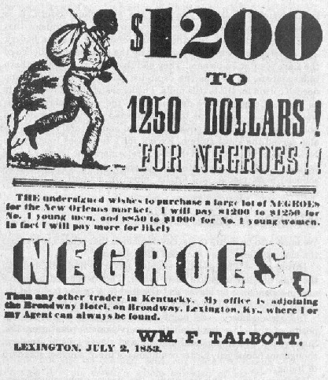
Southern views of slavery
Slaves were about a third of the population
Only a small population owned slaves but was supported for economic, social, and political reasons
Defenses of slavery
Better than “wage labor” in the north
Happier and healthier than factory workers
1836: Southern Senators passed gag rule
Could not discuss slavery in Congress

Slide 11
Kansas-Nebraska Act & Bleeding Kansas
Southern view?
Northern view?
Why did this increase sectionalism?
Notes:
Southern Representatives block territories statehood applications
Senator Douglas pushed the act through to get around this
It overrode the Missouri Compromise by allowing slavery in territories by popular sovereignty instead of the line
Resulted in a rush by pro and anti slavery settlers and violent confrontations
Bleeding Kansas – Northerners wanted to stop slavery while southerners wanted to support it
Violence erupted and 55 died

Slide 12
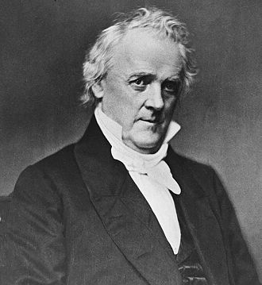
Shifting Politics
A new party unifies Anti-slavery Democrats, Whigs, Free-Soilers & Know-Nothings
Called the Republican Party: believed slavery was immoral and bad for industry
Democrat James Buchanan wins 1856 election with the promise to stop the agitation about slavery.

Slide 13
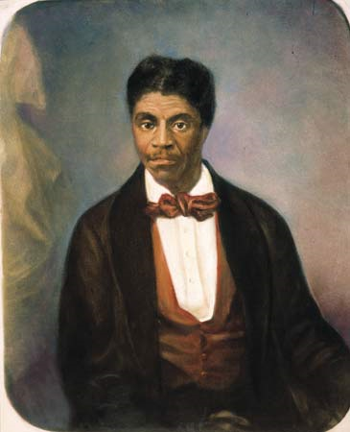
Dred Scott v. Sanford (1857)
Southern view?
Northern view?
Why did this lead to the civil war?
“The question before us is, whether [people of African ancestry]...compose a portion of this people, and are members of this country? We think they are not, and that they are not included, and were not intended to be included, under the word 'citizens' in the Constitution, and can therefore claim none of the rights and privileges to citizens of the United States.”
Chief Justice Roger B. Taney
Notes:
Supreme Court under Chief Justice Roger Taney holds:
Slaves aren’t citizens so they can’t sue
Missouri Compromise was unconstitutional
Congress couldn’t ban slavery: against the 5th amendment:
Can’t deprive people their property without due process of law

Slide 14
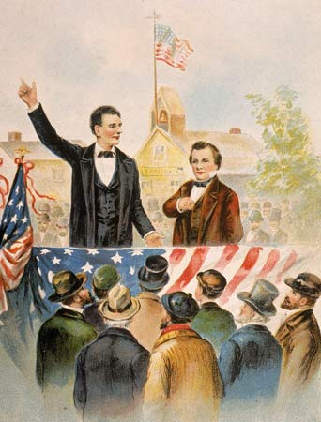
Lincoln-Douglas Debates - 1858
Competing for Illinois Senate seat
Douglas: Supported popular sovereignty
“The Union was established on the right of each State to do as it pleased on the question of slavery, and every other question”
Lincoln: Slavery was morally wrong and should be stopped by Congress
“There is no reason in the world why a negro is not entitled to all the natural rights enumerated in the Declaration of Independence… I hold that he is as much entitled to these as a white man.”
Significance: Lincoln didn’t win, but he gained many followers

Slide 15
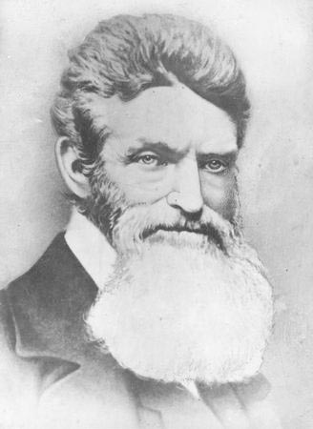
Harpers Ferry (1859)
Northern view?
Southern view?
Civil war?
“The crimes of this guilty land will never be purged away without very much bloodshed.”
Notes:
Violent abolitionist John Brown and 21 followers raided the US Arsenal in Harpers Ferry, Virginia (now West Virginia).
Brown invited slaves to join, but a few did and they were caught and executed
“The crimes of this guilty land will never be purged away without very much bloodshed.”
Along with the Dred Scott decision, this caused suspicion & rumors of war

Slide 16
The Election of 1860
Northern Democrats: Douglas – Popular Sovereignty
Southern Democrats: Breckinridge – Supporter of Slavery
Constitutional Unionists: Bell – leave things be
Republicans: Abraham Lincoln – no slavery in the territories
Was not on the ballot in 11 states, but won with through the electoral college

Slide 17
Work on your Unit 6 vocab – DUE TOMORROW

