Slide 1
1. Get out your DO now 2. Turn in your hw to the back
Happy Friday and Early Release

Slide 2
2 Aha’s and 1 Huh? Aha moment: what surprised you? What interest you? Huh moment: What are you unsure about? What do you have concerns about?
CNN 10

Slide 3
World connection
How has population growth, urbanization, industrialization, and the global market economy contributed to changes in the environment?

Slide 4
Recap
What was the Great Schism and why did it happen?
What were the differences between Western and Eastern Europe?
Islamic Schism – so what?
What did you learn about the Islamic Schism? Why did it occur?
How has this schism impacted society?

Slide 5
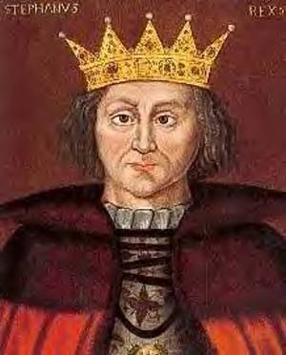
Balance of Power
Three groups competing for power during Middle Ages in Europe:
Monarchs Nobles The Church
Notes:
Why are Monarch and Church leaders not getting along?
How are nobles competing for power?

Slide 6
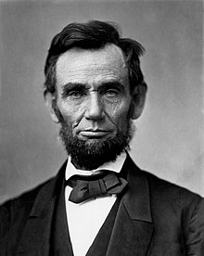
Vocab Clarified
President
Presidency
Presidential
Pope
Papacy
Papal

Slide 7
Royal Power grows
In 1154, King Henry II of England put in place common law and a jury
This effort to extend royal power led to disputes with the church
The royals continued to clash with the nobles and the Church as they tried to raise taxes and to impose royal authority over traditional feudal rights.

Slide 8
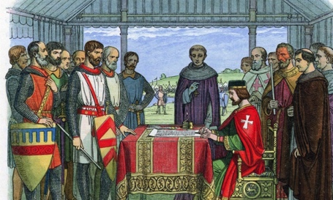
Magna Carta
King John (son of King Henry II) was an untrustworthy leader
High taxes and abuse of power made him unpopular
Notes:
How was this expressed throughout Robin Hood?
What does Magna Carta mean? Great charter
What did King John do to those that refused to pay? Punished them severely or seized their property
The Magna Carta has become a famous symbol of __________ (liberty) around the world
Who did the Charter apply to? Free men
What happened when King John declared the charter as invalid? Civil war
Where is the Magna carta echoed today? US declaration
What is a lasting and important legacy of Magna Carta? Everyone must obey the law – even leaders

Slide 9
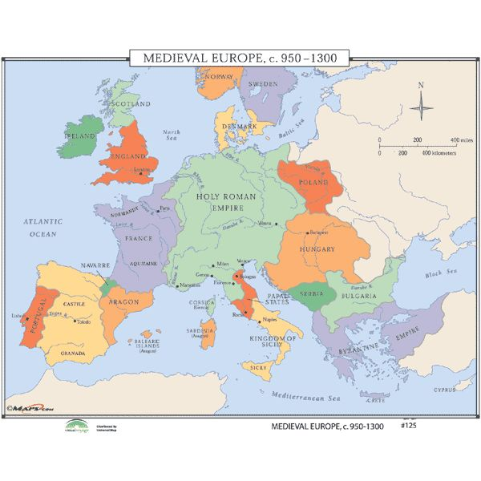
Where on the map is this happening?

Slide 10
Vocab review activity
There are 3 levels to the activity
Green: easy
Yellow: medium
Pink: hard
Find a starting point – pick a color and find one card to go to
Write down the letter code from the front cover of the clue
Open the clue and read it
Decide on the vocab word that fits the clue , once you know it write it down and go to the card with that word.
Write down the new letter code and continue the process

