Slide 1
1. Pick up a Do Now
2. Turn in Crash Course/Summary to the back
3. Test recovery to the back
Happy Monday

Slide 2
News to…
Text (book, movie, song, tv show)
Self (you, how can you relate?)
World (historically or in the future)
CNN 10

Slide 3
What was the Protestant Reformation?
CHRISTIANITY
CATHOLIC
PROTESTANT

Slide 4
Review
Who was Martin Luther and what were his beliefs?
What were some causes of the Protestant Reformation?
Notes:
Reformer in Germany, a Monk, a person who wanted to change the Catholic Church
Indulgences, humanism, church corruption, political issues, lack of people being able read the bible for themselves

Slide 5

Martin Luther’s ideas of protest and reform spread quickly
Some of his supporters may not have been “there for he right reasons”
As you watch “The Bachelor: Protestant Reformation Edition” consider which, if any, of these Protestants truly support the movement for sincere religious reasons, and are not just looking to attain secular benefits.

Slide 6
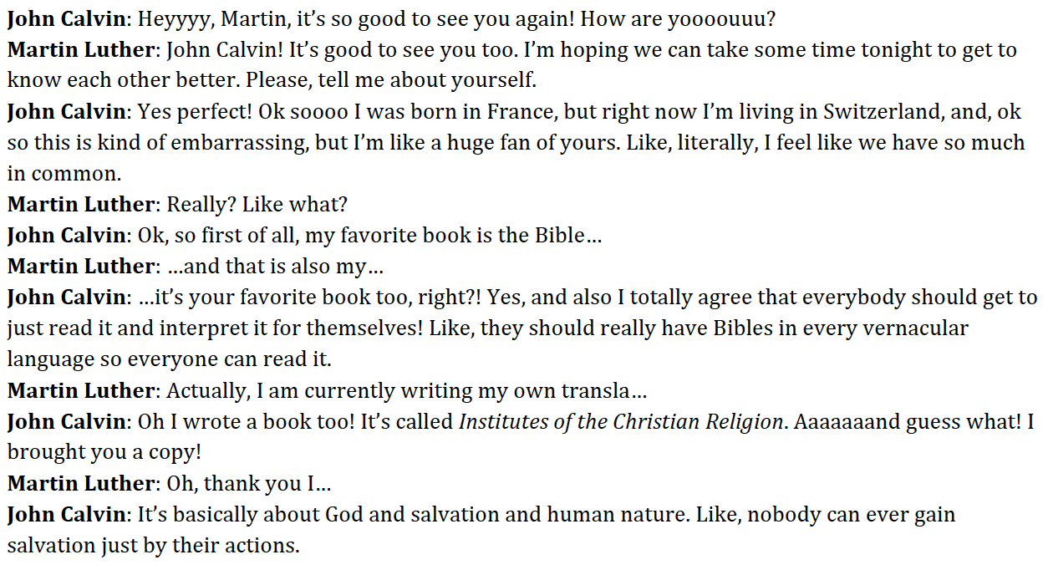
John Calvin

Slide 7
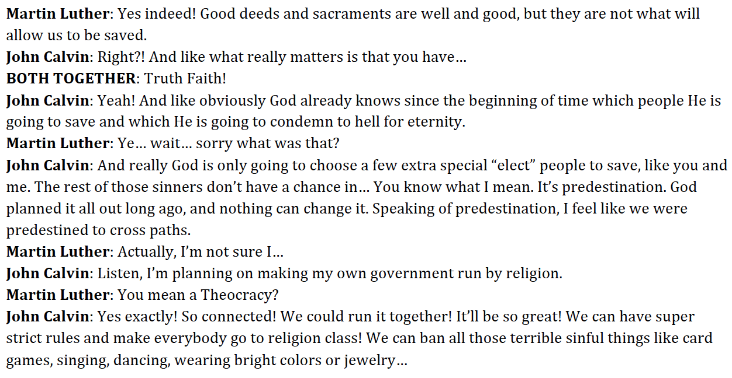
John Calvin

Slide 8
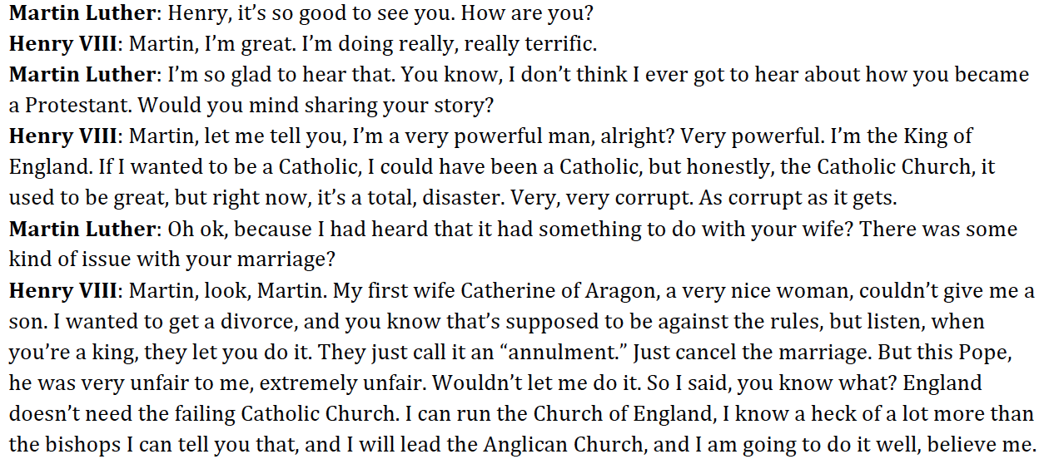
Henry VIII

Slide 9
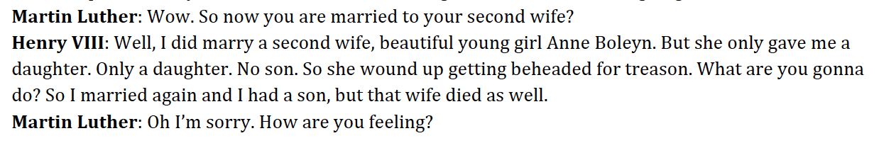
Henry VIII

Slide 10
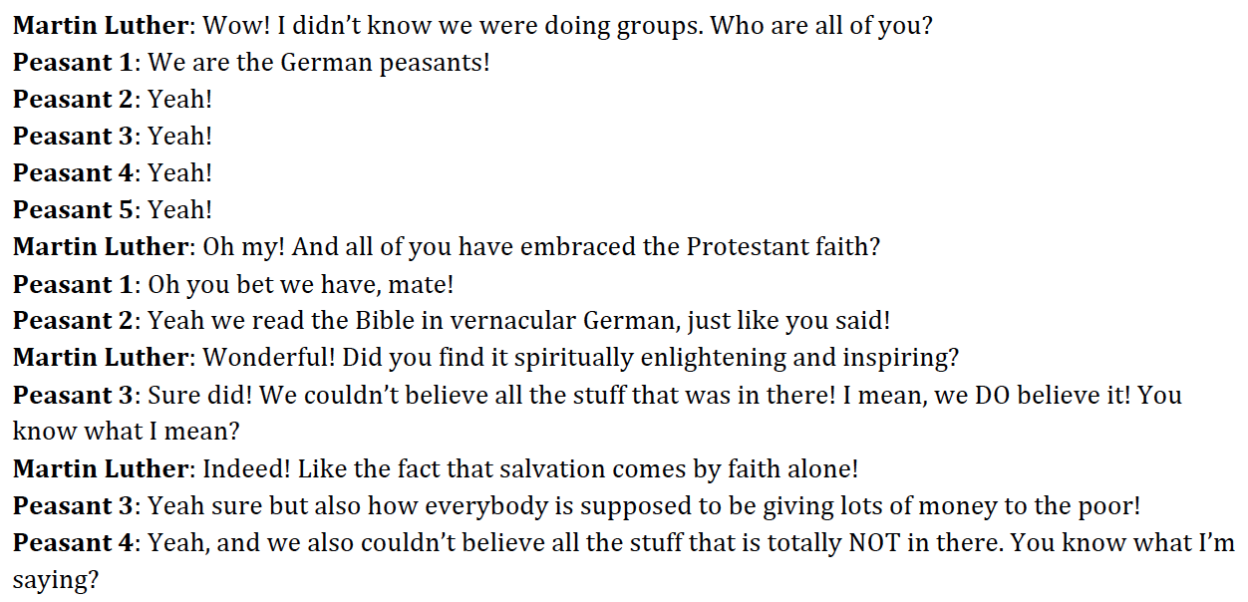
German Peasants

Slide 11
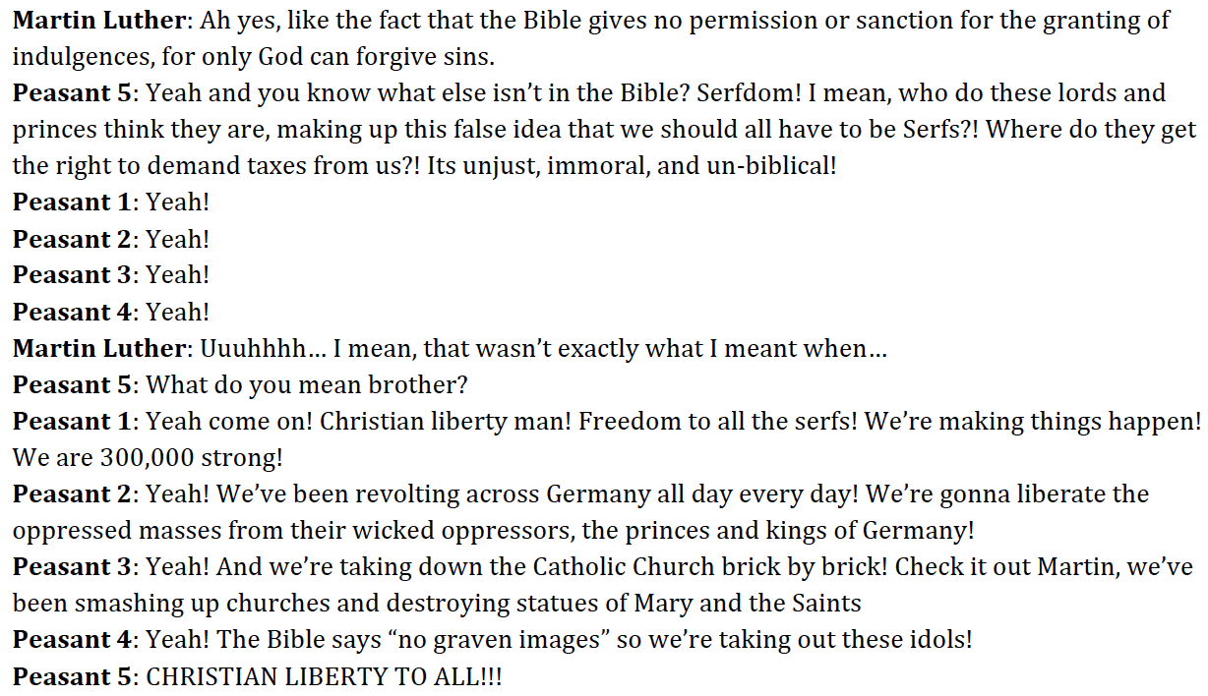
German Peasants

Slide 12
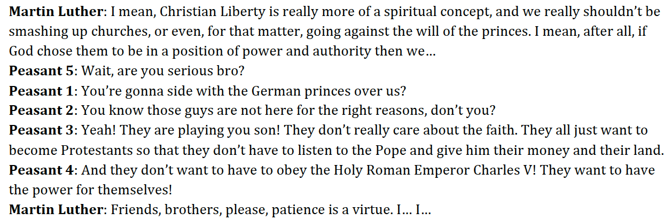
German Peasants

Slide 13
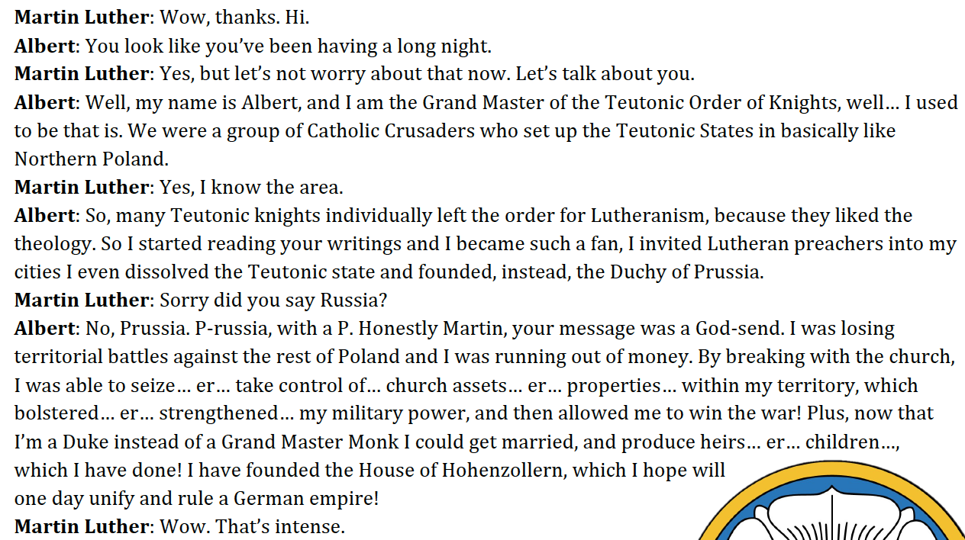
Albert

Slide 14
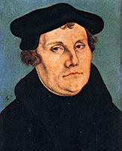
Martin Luther
F– faith saves people, not good works
U – Ultimate authority for Christians is the Bible
N – Nobody is more important in God’s eyes, all humans are equal before God (no hierarchy)
Notes:
Show video!

Slide 15
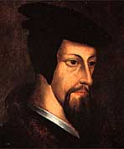
John Calvin
His ideas hit the Church with a: POW
Predestination -God chooses who goes to heaven, you don’t get there by good works and created the sect Puritanism
Our moral lives will reveal if we’re chosen by God to go to heaven or hell
Work ethic, righteous life that honors God

Slide 16
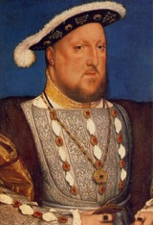
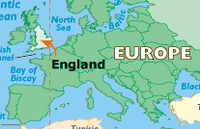
King Henry VIII
DAD of the Church of England
Divorce: Henry wants one but Pope says no.
Anglican Church – Henry is in charge – no Pope
Did away with Catholic Church’s land & wealth in England

Slide 17
Christianity
Catholic
Protestant
Lutheran
Calvinism
Presbyterian
Puritan
Huguenots

Slide 18
1st period
Martin Luther’s ideas of protest and reform spread quickly
John Calvin
German Peasants
Albert, Duke of Prussia
King Henry VIII
Was the Protestant Reformation motivated more by religious or secular motivations?

Slide 19
The
Catholic Reformation AKA Counter Reformation
Effects of the Protestant Reformation – What did the Catholics do in retaliation?
Notes:
The effects of the Protestant reformation on Catholics

Slide 20
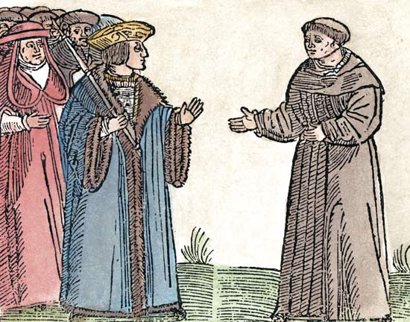
Catholic Reformation
Also known as the counter-reformation
Catholic response to the Reformation
Notes:
What does counter mean? Against, in return, in response
Why would the Catholics perform a counter reformation? Why would they be concerned about change?

Slide 21
Targeting Dissenters
Notes:
What do you think dissent means based on what we are discussing?
Dissenters/Dissent = to publicly disagree with an official, opinion, decision, or set of beliefs

Slide 22
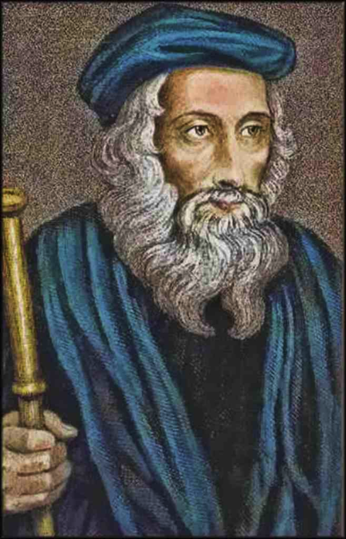
John Wycliffe
English reformer
Translated Bible into English
Notes:
Targeted – Why would the Catholic target John?

Slide 23
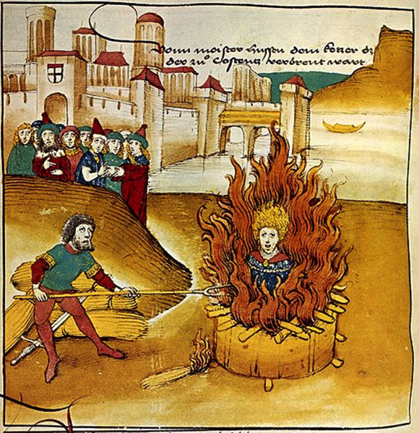
Jan Hus
Czech reformer
Burned at the stake for heresy
Notes:
What did he do to be targeted?
Spoke out against indulgences and the catholic church

Slide 24
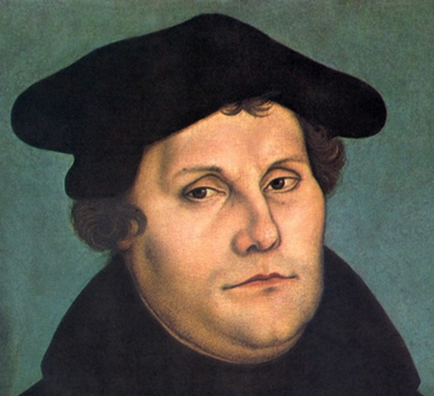
Martin Luther
Began the Protestant Reformation & Lutheran Church
Excommunicated
Notes:
Why did the Catholic Church excommunicate Luther?

Slide 25
Defending the Faith
Notes:
What do you think the Church did to defend their faith and ideas?
Pope Paul III was set out to revive and restore faith in the Catholic church

Slide 26
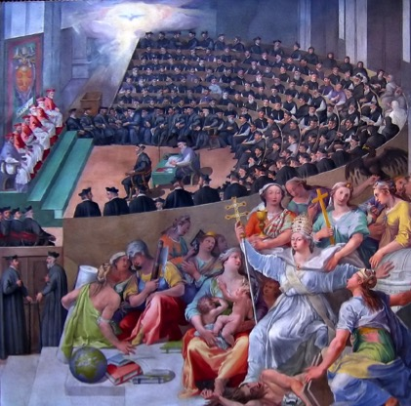
Council of Trent
Reaffirmed most church doctrines and practices
Training priests would be regulated
Financial abuse was curbed (declining)
The sale of indulgences was abolished
Notes:
Reaffirmed many of the ideas that the Protestants challenged – back to their roots
Council took steps to make change within their own churches

Slide 27
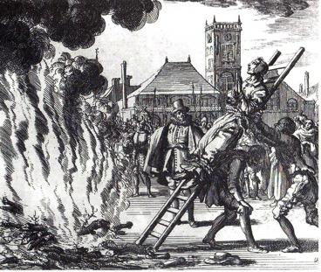
Inquisition: Auto-da-fé
Church court set up to root out heresy
  This was done through torture, execution, and secret testimony
Banned books so people would not covert to the Protestant denominations
Notes:
Inquisition: A court created by the Catholic Church to try heretics --- heresy is people going against the Catholic Church

Slide 28
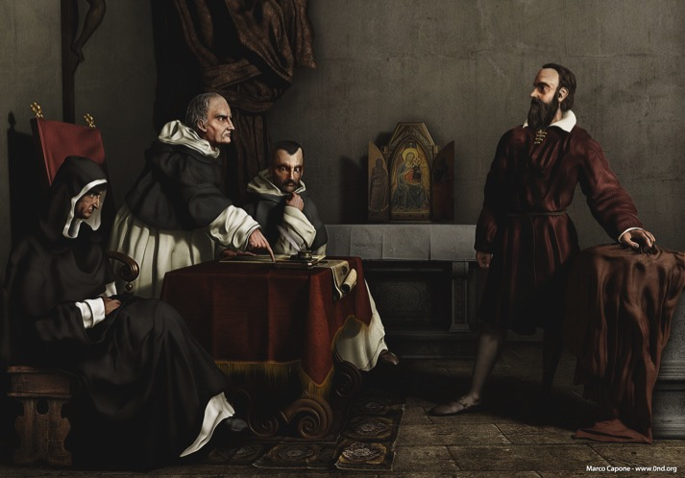
Inquisition: Galileo
Notes:
Who was Galileo during the role activity? What was he doing?
Galileo was controversial for the Catholic Church – why would the church worry about a scientist?

Slide 29
Spreading the Catholic Faith

Slide 30

Exploration
Gold
God
Glory

Slide 31
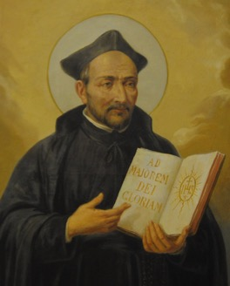
Ignatius of Loyola from Spain
Founder of the Society of Jesus
(a.k.a. Jesuits)
Spiritual and moral disciplines,
rigorous religious training, and absolute obedience
Sent missionaries – essentially a peaceful crusade
Established schools and universities
Notes:
Ignatius was a Spanish (Spain) knight raised in the crusading tradition – what can be infer about this person by knowing his background?

Slide 32
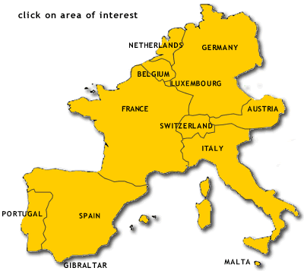
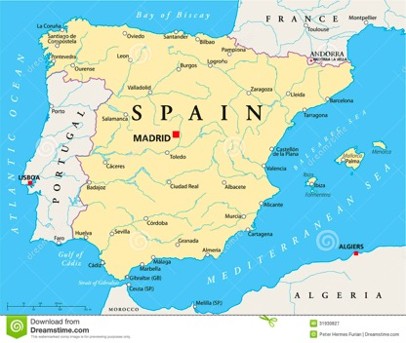
Home of the first Jesuits
Notes:
SPAIN

Slide 33
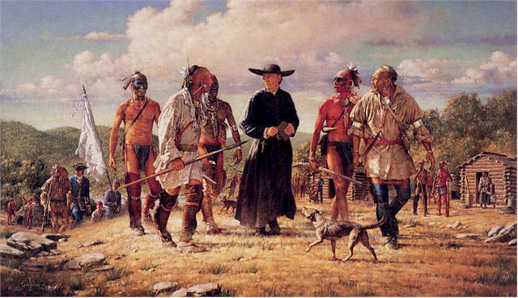
Society of Jesus

Slide 34
Effects of the Reformation

Slide 35
Widespread Persecution
Witch Hunts – killing many men and women
Some people believed in Christianity and magic
Italy and other Western European Catholics ordered Jews to move and live in ghettos (separate quarters of the city)
Martin Luther even expelled Jews from Christian lands

Slide 36
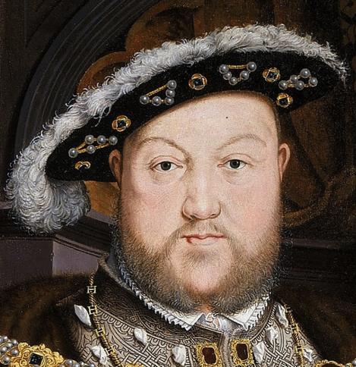
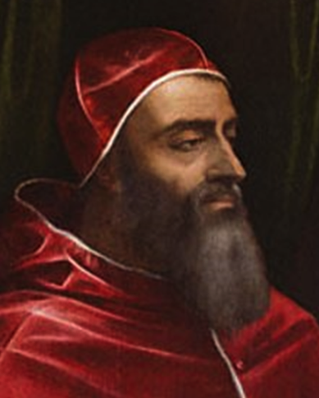
Monarchs over Popes

Slide 37
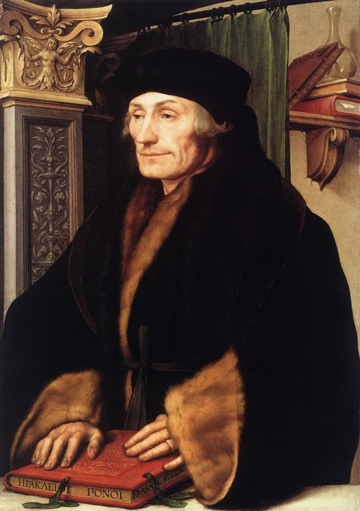
Humanism
Desiderius Erasmus
Human achievement
Rationality

Slide 38

Individualism

Slide 39
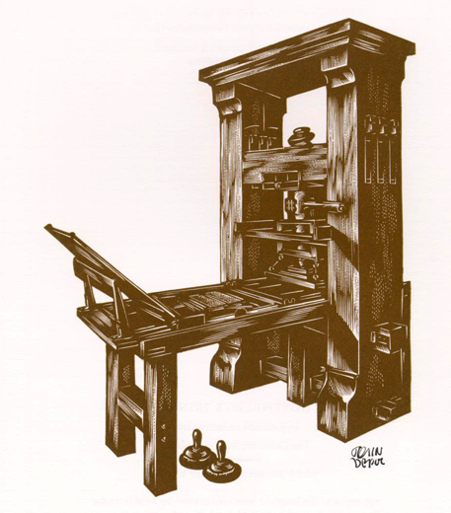
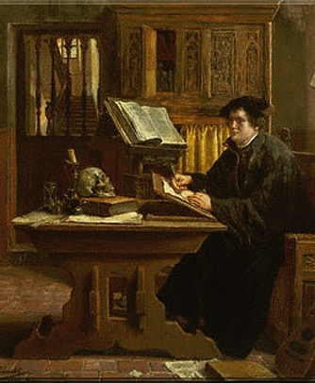
Increased Literacy Rates

Slide 40
Over all Effects
Catholic Church unified but power lessened
Decline in religious unity
Protestant denominations grew (creating opportunity for new nation-states)
Churches authority and power in general will continue to be questioned (part of this was inspired by the Renaissance)
Inspire the Enlightenment
Inspired education, travel, and exploration

Slide 41
Kahoot Review
Remember this is a privilege
You may play and work on your study guide
Stay off of other apps and focus on Kahoot

