Slide 1
1. Get out your do now 2. Turn in your CC Egypt
Happy Tuesday

Slide 2
CNN 10
Tweet the News activity
At least 7 words!
You may use hashtags
Be clear and concise
Have fun!
World History Connection: How do religious tensions impact the world?
Examples from yesterday news:
US Government set to reopen, but for how long? #Funding #Historicalshutdown
Igloo Hotel? Sounds too cold for me, I prefer my feet in the sand. #toocold #coldcloudbed

Slide 3
Hammurabi Discussion questions
PART 1
Which laws do you believe to be unfair?
Is the Code of Hammurabi similar to our current laws?
Which Babylonian values are similar to American values? Which values are different?
How would you feel about living in a community that used the laws from the Code of Hammurabi? Why?
PART 2
Are Hammurabi’s codes still being used today?
Notes:
Theft – if ones property is destroyed the criminal will have to pay for it
Physical abuse- taken to court and face jail time

Slide 4
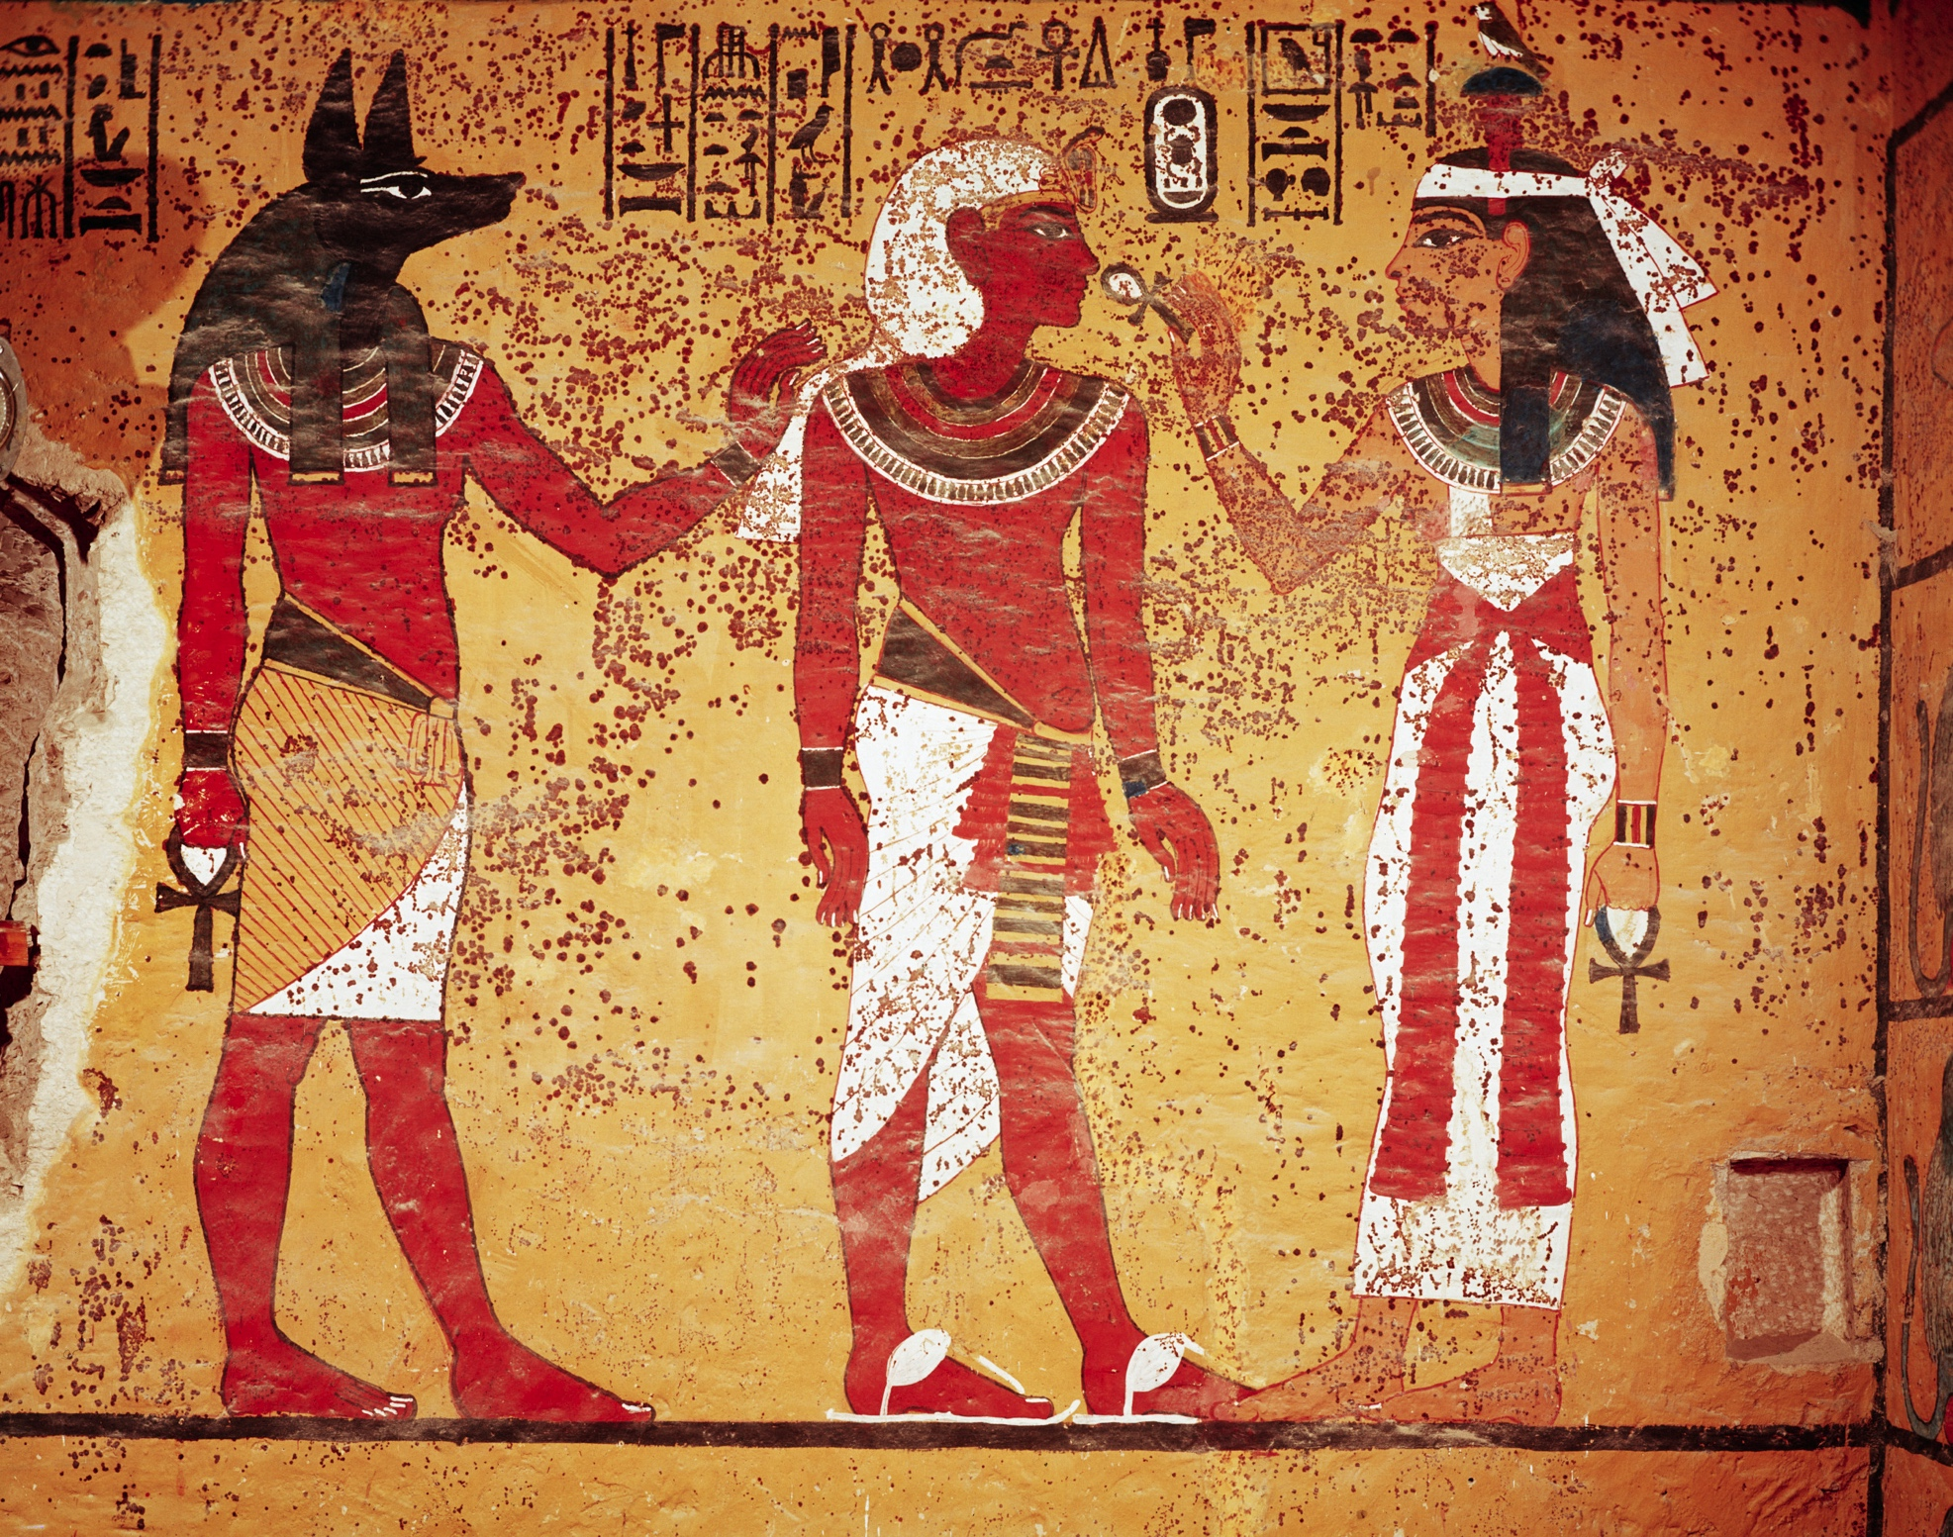
EGYPT
Nile River Valley Civilization
Notes:
Where is Egypt on this map?

Slide 5
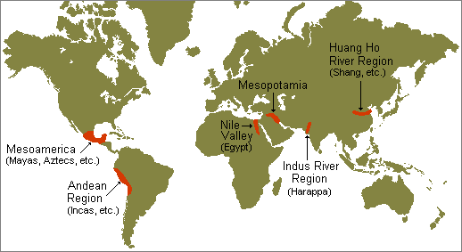
Emergence of River Valley Civilizations

Slide 6
EGYPT “The Gift of the Nile” (Herodotus)
What did Herodotus mean when he said that Egypt is the “gift of the Nile?”
Nile River
Sahara Desert
The geography of the area is the key to its success, without the Nile River, there would be no Egypt.
Notes:
Nile is about 4,000 miles long

Slide 7
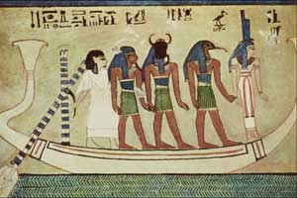
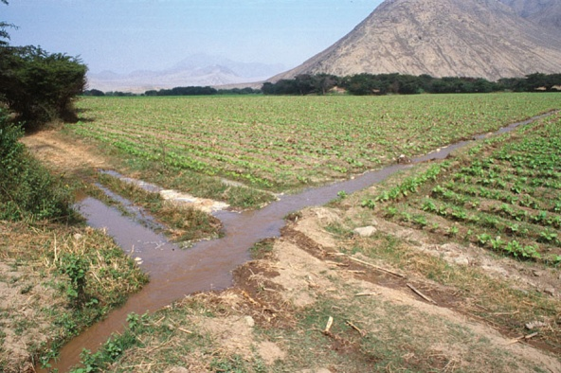
“Gifts of the Nile”
Predictable flooding
Mild flooding, so people were able to use the river for irrigation
Winds made trade possible both north and south using the river for transportation
Rich deposits of clay, granite, sandstone & limestone used for building (fertile land)
Notes:
The predictable flooding was celebrated with the seasons

Slide 8
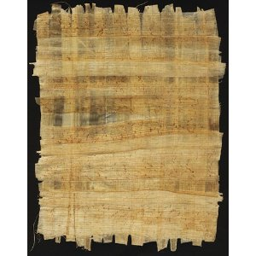
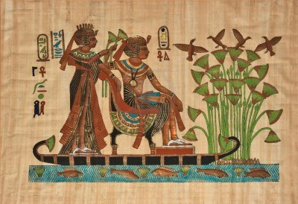
“Gifts of the Nile”
Silt (sand and clay) deposits rich for farming
Material goods - papyrus (tall water plant) used for mats, rope, sandals, baskets, paper
Notes:
Papyrus was used to make one of the first forms of paper – grown in the Nile

Slide 9
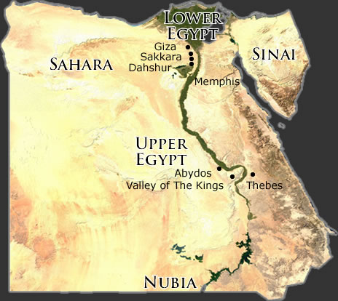
Nile River Valley
Egypt's prime geography helped to develop and become a peaceful civilization with a higher standard of living.
People as individuals were treated with more respect here than in other civilizations of the time.
The Nile River Valley is Surrounded on Four Sides by Natural Barriers
Red Sea to the East
Desert to the West
Mediterranean to the North
Mountains to the South
Notes:
What is a standard of living?
How did we see people treated with disrespect in Mesopotamia?
Natural barriers

Slide 10
Egyptians inventions:
Hieroglyphics – written language
Pyramids- used as tombs to bury Egyptian kings (pharaohs)
Advances in medicine and surgery
12 month lunar calendar
Geometry
Notes:
Medicine – herbal and documenting what worked and did not work

Slide 11
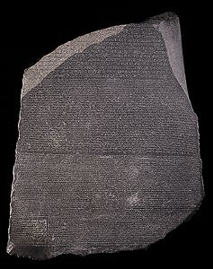
The Rosetta Stone – 196 BC
A tablet with inscriptions
in Greek and Egyptian hieroglyphic scripts
Discovered in 1799 near
Rosetta, a town of
northern Egypt in the
Nile River delta
Provided the key to
deciphering Egyptian
hieroglyphics.
Notes:
Different scripts – what does this tell us?
Rosetta stone lists the good things the pharaohs and priests had done

Slide 12
During the clip…
Record at least 5 facts about Ancient Egypt – be prepared to share your findings to the class.
Notes:
Greatest civilization
Ruled for 3000 years by Pharaohs
Divided into upper/lower Egypt
Old, middle, new periods
300 rulers – pharaohs – means great house – protectors of the people
Pharaohs become gods in the afterlife
Mummification
Great pyramids – role of religion and innovation
Math (cubit measurement/time with astronomy/solar calendar) and written language was advanced (Rosetta stone/hieroglyphics)
Papyrus plant to keep records
Conquered by Persians and Romans
Cultural contributions that have lasted over time
High standard for future civilizations

Slide 13
News Paper Civilization project
Objective: To enrich student knowledge and deepen understanding of ancient civilizations. Students will work in groups to create an Ancient Civilization Newspaper, they will choose a civilization from a predetermined list from Unit 1 and delegate each person with tasks to complete while using Google Classroom to collaborate.

Slide 14
Newspaper– Google class room
Sign into our Google Classroom using your Wake County email and join the class.
When you get with your group you have an assignment to complete.
Record each group members name along with goals for the group and group members to complete when you meet up again on Friday to continue working on your project.

Slide 15
Ancient Civilization project
Time in class 4 days for 40-55 minutes each – first day will be today, Friday Feb 1, Wednesday Feb 7, Monday Feb 11.
Everyone is working on something at ALL times in class
If you finish one task then you must look for the next thing to accomplish (use instructions/rubric)
Use Google drive (slides, docs, etc.) to work with your group
Set goals for daily progress
Project due by 6pm on Monday Feb 11

Slide 16
Civilization newspaper
Your group will print your civilization newspaper for a class gallery walk. (I can print it in b/w)
Remember you want your civilization newspaper to be unique, clear, and include good information.
All newspapers will be available through my website after they have been submitted.

Slide 17
1st period Teams
Team 1

Slide 18
3rd period Teams
Team 1

Slide 19
Homework
Honors – Complete Crash Course Indus Valley AND China

