Slide 1
1. Get out your NCFE Review 2. Turn in Unit 5 vocab and any missing work to the back
Happy Tuesday

Slide 2
NCFE Review

Slide 3
Manifest Destiny
Manifest: Clear or obvious
Destiny: Future or Fate

Slide 4
John Gast, American Progress, 1872
Notes:
Question to students: What do you see in this painting?
You have 1 minutes to write down as many observations as possible
What transformation of the west are implied?
Motivations?
Who?
How does this relate to manifest destiny? – fate of the American future

Slide 5
Does Manifest Destiny still exist?

Slide 6
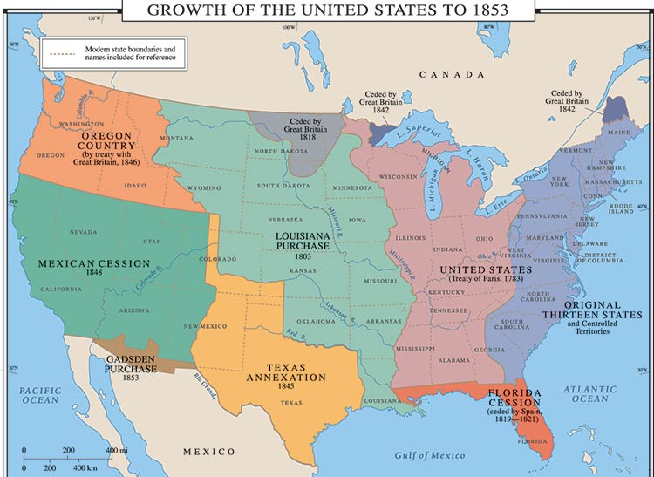
Manifest Destiny and TEXAS
Notes:
1st period, 3rd period, 4th period

Slide 7
Moving West - Texas
The Spanish had been in the Americas since Columbus in 1492.
Spain owned a large part of North America, including Texas.

Slide 8
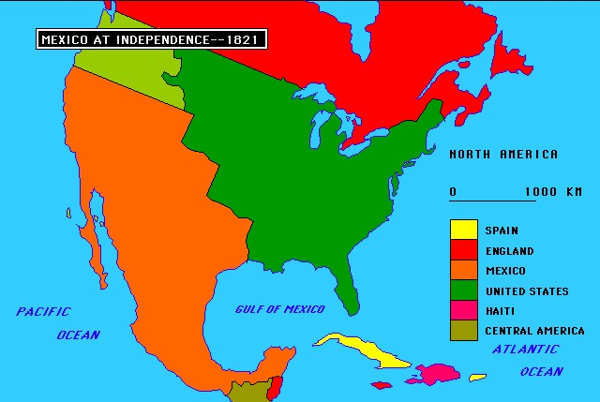
Mexico won independence from Spain -1821

Slide 9
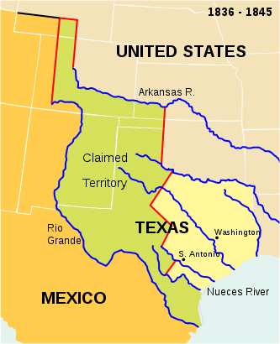
Texan Independence (1836)
Mexico owned Texas
Many Americans settled in TX
Mexico agreed to let U.S citizens stay if they:
Became Mexican citizens, gave up slavery & joined the Roman Catholic Church
Settlers would not… Instead, declared independence
Steven F. Austin led American settlers to found Austin, TX
Came from the South, raised corn pigs, cattle and cotton
Notes:
Spanish government started the colony in Texas, the Americans had to do what Mexico asked them
Austin was able to recruit 297 families to move
SO what were the steps to independence

Slide 10
The success of Austin’s colony attracted more land speculators and settlers to Texas from the United States.
Looking for a new life
Escaping from the law
A chance to grow rich
By 1830, the population had swelled to about 30,000, with Americans outnumbering the Tejanos six to one.
Notes:
Why would Americans want to move to Texas?

Slide 11
Rising Tensions in Texas
In 1829, the Mexican government outlawed slavery.
Anglo-Texans smuggled in slaves
The settlers wanted to keep their slaves so they could grow cotton.
The Americans also didn’t want to learn Spanish or follow Mexican laws.
Very few settlers had converted to Catholicism.

Slide 12
Texans Revolt
In 1829, the Mexican government stopped American immigration.
Texans had to start paying taxes for the first time.
Mexican president (dictator), General Antonio Lopez de Santa Anna sent more Mexican troops to Texas.
Texans began talk of breaking away from Mexico.
When Stephen Austin was jailed, the Texans revolted.
Santa Anna led 6,000 troops to Texas to put down the revolt.

Slide 13
Texas Independence
Santa Anna led an army to Texas
Battle of the Alamo
Texans held out for 12 days
Mexico won; Santa Anna had all survivors killed
Cry of “Remember the Alamo” rallied Texans to continue the fight
Notes:
Only 183 Texans guarding the Alamo vs Mexican Army with 1800 men
Why would Congress and people worry about annexing Texas?
Mexican army was ultimately defeated
SHOW video http://www.history.com/topics/alamo/videos/the-alamo

Slide 14
Battle at San Jacinto
Santa Anna executed over 300 Texans executed
Texan general, Sam Houston gathered 800 troops
Tejanos, American settlers, volunteers from the United States, and many free and enslaved African Americans.
They met Santa Anna at San Jacinto.
Their battle cry was, “Remember the Alamo!”
It was over in 18 minutes. More than half the Mexican army was killed.
Santa Anna was forced to sign a treaty giving Texas its freedom.
With the Battle of San Jacinto, Texas was now an independent country.
Notes:
Battle of San Jacinto
Texans trapped Santa Anna & defeated him with little loss
He signed a treaty to give TX independence
TX President Sam Houston asked U.S. to annex TX, but Congress feared such a large slave state

Slide 15
The Alamo Mexican Army was ultimately defeated

Slide 16
General Santa Anna surrenders to General Houston

Slide 17
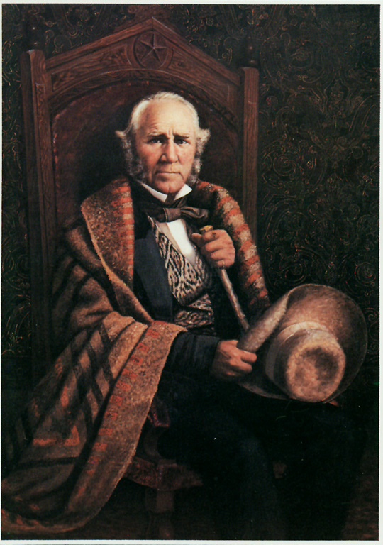
Lone Star Republic
In 1836, Texas declared itself The Lone Star Republic.
Sam Houston was elected president.
Some Americans wanted Texas to be part of the U.S.
Some people were afraid of Texas becoming a slave state, others of war with Mexico.
Notes:
Later joined as the 28th state
Show video

Slide 18
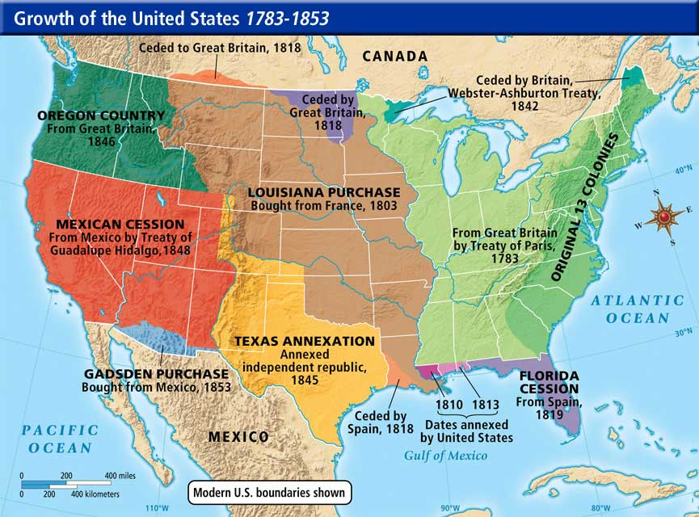

Slide 19
Politics in the U.S.
1829-1837 Jackson - Democrat (for the common man), spoils system (faithful party members would be rewarded with government jobs), Indian Removal (Oklahoma), Tariffs (promote US industry), 2nd Bank of US (Jackson felt it only benefitted the rich/unconstitutional)
Whig Party forms – Supporters of the Bank of US split from Democrats, strong federal government, loose interpretation of Constitution, American System – lead by Henry Clay
1836- Jackson successor Democrat Martin Van Buren elected as president
Against annexation of Texas
Notes:
Jackson vetoed the BUS

Slide 20
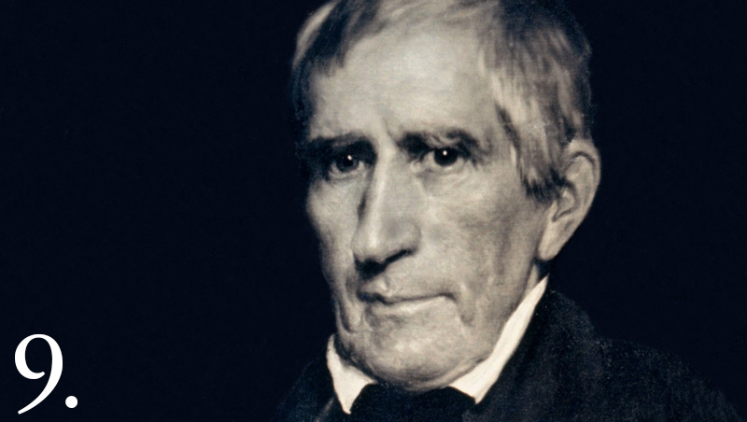
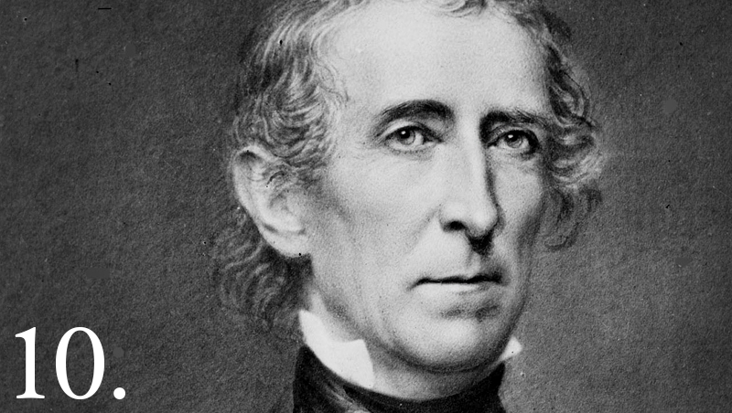
Politics in the U.S. – POTUS #9 & #10
Next set of presidents are Whigs
After a depression in 1837, Whigs William Henry Harrison ran for president with VP John Tyler in 1840
Whigs also won several seats in Congress
Harrison died of pneumonia after a month and VP John Tyler became president (1841-1845)
Went against the Whigs beliefs
Vetoed the Bank of the US and American system
Annexed Texas to the US
<<< #9 William Henry Harrison
John Tyler #10 >>>

Slide 21
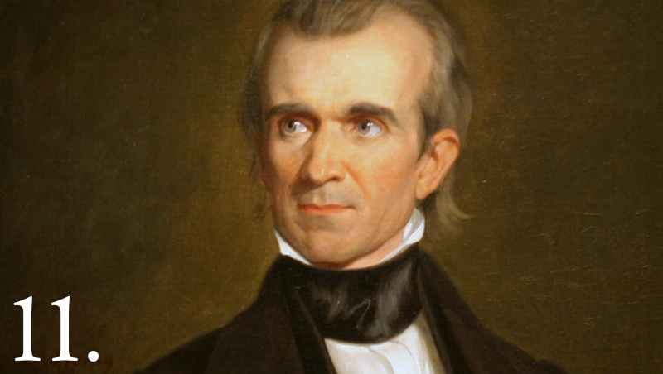
Politics in the U.S. – POTUS #11
An expansionist President
Annexing Texas was a key issue in the 1844 presidential election
Democrat James K. Polk wins and is the 11th president
Southern slaveholder, believed in Manifest Destiny, approved of annexation
To get the votes he promised northerners that he would annex Oregon territory
#11 James K. Polk>>>

Slide 22
Mexican-American War
When the U.S. annexed Texas they also included territory that Mexico claimed as theirs.
Polk sent troops to the Rio Grande
General Zachary Taylor
The disputed land become a war between Mexico and America.
Notes:
Show video
Why did James K. Polk want to go to war with Mexico? – more land, manifest destiny
How did Polk “pick a fight? – Put troops in a disputed area then declared war on Mexico
Major impact? – large land

Slide 23
Outcome of the war - U.S. Victory (Sept. 1847)
U.S. advantages
Industry: better weapons and supplies
Man-power
Commanders trained at the military academy at West Point (Lee, Grant & Sherman get experience)
Mexico was undersupplied and divided in support of the dictator Santa Anna
Americans took control of New Mexico and California

Slide 24
Treaty of Guadalupe Hidalgo (1848)
Ended the Mexican American War
Set the border for Texas at the Rio Grande
U.S. gained New Mexico and California territory (included CA, NV, UT, Arizona, part of Colorado and Wyoming) for $15 million
Promised American citizenship to Latinos/ Latinas left in the western territories

Slide 25
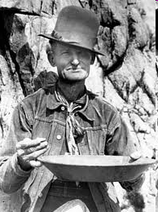
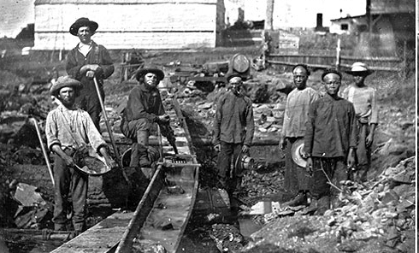
California Gold Rush (1849)
80,000 men rushed to California to find gold
Forty-niners: nickname for the miners, most never earn much
Mining conditions: poor sanitation, disease, no law & order
Mining methods
Placer mining: dug for gold on the surface with picks and pans
Hydraulic mining: water used to erode hills (damaged environment)
Hard rock mining: used tunnels & shafts (expensive)

Slide 26
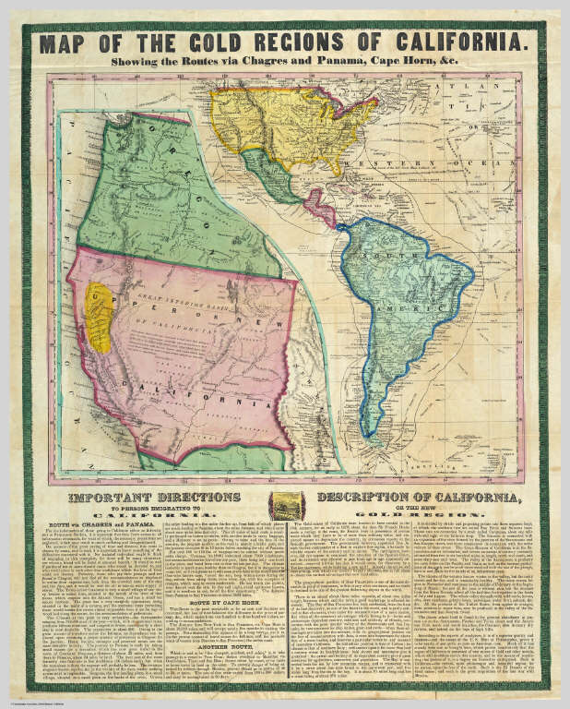
Journey to California
There were three ways to get to California from United States…
Overland- cutting across the country taking routes like the Oregon or Santa Fe Trail.
By ship to Panama in Central America, across dangerous jungles to the Pacific side.
By ship around the horn of South America

Slide 27
Chinese Immigrants
Between 1848-1852 more than 20,000 Chinese immigrated to California (In 1852, 1 in 10 Californians was Chinese)
Originally welcomed by Californians!
Once mining became difficult attitudes towards immigrants changed.
1852, state legislature passed law requiring foreign miners to pay monthly fee to mine.
Most immigrants left
Chinese immigrants paid the tax and stayed
Americans began to bully Chinese into leaving (cutting their queues (braids) and burning their shacks)
Many Chinese then left the mines to open businesses or begin farms.

Slide 28
Roots Prep
Part I: Define the terms
Part 2: We will read this out loud

