Slide 1
1. Get out your do now 2. Turn in your Crash Course French Revolution to the sub 3. Be kind and respectful
Happy Thursday!

Slide 2
CNN Student News
K – What do you KNOW?
W – What do you WANT to know?
L – What did you LEARN?
Remember to write in complete and detailed sentences.

Slide 3
Recap of the American Revolution (1775-1783)
King George III asserted his leadership and royal power and began to create colonies on the east coast the North American.
Colonists were left to find resources and the British crown didn’t give them much attention as long as the resources were sent over. (Salutary neglect)
Colonists began to form their own governments
Tension began to rise between the British and colonists
Stamp Act along with other acts/taxes were passed in the colonies – they were still under British rule
Colonists felt that they did not have representation to make any of the decisions about the taxes.
Notes:
Different factions came about – Patriots and Loyalists

Slide 4
Recap of the American Revolution
Battle begins
Declaration of Independence (Life, liberty, and property) – popular sovereignty
After two years of battle, American, British, and French diplomats signed the Treaty of Paris to officially end the war.
By 1789 there was a federal republic under the Constitution – based on many of Montesquieu's ideas.
Notes:
Popular sovereignty – Authority of the government given by the people --- power of the people to vote and chose government

Slide 5
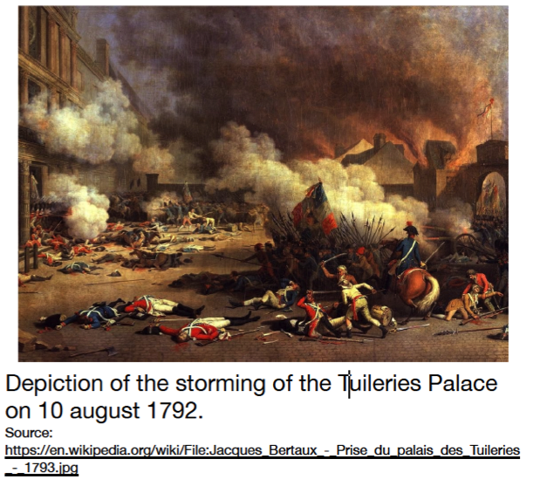
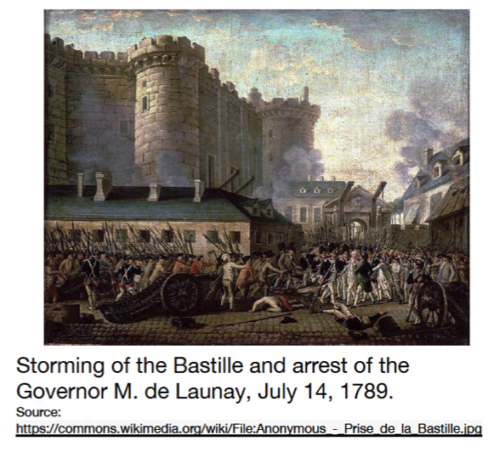
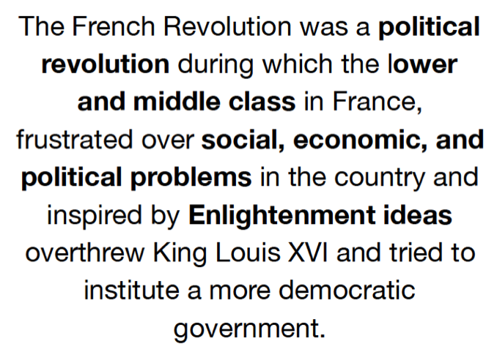
The French Revolution 1789-1799

Slide 6
Causes of the French Revolution based on the video clip
https://www.youtube.com/watch?v=VEZqarUnVpo

Slide 7
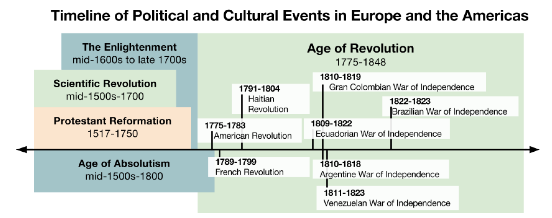
Part II. Timeline

Slide 8
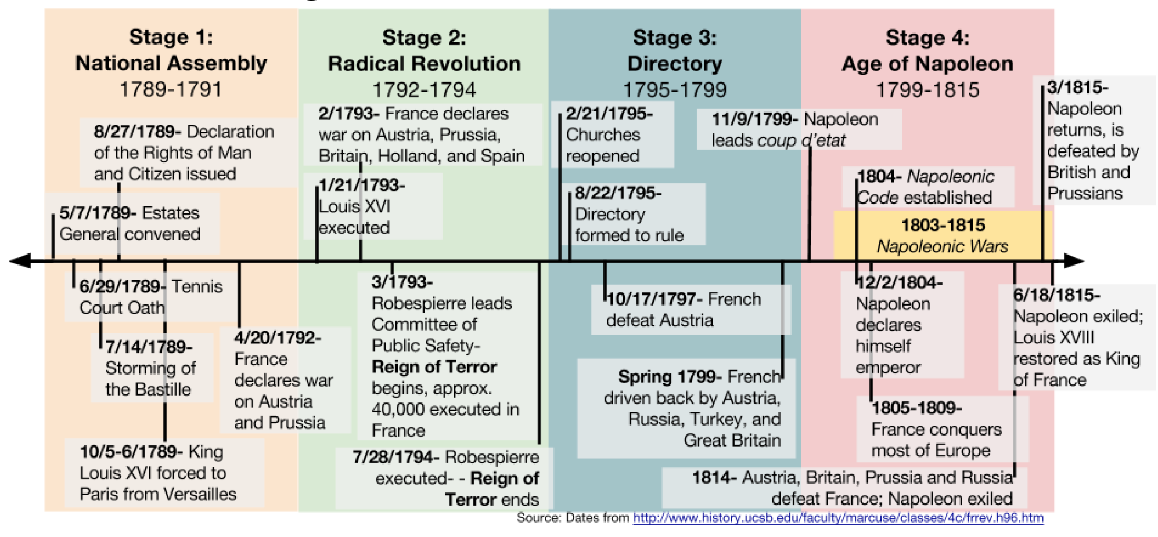
Part III: Stages and Events of the French Revolution

Slide 9
Social, economic, & political problems in pre-revolutionary France
Notes:
Review social, economic, and political with the class

Slide 10
Stations
You have 9 stations to visit
You can go in any order, as long as you visit all 9 and answer the questions for each station.
Don’t forget to fill out your organizer (political, social, economic) either as you go OR after visiting the stations. Refer to the station to make sure you know which one it is.
Don’t rush through them, make sure you read/view each station and answer all the questions.
You have the rest of the class period to complete the activity.

Slide 11
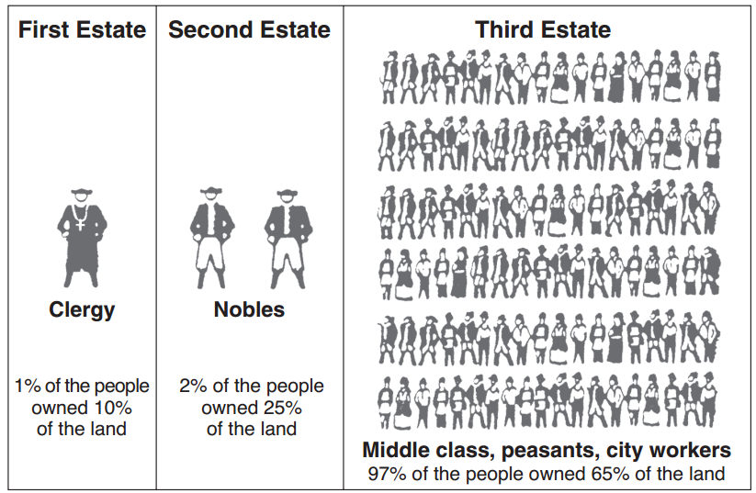
Social? Economic? Political? --Station 1

Slide 12
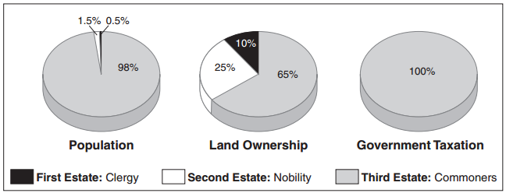
Social? Economic? Political? Station 2

Slide 13
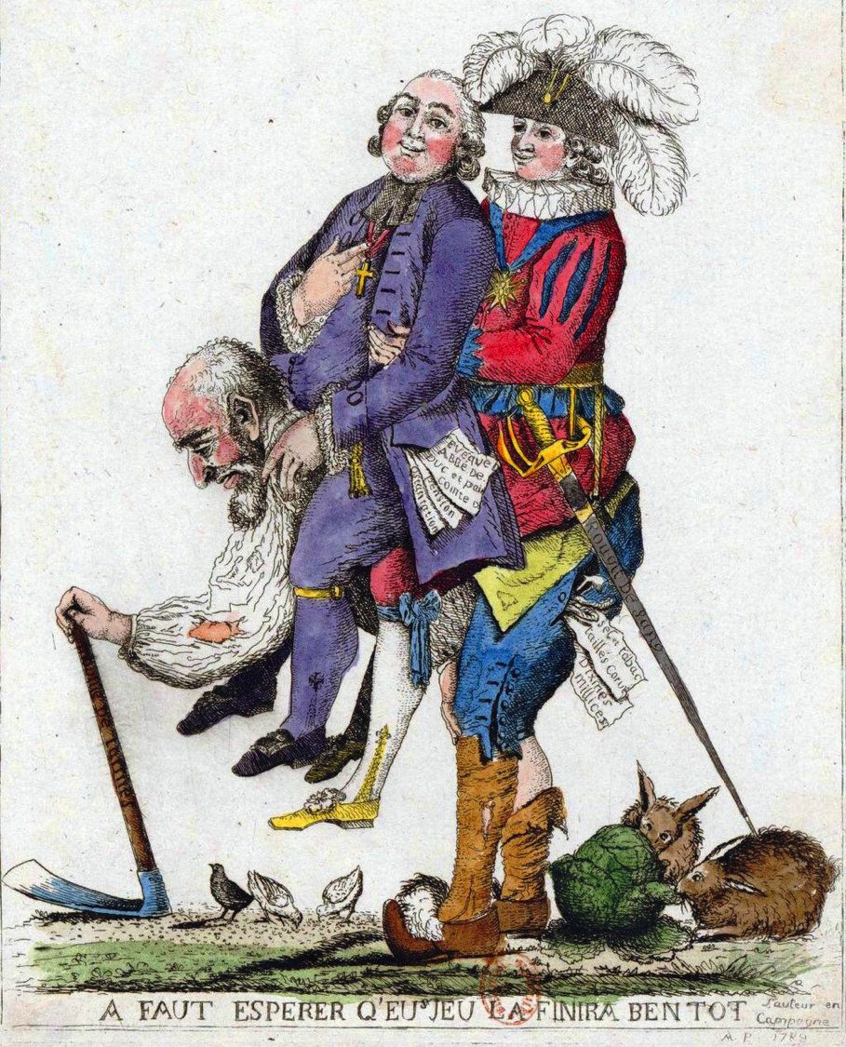
Social? Economic? Political? Station 3

Slide 14
Social? Economic? Political? Station 4

Slide 15
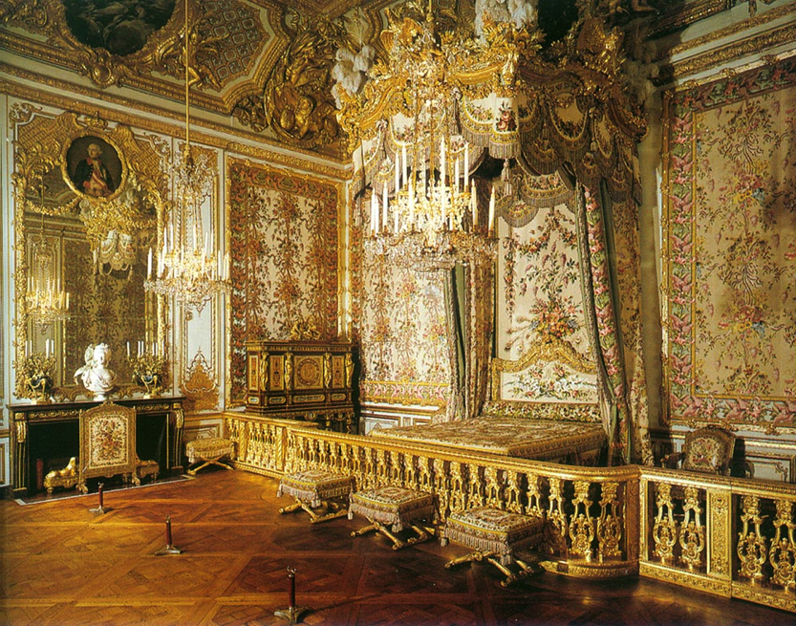
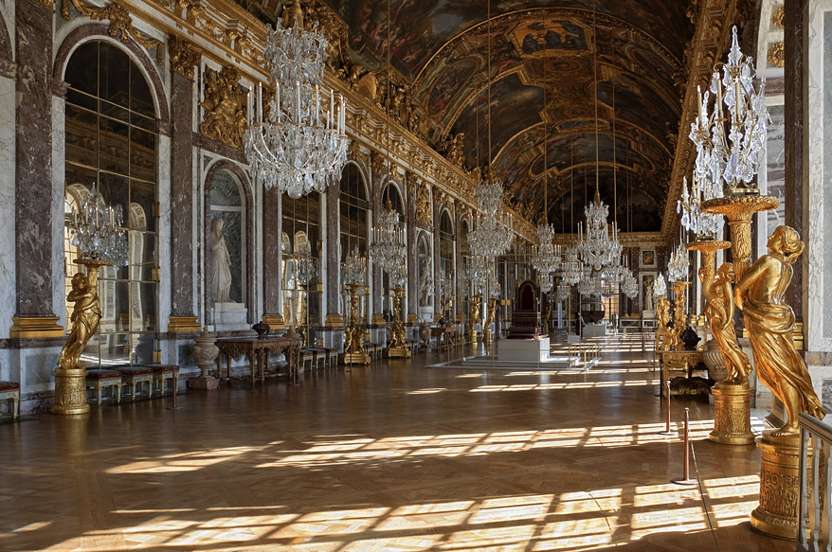
Social? Economic? Political? Station 5

Slide 16
Social? Economic? Political? Station 6
. . . The 12th. Walking up a long hill, to ease my mare [female horse], I was joined by a poor woman, who complained of the times, and that it was a sad country; demanding her reasons, she said her husband had but a morsel of land, one cow, and a poor little horse, yet they had a franchar (42 lb.) of wheat, and three chickens, to pay as a quit-rent [a payment that allowed the husband and wife to continue to use their land] to one Seigneur [noble]; and four franchar of oats, one chicken and 1 sou [small unit of money] to pay to another, besides very heavy tailles [taxes on the land and its produce] and other taxes[…] It was said, at present, that something was to be done by some great folks for such poor ones, but she did not know who nor how, but God send us better, car les tailles & les droits nous ecrasent [because the taxes and laws are crushing us]. —This woman, at no great distance, might have been taken for sixty or seventy, her figure was so bent, and her face so furrowed [wrinkled] and hardened by labour, — but she said she was only twenty-eight. An Englishman who has not travelled, cannot imagine the figure made by infinitely the greater part of the countrywomen in France; it speaks, at the first sight, hard and severe labour[…] To what are we to attribute this difference in the manners of the lower people in the two kingdoms [England and France]? To Government . . . .

Slide 17
Social? Economic? Political? Station 7
Date | Event that Increased the French Debt
1678-1789 | Building of, additions to, and upkeep of the Palace of Versailles
1756-1763 | Seven Years’ War Fought against their rivals at the time, Great Britain, and several other European powers in Europe and North America.
1775-1783 | American Revolution France lended 1.3 billion livres, soldiers, and ships to the American colonists in their fight against the British.
1678-1789 | Extravagant lifestyles of Louis XVI and Marie-Antoinette

Slide 18
Social? Economic? Political? Station 8

Slide 19
The third estate of the electoral district of Carcassonne very humbly petitions his Majesty to take into consideration these several matters, weigh them in his wisdom, and permit his people to enjoy, as soon as may be, fresh proofs of that benevolence [goodwill; kindness] which he has never ceased to exhibit toward them and which is dictated by his affection for them...:
8. ...the nation should hereafter be subject only to such laws and taxes as it shall itself freely ratify [approve].
9. The meetings of the Estates General of the kingdom should be fixed for definite periods...
10. In order to assure to the third estate the influence to which it is entitled in view of the number of its members, the amount of its contributions to the public treasury, and the manifold[many] interests which it has to defend or promote in the national assemblies, its votes in the assembly should be taken and counted by head.
11. No order, corporation, or individual citizen may lay claim to any pecuniary [financial] exemptions. … All taxes should be assessed on the same system throughout the nation.
12. The due [tax] exacted from commoners holding fiefs [land] should be abolished, and also the general or particular regulations which exclude members of the third estate from certain positions, offices, and ranks which have hitherto [until now] been bestowed on [given to] nobles either for life or hereditarily [based on family relations]. A law should be passed declaring members of the third estate qualified to fill all such offices for which they are judged to be personally fitted.
14. Freedom should be granted also to the press, which should however be subjected, by means of strict regulations to the principles of religion, morality, and public decency. …
Social? Economic?
Political?
Station 9

Slide 20
Overall causes of the French revolution
Social | Economic | Political

Slide 21
Homework
Finish Causes of the French Revolution Packet

