Slide 1
1. Get out your Do Now
Happy Thursday

Slide 2
CNN 10
Square – square with your thinking
Triangle – angle you don’t agree with/see differently
Circle – question you have

Slide 3
World Connection

Slide 4
Prove this statement by taking notes during the video
Innovations from Asian and Islamic civilizations laid the foundation for the Renaissance.

Slide 5
Why and how did the Renaissance spread outside of Italy?
The spread of wealth through trade
The invention of the printing press

Slide 6
Reason #1: The spread of wealth through trade

Slide 7
Reason #1: The spread of wealth through trade
Trade routes have existed since the Roman Empire
Grew over time with new wealth and products traded after the Crusades.
Large cities became centers of trade and banking
Cities established wealthy merchants and bankers
What is the connection between wealth and art?

Slide 8
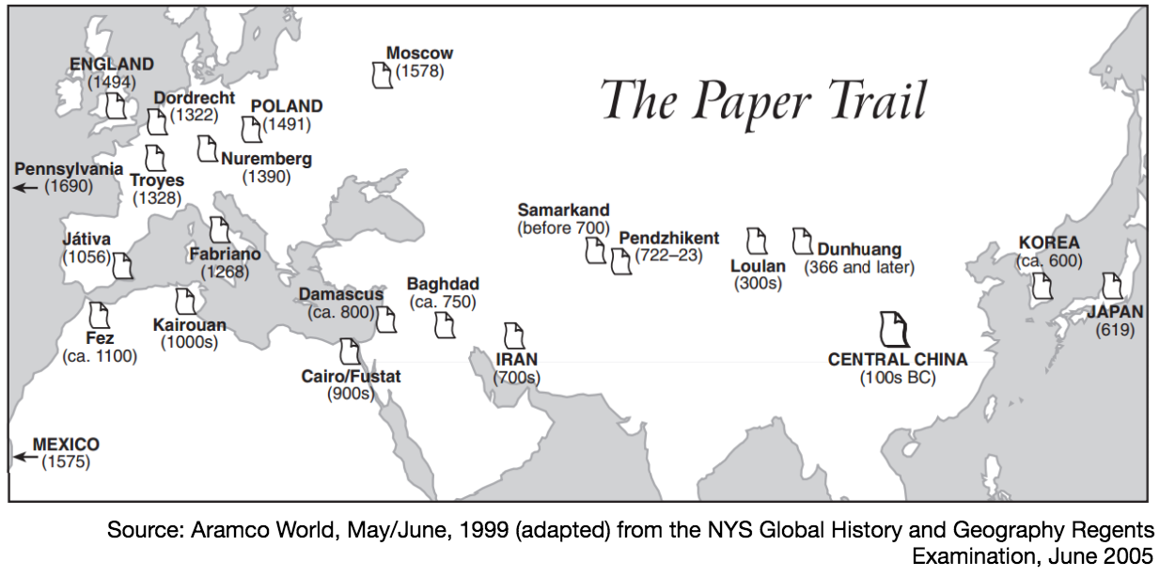
Reason #2: The invention of the printing press
By 1300, papermaking and printing technology reached Europe from China and the Middle East
Pushed China and the Middle East into the golden ages
Helped preserve Greek and Roman learned
Johannes Gutenberg invented the printing press

Slide 9
Reason #2: The invention of the printing press
Earlier books were written on scrolls
Middle Ages – manuscript books were produced by monks who worked with pen and ink to copy by hand
A small book or Bible would take years to complete
1. What effects might the way books were produced in the Middle Ages have had on Europeans and Europe?
2. How might this have affected the number of books available the cost of those books, and the number of people who could read them?
Notes:
Show mankind story of us video clip

Slide 10
What cultural effects did the Renaissance and the printing press have in northern Europe?
Oil Painting
Italian Renaissance artists focused on sculpture and paintings using lighter water colors
North of Italy artists used oil based paints for a greater variety of color to paint more realistic scenes.

Slide 11
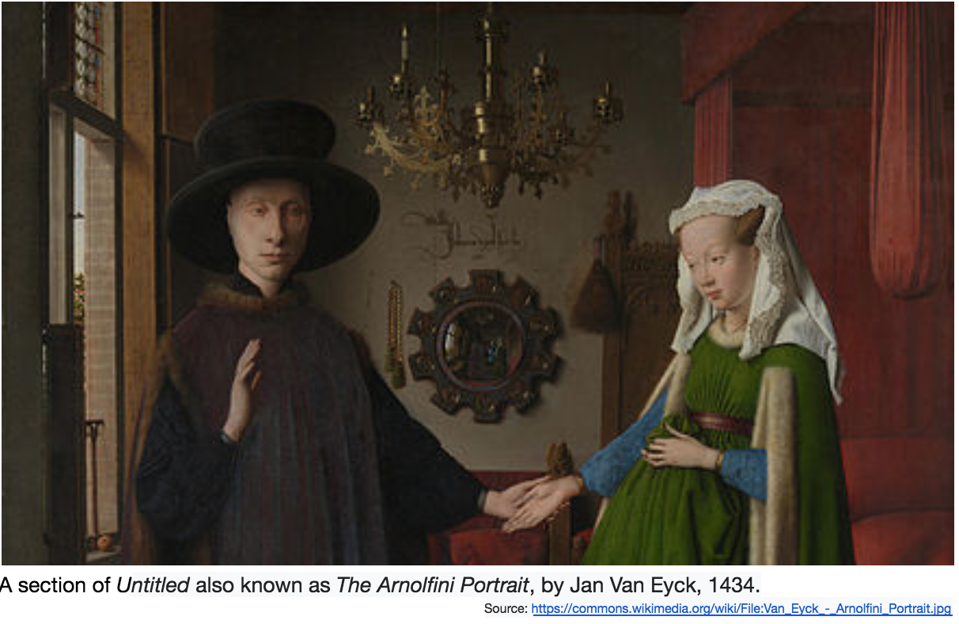
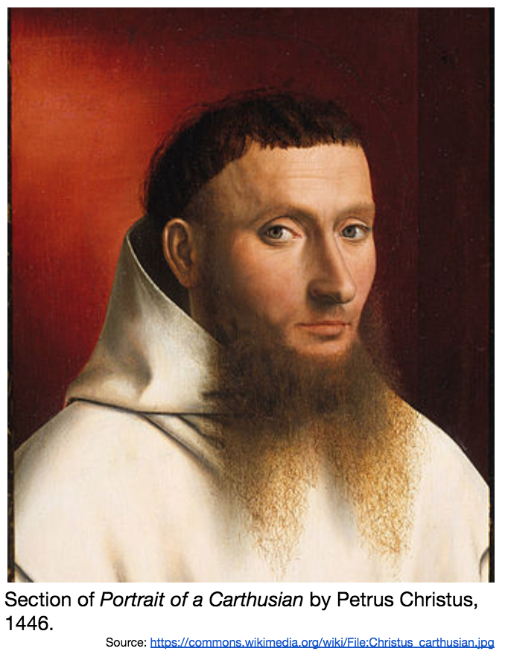
How did art in northern Europe differ from art in Italy during the Renaissance?

Slide 12
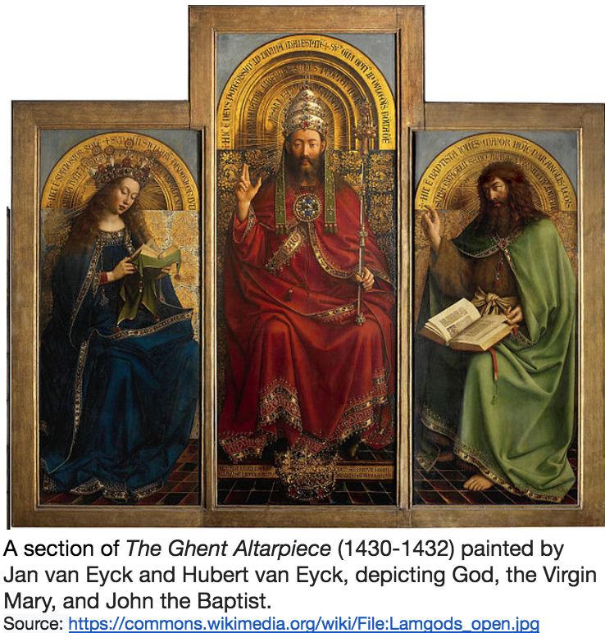
What cultural effects did the Renaissance and the printing press have in northern Europe?
Religious and Secular topics
Like Renaissance artists in Italy, northern European artists depicted both religious and secular scenes.

Slide 13
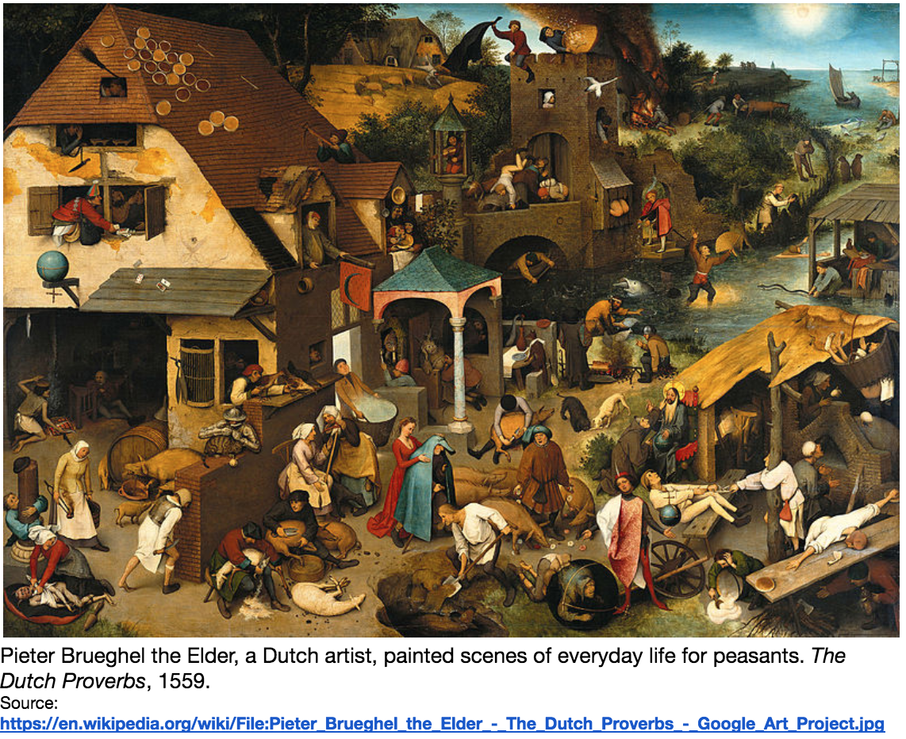

Slide 14
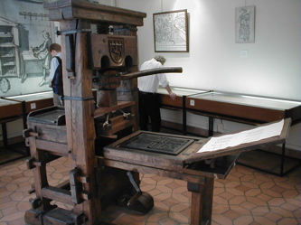
What cultural effects did the Renaissance and the printing press have in northern Europe?
Mass Production Using the Printing Press
Johannes Gutenberg invented the printing press in Germany
Technology spread throughout Europe
Used for creating wood-block engravings then making copies of them to be sold

Slide 15
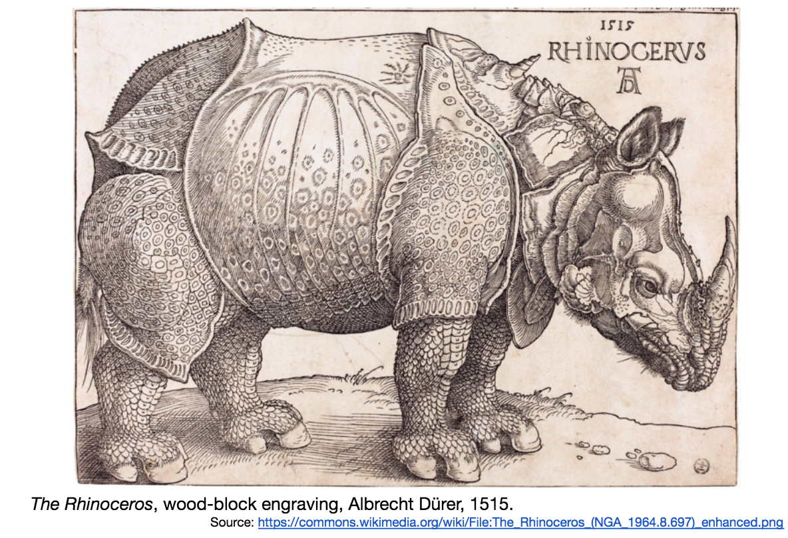
Example Durer was a master engraver Famous engraving is a depiction of an Indian Rhinoceros
Notes:
In 1515, for the first time since the Roman Empire, a Rhinoceros was brought to Europe. It was shipped from India for the King of Portugal and displayed for the public. Durer never saw the animal but instead based his drawing on another persons description. Durer’s depiction of the rhinoceros was incredibly popular and was circulated throughout Europe. For centuries it appeared in science texts and student texts until another rhinoceros was brought to the continent in 1751. Though Durer’s illustration has errors, like the horn on the animal’s back, it demonstrates the influential power of art and printing through its ability to shape how Europeans imagined one animal for hundreds of years.
What does the story of Durers rhinoceros tell you about northern Europe during the 1500s, and the impact of the printing press on art and the communication of knowledge?

Slide 16
Describe the cultural effects of the Renaissance and the printing press on northern Europe.
Notes:
Turn and talk with a partner – hear out loud

Slide 17
Reformation
Although the renaissance era is focused on humanist ideas and did spread throughout Europe, many people still focused on religion and some were not even exposed to the Renaissance.

Slide 18
Reformation
In your notes answer the following question.
What do you think is a major reason people might leave a religion in today's world?
Notes:
Leave one religion for another
Highly personal reasons
Needs are not being met
Politics
Too radical
Spouse
Friends/family
Money
Time
Many Europeans felt that the Church was not meeting their needs

Slide 19
Notes:
Students will complete in their notes

Slide 20
Protestant Reformation
Protest + ant = Protestant
Protest = to challenge or dissent
Ant = a person who
Re + formation = Reformation
Re = again
Formation = the process of shaping or making

Slide 21
Protestant Reformation
16th century religious, political, intellectual, and cultural revolution that sought to change or remake the Catholic Church.
In northern and central Europe, reformers like Martin Luther and John Calvin protested and challenged Church authority.

Slide 22
Unit 3 Vocab review
You need a device (phone/laptop)
Apples to apples concept
1 person draws a card
The rest of the group members find an image using Google that represents the vocab term without typing in the word directly (be creative and refer to your vocab sheet). Only 45 seconds to find an image (the judge can be in charge of the time)
The person that drew the card picks a winner and gives the card to the winner.
Next person draws a card and so on.

Slide 23
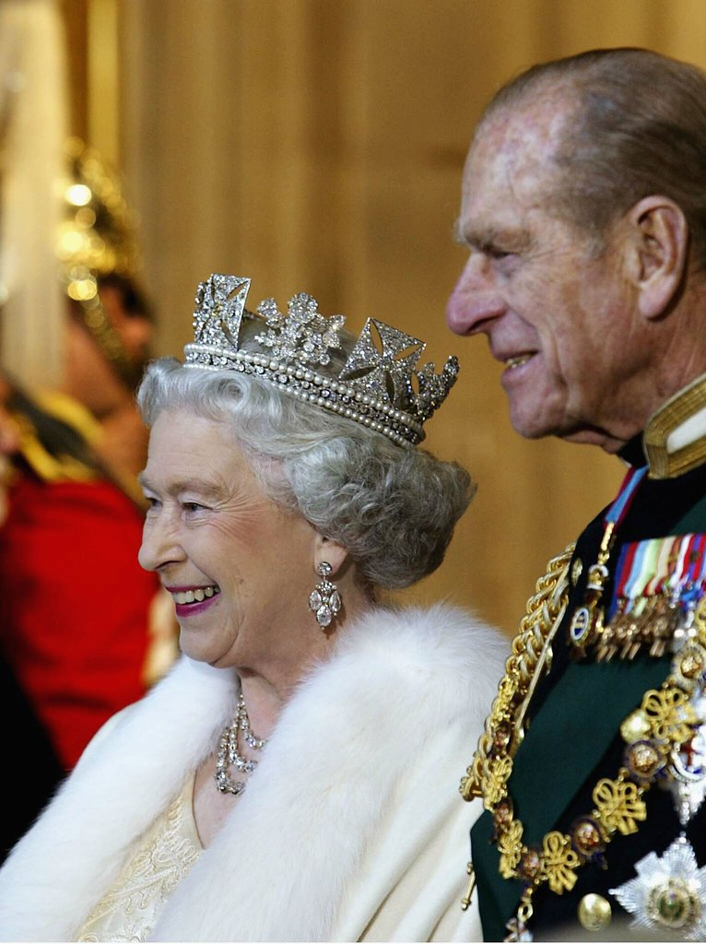
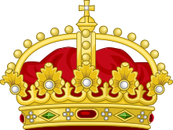
Example: Monarchy

