Slide 1
Welcome back! Please find your new seat!
If you have your Unit 5 vocab or missing work turn it into the back.
10 days left before exams!

Slide 2
American I
There are 2 weeks left so make them count.
Unit 5, 6, and 7 to cover still. We will be moving fast and there will be an open note test at the end.
Review for NCFE
Phones – I shouldn’t see them, I will gladly collect yours if it is a distraction.

Slide 3
Unit 4 Test Recovery Due THURSDAY
Worried about your Unit 4 test?
Earn up to 29 points! Maximum is half of the points missed (ex. 80 on your test means you can only earn up to 10 points to be added back to the test).
Follow all instructions
Do NOT Google the answers or copy from the internet.

Slide 4
#2
Thomas Jefferson opposed Alexander Hamilton's plan to create a national bank primarily because the plan would do which of the following?
Weaken the nation's currency
Increase the national debt
Promote the interests of farmers
Support using a loose interpretation of the Constitution
Notes:
Answer D

Slide 5
#14
Why is Jefferson sometimes considered a hypocritical president? CHOOSE TWO ANSWERS.
While supporting loose interpretation of the Constitution, he signed the Louisiana Purchase which required strict interpretation of the Constitution.
While supporting strict interpretation of the Constitution, he signed the Louisiana Purchase which required loose interpretation of the Constitution.
While writing that “all men are created equal” in the Declaration of Independence, he personally owned slaves
While allowing slavery in the Constitution and as president, he condemned slavery in his personal life
Notes:
Correct BC

Slide 6
#17 see timeline--NCFE question
To what extent did the Whiskey Rebellion have a lasting impact on the power of the federal government?
The power of the federal government to regulate commerce was increased when President Washington placed a tax on distillers.
President Washington′s use of federal troops asserted the supremacy of the national government over state governments.
The power of the Treasury Department was increased by charging a license fee for distillers.
Federal troops used to stop the rebellion became the nation′s permanent military force.
Notes:
View timeline on test
Correct - b

Slide 7
A - #18---NCFE question
Read the passage below. Then, answer the question that follows.
And, for extending the fundamental principles of civil and religious liberty, which form the basis whereon these republicans, their laws and constitutions are erected; to fix and establish those principles as the basis of all laws, constitutions, and governments, which forever hereafter shall be formed in the said territory: to provide also for the establishment of States, and permanent government therein, and for their admission to a share in the federal council on an equal footing with the original States, at as early periods as may be consistent with the general interest. -Sec. 13 of the Northwest Ordinance, 1787

Slide 8
#18
How did the Northwest Ordinance of 1787 influence settlement patterns?
It established a plan for surveying land west of the Appalachians.
It provided a procedure for admitting new states into the Union.
It settled the conflict over colonial land claims to the west.
It established reservations for American Indians who lived on public lands.
Notes:
Correct B

Slide 9
#20----NCFE question
How does the chart above, which shows the tally of Electoral College votes for the election of 1800, represent a key turning point in U.S. history?
As a result of negotiation in the House of Representatives, Thomas Jefferson became president, this marking the first peaceful transition of executive power in U.S. history.
As a result of a tie in Electoral College votes between Thomas Jefferson and Aaron Burr, both took power as co-presidents, marking the only time in U.S. history with two concurrent presidents.
As a result of negotiation in the U.S. Senate, Thomas Jefferson became president John Adams became vice president.
As a result of a tie in Electoral College votes, the House of Representatives called for a national referendum.
Notes:
Correct = A
Do you even really need the chart??

Slide 10
#25
The Virginia and Kentucky Resolutions argued that the rights to determine the constitutionality of a law passed by Congress rested in
Congress
The states
The Supreme Court
The vote of the people
Notes:
Answer – B
What was this in response to? Alien/sedition acts – made by Federalists – this was a response by the DR (small state gov!!)

Slide 11
NCFE Review
Try your best to answer on your own.
We will go over them together after a few minutes.
This activity is a way to benefit you and help you prepare for the NCFE.

Slide 12
Quick review – Unit 5
Monroe Doctrine
Missouri Compromise
Market Revolution/Industrial improvements
Corrupt Bargain
Jackson
Notes:
Monroe Doctrine – told Europe to stay on their side of the globe, became more of a selfish move for America
Missouri Compromise – Missouri entered as a slave state while Maine entered as a free state, continued to see more sectionalism
Industrial improvements – transportation (roads, railroads, steam boats, canals), factories (new jobs), interchangeable parts, new inventions
Jackson – keep state power stronger than federal government, king cotton

Slide 13
Andrew Jackson
Democracy was key for him
Common Man mentality
Spoils System – some viewed as corruption
American System
Tariffs (taxes on imports) hurt the south but benefited the north
Did not think it was the federal governments job to pay for roads

Slide 14
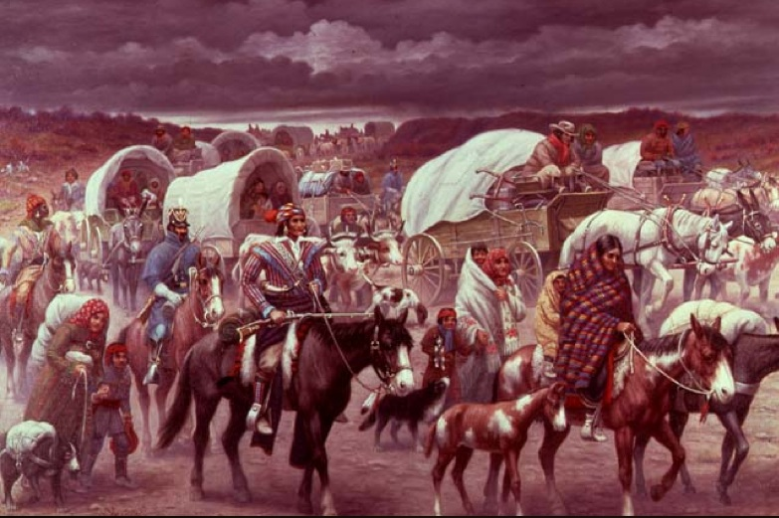
Andrew Jackson
Trail of Tears/Indian Removal Act
Moved Cherokee people west to Oklahoma, many died along the way.
Often brutal
Cherokees in GA tried to use legal action to keep their land but it was ignored.
Make room for settlers.
Notes:
https://www.youtube.com/watch?v=SosZ2ZRJymU

Slide 15
Reform
The years between 1820 and 1865 in the US might be described as one long era of reform, marked by the predominant desire to purify individuals.

Slide 16
2nd Great Awakening
Revival of religious feeling started in KY in the early 1800s and spread across the country for half a century
Preachers believed Americans had become immoral and needed to bring back religious participation
Personal faith stories, strong emotions
Did you notice this in Roots?
Notes:
Protestant revival
New religious groups, new movements, questioning church and state
Sparked reform – some just wanted change due to what they saw going on around them

Slide 17
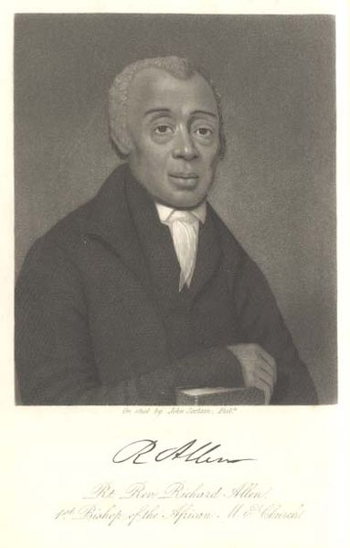
African Americans in the 2nd Great Awakening
Many African Americans were welcomed by revivalists
One group founded their own church, African Methodist Episcopal Church (AME)
For slaves:
Religion offered a way to deal with oppression
Inspired some to revolt against oppressors
AME Church founder Richard Allen
Notes:
Nat Turner

Slide 18
New Religious Groups Form
Church of Jesus Christ of Latter-day Saints, commonly called Mormons
Founded by Joseph Smith in 1830
Persecuted by people who didn’t agree with their beliefs
Were chased from Ohio, Missouri & Illinois, all the way to Utah.
Notes:
Persecuted those that did not agree --- where else have we seen that?
Involuntary migration

Slide 19
Religious Discrimination
Mormons were persecuted:
Isolated from mainstream society
Powerful as a group because they held land together & voted together.
Catholics experienced discrimination:
Some Americans thought Catholics would be loyal to the Pope over the U.S.
Many new Catholic immigrants were also poor and there were a lot of them, Americans felt threatened.

Slide 20
Utopian Communities
Groups who lived apart from mainstream society and shared their belongings.
Tried to become “perfect” communities & inspired others
Most are not successful
New Harmony, Indiana lasted 2 years
Brook Farm, Massachusetts lasted 6 years
Shakers (United Society of Believers in Christ’s Second Appearing) succeed
Lived communally and recruited others

Slide 21
Transcendentalism
Name comes from belief that people should “go beyond” their senses to learn about the world
New way to look at the connection between humanity, nature and spirituality
Find yourself and the world through nature
Spiritual “goodness” is recognized through intuition rather than religious doctrine.
Leaders were writers Ralph Waldo Emerson & Henry David Thoreau

Slide 22
Reforming Education
Since colonial times most children were taught at home
The American Spelling Book by Noah Webster
Worry that children were not required to go to school
Led the public schools or “common school” movement
Argued public schools would:
Create knowledgeable citizens to participate in democracy
Promote economic growth—knowledgeable workers
Keep the educated wealthy from oppressing the illiterate poor

Slide 23
Penitentiary Movement
Prison viewed as a place to punish criminals
Dorothea Dix & other reformers thought that penitence (sorrow, feeling bad about their crimes) was better
Pennsylvania system: prisoners were encouraged to repent for crimes while completely isolated from others
Expensive and later considered cruel
Auburn Prison: prisoners worked together in silence during the day and retreated to separate cells at night
Adopted by many states

Slide 24
Temperance Movement
With industrialization came: crime, sickness, poverty, neglect & abuse
Many believed alcohol abuse was to blame
Reformers advocated for temperance (moderation) or prohibition (ban) of alcohol
Created pamphlets, had public speakers and meetings to get people to pledge temperance
Notes:
Americans were drinking 2 times what the average American drinks now

Slide 25
Think back all the way to Unit 1: Why did colonists first establish settlements along the EAST Coast of the US?
Notes:
Landed there by chance
Came from the East (England)
Didn’t venture further – lack of resources
Closer to England for resources

Slide 26
School House Rock: Elbow Room
According to the video, why did Americans need more “Elbow Room”?
The song goes “The way was opened up for folds with bravery, There were plenty of fights, To win land rights, But the West was meant to be; It was out Manifest Destiny!” What does the phrase “Manifest Destiny” mean?
Notes:
Tell them to write their answers down in their notebooks
Population was growing
It was our destiny as a nation to take over the whole land and spread from west to east coast

Slide 27
Manifest Destiny
Manifest: Clear or obvious
Destiny: Future or Fate

Slide 28
John Gast, American Progress, 1872
Notes:
Question to students: What do you see in this painting?
You have 1 minutes to write down as many observations as possible
What transformation of the west are implied?
Motivations?
Who?
How does this relate to manifest destiny? – fate of the American future

Slide 29
Does Manifest Destiny still exist?

Slide 30
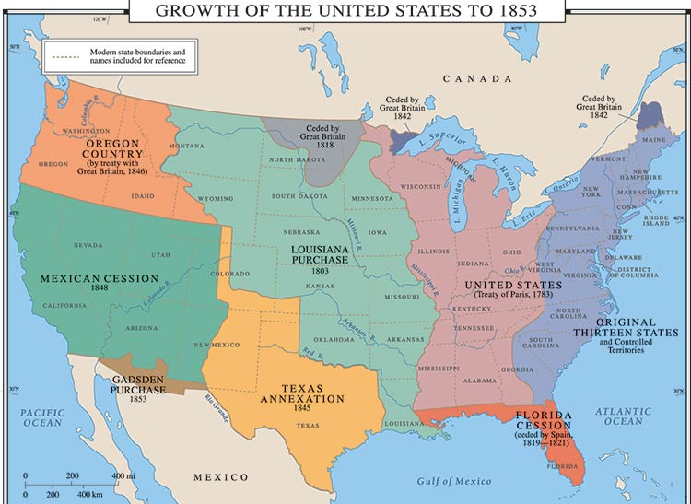
Manifest Destiny and TEXAS
Notes:
1st period, 3rd period, 4th period

