Slide 1
1. Get out your Do Now
Happy Wednesday

Slide 2
CNN 10
2 Tweet
Tweet must be at least 7 words long
Include important information for your reader
Use hashtags if you would like
Be creative

Slide 3
World Connection
Borders: How have you seen issues with borders throughout history?

Slide 4
Test Recovery
Due Monday
Possible 40 points

Slide 5
Humanism
Pursuit of individualism
Recognition that humans are creative
Appreciation of art as a product of man
Love of the classical past (Greece/Rome)
Often rejects the importance of belief in God.
- Life could be enjoyable
- Emphasis on reason, scientific inquiry, and
human fulfillment in the natural world
Notes:
1st

Slide 6
Why did the Renaissance occur?
Increased trade with Middle East/Asia, this improved the lives of the middle class
Growth of large, wealthy city-states in Italy with a decline in feudalism
Renewed interest in the classical learning of ancient Greece and Rome - education
Rise of rich and powerful merchants, who became patrons of art
Increased desire for scientific and technical knowledge with a decreased desire to go to church
Desire to beautify cities – recapture the glory of the Roman Empire

Slide 7
Growth of Cities as Centers for Trade
Profit-making became more important than Church doctrine
To overcome guilt, profit-makers indulge in philanthropy (concern for welfare of people; seen in charity)
High profits led to economic diversification (creating and selling a variety of products)

Slide 8
Machiavelli – View of Power
Niccolo Machiavelli
One of the most influential writers of the Renaissance
Believed Italy could not be united unless its leader was ruthless
1513 - wrote The Prince,
Warned, it is better to be feared than loved.

Slide 9
Machiavelli
“You must know there are two methods of fighting, the one by law, the other by force; the first method is of men, the second of beasts; but because the first is frequently not sufficient, one must have recourse to the second. Therefore it is necessary for a prince to understand how to use the methods of the beast and the man . . .

Slide 10
Machiavelli
A prince . . . ought to choose the fox and the lion; because the lion cannot defend himself against traps and the fox cannot defend himself against wolves. Therefore, it is necessary to be a fox to discover the traps and a lion to terrify the wolves. Those who rely simply on the lion do not understand this.”
-- Niccolo Machiavelli, The Prince (1513)

Slide 11
Machiavelli – in your notes answer the following
Do you agree with Machiavelli that it is more important that a ruler be feared than loved? Explain your answer.
When do you feel it is appropriate for a ruler to be a fox, and when is it appropriate to be a lion? In other words, when is it important to use physical strength, and when is it for a ruler their use their wits?
How might Machiavelli’s writing impact how leaders govern their states?
Notes:
Think back to CNN 10 – does the leader of Saudi Arabia seem to be feared or loved?

Slide 12
Humanism
Philosophy emphasizing reason, scientific inquiry, and human fulfillment (importance) and often rejects the importance of religion.
Humanist can still be religious but it may not be the priority in life.
The individual matters!
Humanities – art, science, history, reading

Slide 13
Renaissance Role Play
The Italian Renaissance roughly lasted from 1300 to 1600. During this era, Italian merchants formed commercial relationships with Middle Eastern traders and northern Europeans, so they acted as the middle-men of Mediterranean trade. The Italian merchants used their new wealth to pay for art, buildings, music, theater, copies of Greek and Roman texts that Muslims had preserved, and private tutors for their children. Many scientists could get funding for experiments and discoveries that went beyond what Greek, Roman, Indian, African, and Arab scientists had accomplished.

Slide 14
Renaissance Role Play
Directions:
You will take on the role of a person during the renaissance
Based on your biography you must find individuals who can help you achieve your goals by working with them and making a plan about:
What you will do for them
What they will do for you
How your plan shows humanist ideas of the Renaissance
Then find another individual and make a second plan in the same way. You can also work with multiple people to work out plans that benefit a group.

Slide 15
Prove this statement by taking notes during the video
Innovations from Asian and Islamic civilizations laid the foundation for the Renaissance.

Slide 16
Why and how did the Renaissance spread outside of Italy?
The spread of wealth through trade
The invention of the printing press

Slide 17
Reason #1: The spread of wealth through trade

Slide 18
Reason #1: The spread of wealth through trade
Trade routes have existed since the Roman Empire
Grew over time with new wealth and products traded after the Crusades.
Large cities became centers of trade and banking
Cities established wealthy merchants and bankers
What is the connection between wealth and art?

Slide 19
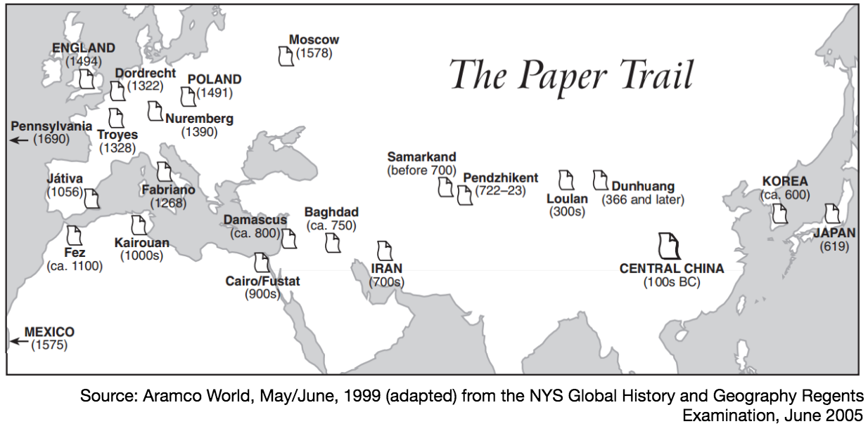
Reason #2: The invention of the printing press
By 1300, papermaking and printing technology reached Europe from China and the Middle East
Pushed China and the Middle East into the golden ages
Helped preserve Greek and Roman learned
Johannes Gutenberg invented the printing press

Slide 20
Reason #2: The invention of the printing press
Earlier books were written on scrolls
Middle Ages – manuscript books were produced by monks who worked with pen and ink to copy by hand
A small book or Bible would take years to complete
1. What effects might the way books were produced in the Middle Ages have had on Europeans and Europe?
2. How might this have affected the number of books available the cost of those books, and the number of people who could read them?
Notes:
Show mankind story of us video clip

Slide 21
What cultural effects did the Renaissance and the printing press have in northern Europe?
Oil Painting
Italian Renaissance artists focused on sculpture and paintings using lighter water colors
North of Italy artists used oil based paints for a greater variety of color to paint more realistic scenes.

Slide 22
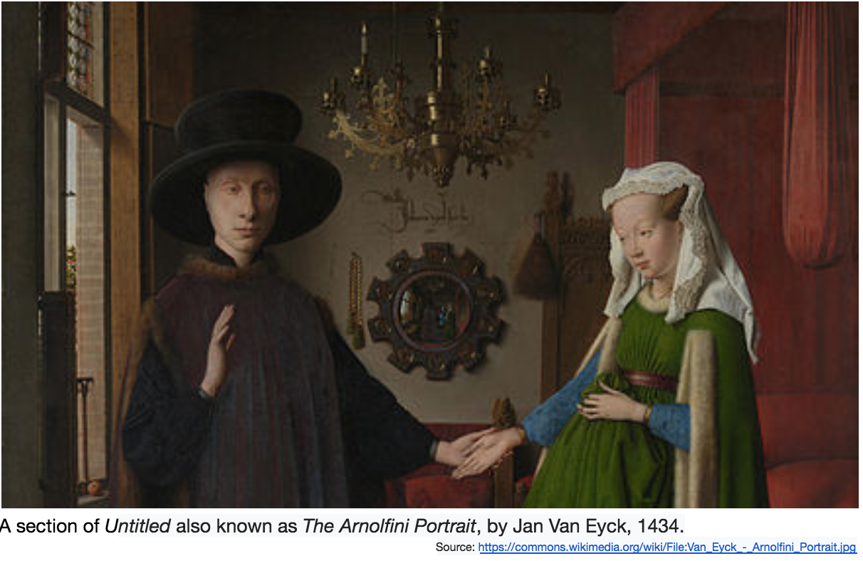
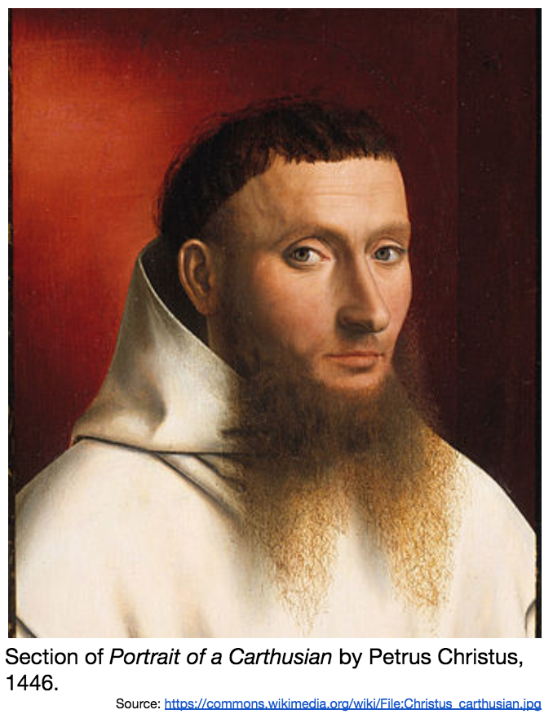
How did art in northern Europe differ from art in Italy during the Renaissance?

Slide 23
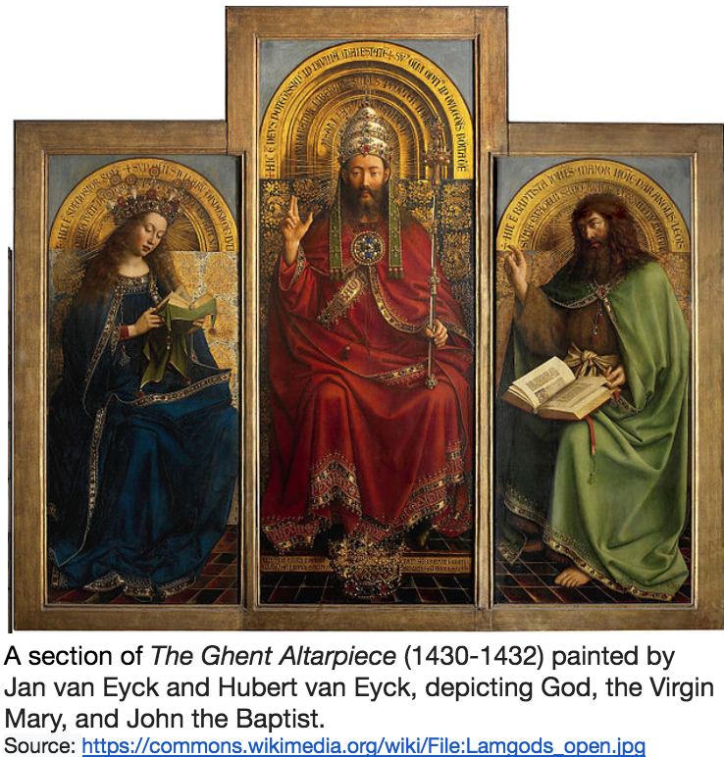
What cultural effects did the Renaissance and the printing press have in northern Europe?
Religious and Secular topics
Like Renaissance artists in Italy, northern European artists depicted both religious and secular scenes.

Slide 24
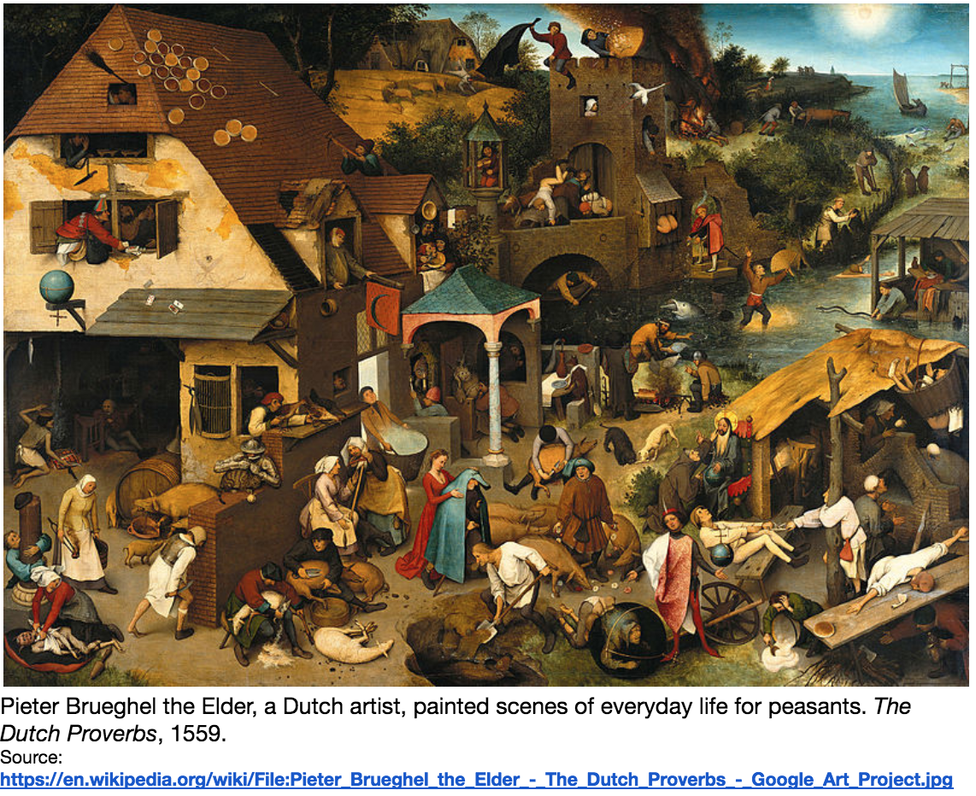

Slide 25
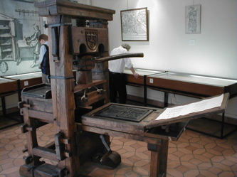
What cultural effects did the Renaissance and the printing press have in northern Europe?
Mass Production Using the Printing Press
Johannes Gutenberg invented the printing press in Germany
Technology spread throughout Europe
Used for creating wood-block engravings then making copies of them to be sold

Slide 26
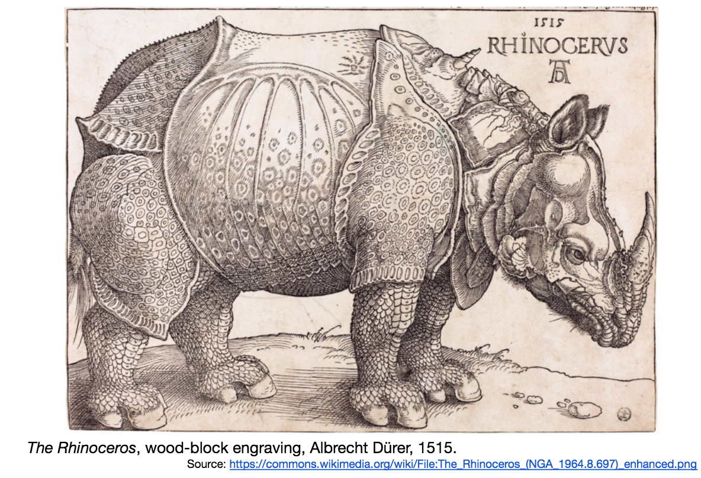
Example Durer was a master engraver Famous engraving is a depiction of an Indian Rhinoceros
Notes:
In 1515, for the first time since the Roman Empire, a Rhinoceros was brought to Europe. It was shipped from India for the King of Portugal and displayed for the public. Durer never saw the animal but instead based his drawing on another persons description. Durer’s depiction of the rhinoceros was incredibly popular and was circulated throughout Europe. For centuries it appeared in science texts and student texts until another rhinoceros was brought to the continent in 1751. Though Durer’s illustration has errors, like the horn on the animal’s back, it demonstrates the influential power of art and printing through its ability to shape how Europeans imagined one animal for hundreds of years.
What does the story of Durers rhinoceros tell you about northern Europe during the 1500s, and the impact of the printing press on art and the communication of knowledge?

Slide 27
Homework
Study for Vocab quiz on Friday (3rd/4th)
We will play a review game tomorrow

