Slide 1
1. Get out your Do Now 2. Get out A New Nation Reading and questions
Unit 4 Day 3

Slide 2
CNN 10

Slide 3
Reading debrief
Thomas Jefferson’s vision?
Alexander Hamilton’s vision?
American Reaction the French Revolution?
Why did political parties form and what were they?
US alliance with France put US in an awkward position?
Washington and the Neutrality Proclamation?
Notes:
Small farmers, weaker central government
Manufacturing, strong central government, national bank, tax on whiskey, national gov assuming states debts
Many celebrated and saw it as a victory for liberty, Declaration of the Rights of man being a clear idea of human rights, Americans felt influential in foreign affairs and the world
Disagreement over the French Revolution//Federalist – viewed revolution as a threat to liberty and Democratic Republicans- Jefferson viewed revolution as a good thing (Shays rebellion)

Slide 4
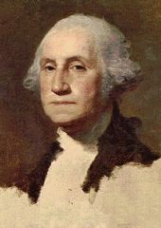
George Washington’s Presidency 1789-1797 VP: John Adams
Notes:
Adams – helped with the constitution, lawyer

Slide 5
Establishment of the Presidential Cabinet – (Precedent)
The Constitution allows Congress to create departments to help the President ← the Cabinet.
The first Presidential Cabinet had four departments:
Notes:
George Washington knew that he would need help, so he found some of the greatest and most diverse minds to help him and the US be successful and to set precedents for the future generations of government officials
There are 15 cabinet positions today

Slide 6
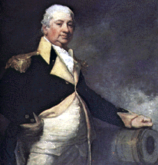
The First Presidential Cabinet
Secretary of War
Henry Knox head of the nation’s defenses.
Notes:
He was a general under GW during the Revolutionary war
From Boston, MA
Dealt with growing unrest in the western frontier
Helped promote law and order

Slide 7
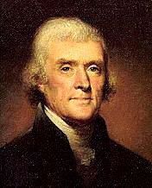
The First Presidential Cabinet
Secretary of State
Thomas Jefferson head of the relations between the U.S. and other countries/foreign policy.
Antifederalist
Notes:
From Virginia – lived on a plantation – owned slaves – originally believed slaves to be biologically inferior – had similar beliefs to GW but did not emancipate his slaves after his death
Wrote the Declaration of Independence
ANTIFEDERALIST – feared a strong government – founder of the Democratic-Republican Party
Supported agrarian nation

Slide 8
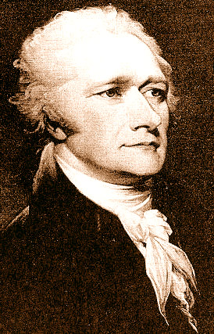
The First Presidential Cabinet
Secretary of the Treasury
Alexander Hamilton to manage the government’s money.
Federalist
Notes:
Federalist papers
Creating economic security
Believed in a strong central government, president, national bank, and national court system
Industrial and commercial ideals

Slide 9
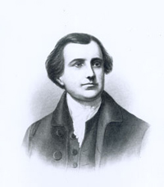
The First Presidential Cabinet
Attorney General
Edmond Randolph to advise the government on legal matters (the justice system)
Notes:
Born into a wealthy Virginia family
George Washington's aid – introduced the Virginia plan
Federalist

Slide 10
Judiciary Act of 1789
The Constitution established the Supreme Court
Congress could make laws to organize the courts and create more
This law established the federal judicial branch
3 levels: district courts, circuit court of appeals, supreme court
Notes:
District – at least one in each state – resolve disputes by determining the facts and applying legal principles
Circuit – 13 appellate courts below the supreme court – 94 federal judicial districts organized into 12 regions – determine if the law was applied correctly in a trial.
Supreme – highest court in the US

Slide 11
Judiciary Act of 1789
Supreme Court had 6 judges that decided contested cases and heard cases between states or with other countries
Washington nominated
Attorney General: Edmund Randolph
Chief Justice: John Jay
Notes:
District -

Slide 12
What predictions can you make about the cabinet?
Will everyone agree with one another?
Will there be conflict within?
What will happen if there is conflict?
Notes:
George Washington picked brilliant people with differing opinions – why?
He wanted multiple perspectives – his cabinet was from different places in the US and it helped Washington gain perspective throughout his presidency to have a clearer representation of ideas between big/small states, n/s states, federalist/democratic republicans

Slide 13
George Washington
Born in Virginia in 1732
Plantation lifestyle – what does this tell us about his upbringing?
Inherited slaves
How do you think George Washington felt about slavery?

Slide 14
Taking a closer look…
Read through the 4 documents written by George Washington
Discover his perspective on slavery
Fill out the organizer then answer the follow up questions
Be prepared to discuss your answers.
You have 25-30 minutes to work on this – be diligent.

Slide 15
Discuss the follow up questions with your neighbors
Why did George Washington view slavery as an important aspect to society?
Why does he not free all slaves upon his death?
How did Washington’s perspective change about slavery?
What contributed to his changed ideas?
Notes:
https://www.youtube.com/watch?v=1iRR5SmJaJA
Show video if there is time

