Slide 1
1. Get out your do now
Happy Tuesday
“Always find time for the things that make you feel happy to be alive!”

Slide 2
2 Aha’s and 1 Huh?
Aha = surprise, learned, new information, shocked
Huh = question you have
CNN 10

Slide 3
*Underlying causes of WWI*
M
A
N
I
A
KNOW THESE!!!
Notes:
Central – Germany, Austria-Hungary, Italy
Allied powers – Russia, GB, France

Slide 4
A- Assassination
Def: To injure or destroy unexpectedly; to murder (usually a prominent person) by sudden or secret attack
http://www.history.com/topics/world-war-i/outbreak-of-world-war-i/videos/world-war-i-alliances
Notes:
Balkins were known as the powder keg – could explode at any moment because of its tight position, location, culture, alliances
Self-determination – freedom for people of a country to live as they chose – nationalism and independence.
http://www.history.com/topics/world-war-i/outbreak-of-world-war-i/videos/world-war-i-alliances?m=528e394da93ae&s=undefined&f=1&free=false

Slide 5
What was war like during WWI? How did it affect those involved?
View the photos to compare and contrast
Industrialization and Total War documents
Technological Developments and Trench Warfare video clips

Slide 6
1. What is similar/different about warfare in the early 1800s and 1900s?
2. Why do you think warfare changed?

Slide 7
Industrialization
By the late 1800’s factories and urban areas were connected by railways
Advances in industrial production
Assembly lines
Mass production
  Guns, tanks, airplanes, automobiles, ammunition
Items needed for the war effort
Notes:
How did industrialization in Europe affect the production of goods needed for WWI?
How did this industrialization affect soldiers and those on the home front in WWI?

Slide 8
Total War
Total War: military conflict in which nations mobilize all available resources in order to destroy another nation’s ability to engage in war.
Military and civilians working together
Nationalistic feelings arise
Young men became part of the military
Women worked in factories
Rationing
Propaganda
Notes:
What is total war?
How is total war different than most wars fought before WWI?
How did total war affect soldiers and those on the home front in WWI?

Slide 9
Technological Developments
Created competition between countries
Watch the video for further investigation.
Notes:
Video on file – tech developments
https://www.history.com/topics/world-war-i/world-war-i-history/videos/tech-developments-of-world-war-I
Describe 3 technological developments in warfare during WWI.
How did technological developments during WWI affect the soldiers who fought?

Slide 10
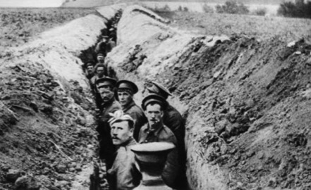
Trench Warfare
Pre-WWI battles were fought out in the open
New technology meant new tactics, new needs for protections
Trenches were dug to stay safe
Hard to gain much of anything
Often resulted in a stalemate
Notes:
Show life in a trench video on file
Explain what trench warfare is.
How did trench warfare affect the soldiers who fought in WWI?
Trench – deep ditch
Stalemate – condition where neither opposing side can make significant gains

Slide 11
Remember…
Unit 8 – WWI vocab quiz Tomorrow
Unit 6/7/8 TEST MONDAY
Outlines will be graded in the order of the presentations. Resubmission date will be in private comments.

