Slide 1
Happy Thursday
1. Get out your Do Now

Slide 2
CNN 10
2 Aha’s and 1 Huh?
Aha – surprise, interest, wow
Huh – question, unsure, confused
World Connection: How will the closing of the GM plant impact the economy and society in Ohio?

Slide 3
Unit 3
Renaissance and Reformation

Slide 4
Based on the information, images and your knowledge, make a claim and support it with evidence to answer the question: How could Europe have changed so much between the Middle Ages and the Renaissance?

Slide 5
Re + naissance Again + “A birth, an origination as that of an idea, or a movement”
“Rebirth” in French
Cultural movement 14th-17th centuries
Rebirth of classical Greek and Roman achievements through art, science, and education
Notes:
Creativity and great change – shifting from agricultural to an urban society
Revival of art and learning

Slide 6
What is a cultural movement?
Culture: language, ideas, inventions, and art of a particular group of people
Movement: a big change
What kind of jeans would be pictured for 2019?
Notes:
Although this is a small change it is still a cultural movement.
Can you think of other cultural movements?

Slide 7
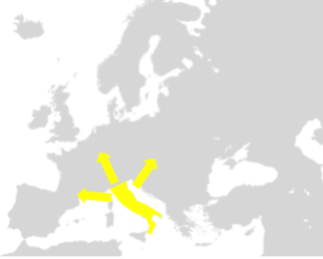
The European renaissance began in Florence, Italy
Notes:
Why do you think it started in Italy?

Slide 8
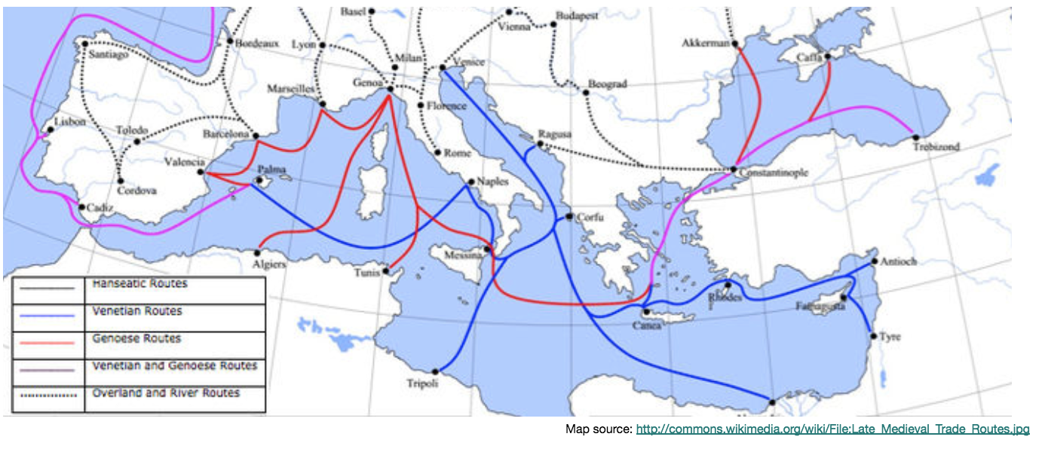
Why Italy?
Notes:
Italy was a travel hub and connection between Western Europe and the Islamic Empires
Italian cities became strong because the trade connections
NEXT SLIDE- prep students for images of nude man statue

Slide 9
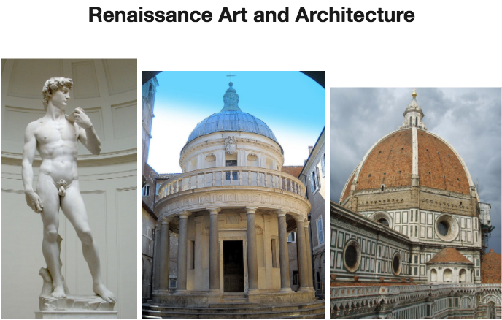
What similarities do you notice between the Classical Greco-Roman art and architecture and the Renaissance art and architecture pictured?

Slide 10
Trace the ideas that led to the renaissance
Part I: Examine the map and the information, then answer the follow up questions.
Be ready to share your ideas – don’t jump ahead.

Slide 11
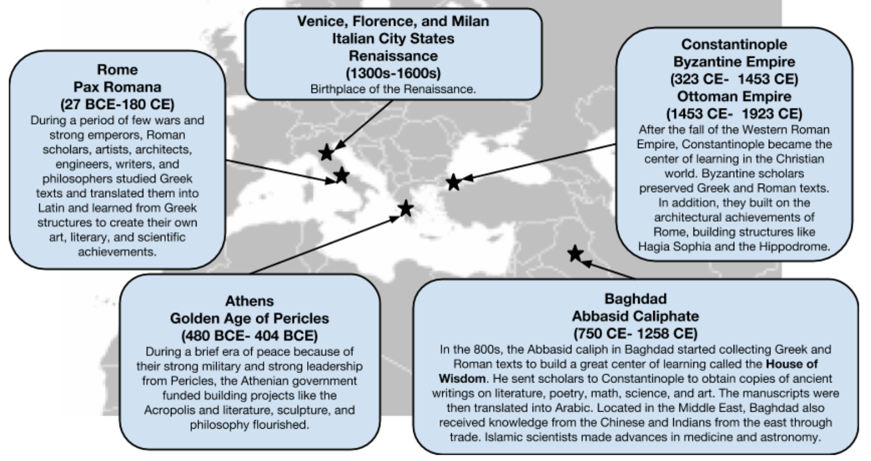

Slide 12
What led to the renaissance?
Golden Ages before the Renaissance.
Which civilization’s ideas were the foundations for collective learning in the Mediterranean world?
Innovations?
Which civilization’s knowledge most directly influenced the start of the Renaissance?

Slide 13
Success and failure during the renaissance
We will read Mario and Giovanni’s stories
Analyze the reasons for success and failure during the Renaissance.

Slide 14
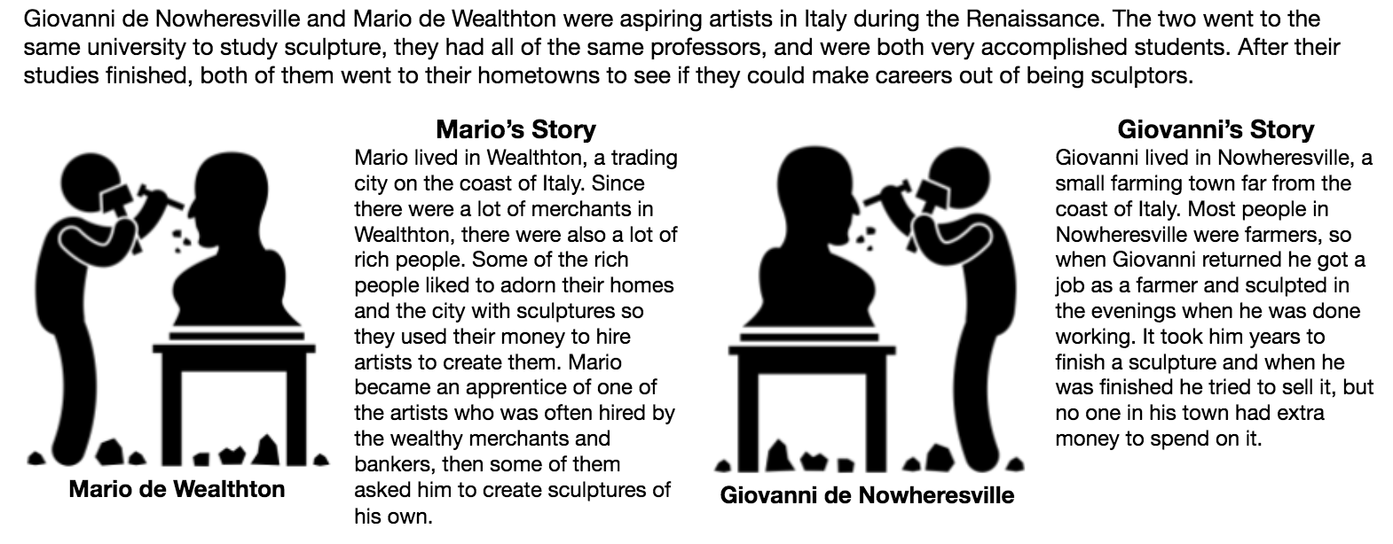

Slide 15
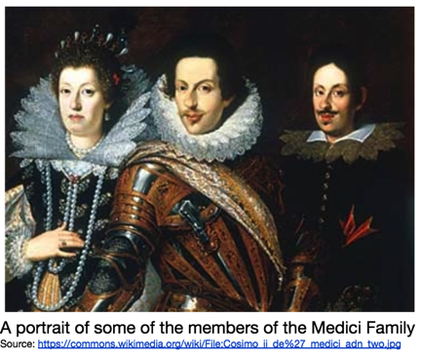
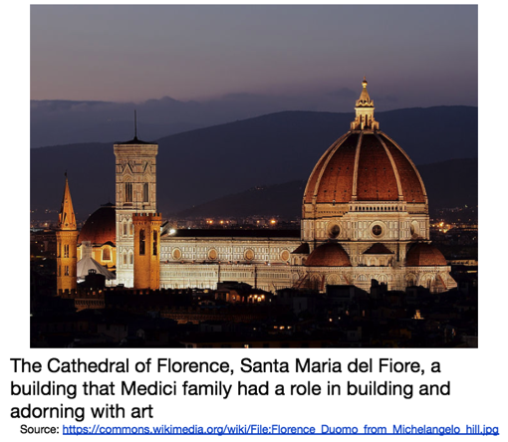
Wealthy Merchants
Medici family funds art by supporting new art/architecture in cities like Florence
Funded artists, architects, and scientists to study Greek and Roman buildings and texts
Where did the Medici's get their money?
Wealth from the Medici bank

Slide 16
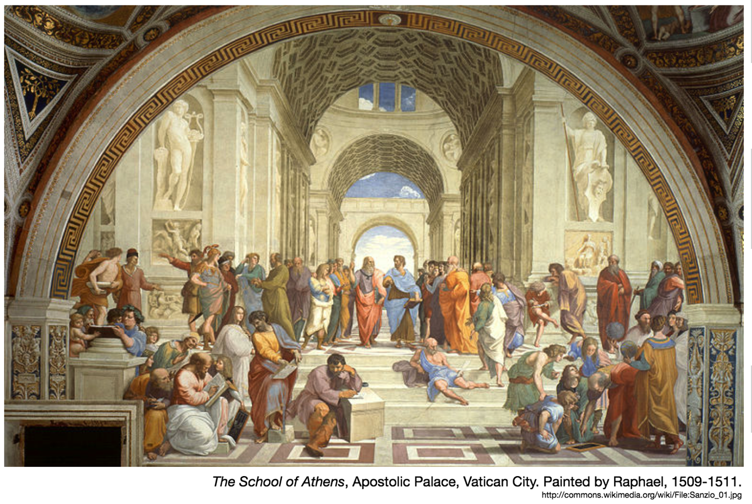
What were the characteristics of the renaissance in Italy?
Notes:
Students will write down
1.3 things they SEE
2. What do you think this is an image of? Why was it painted? What do the figures represent?
3. 1 question about the picture

Slide 17
Characteristics of the Renaissance Activity
Read to make sure you have a clear understanding of Greek/Roman influence, Humanism, Emphasis on the Individual, and the Celebration of Secular Achievements by answering the questions.

Slide 18
Homework
Unit 3 vocab due tomorrow

