Slide 1
1. Turn in your roots questions and absolutism reading to the back 2. Get out last weeks do now
2 weeks until Spring Break
Happy Monday

Slide 2
CNN 10
2 Aha’s and a Huh?
Aha = moment you understood something or learned something new
I learned…I was surprised by…I was shocked by…I didn’t know about…
Huh = question
Who, what, when, where, why, I wonder…

Slide 3
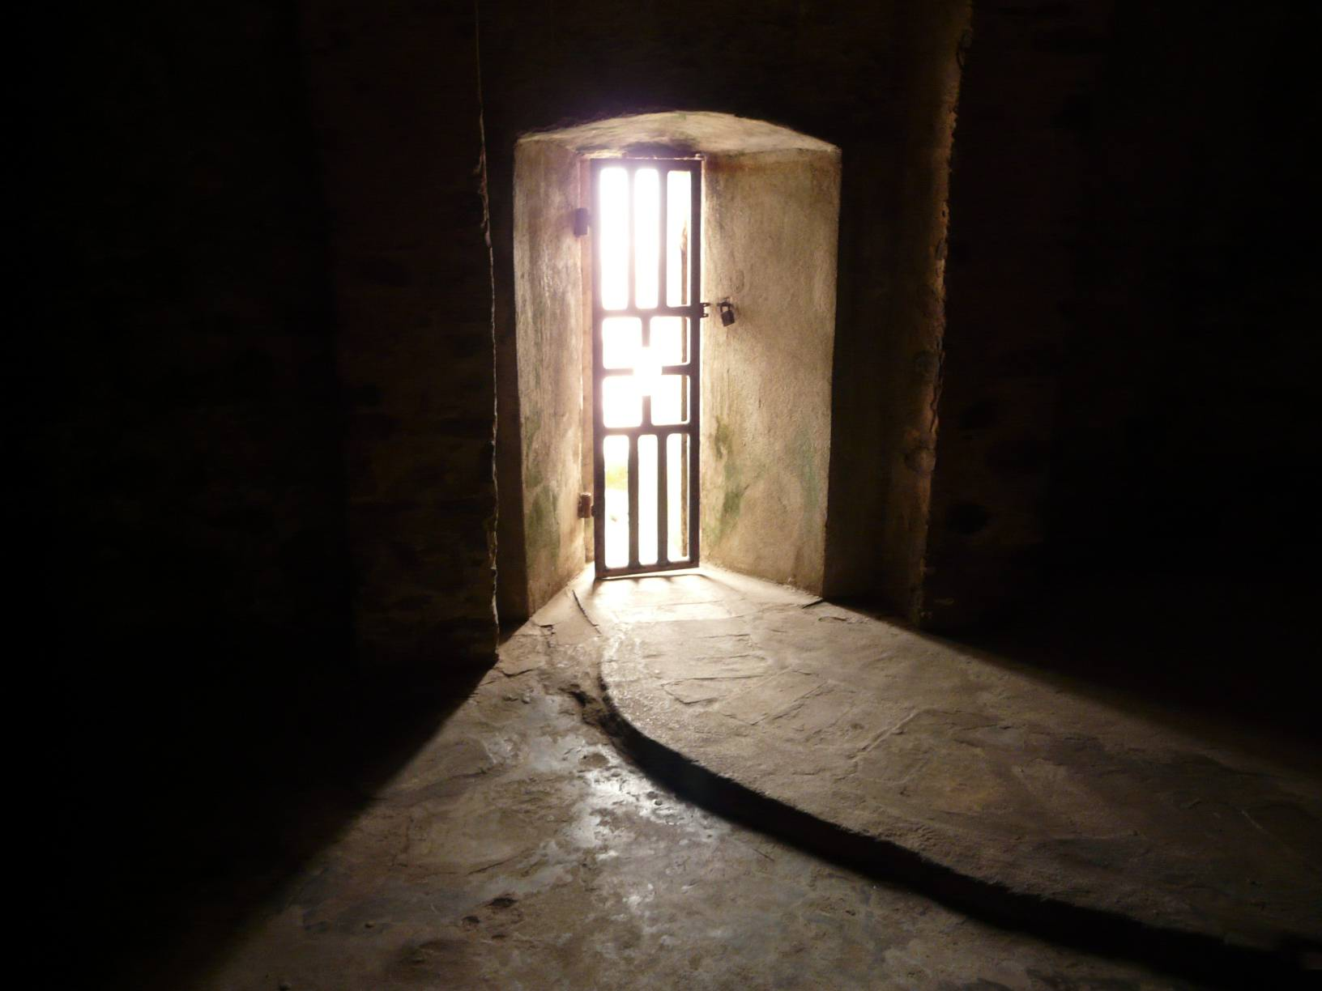
What do you see here? What strikes you about this image?
The Door of No Return
Notes:
Elmina Slave Castle

Slide 4
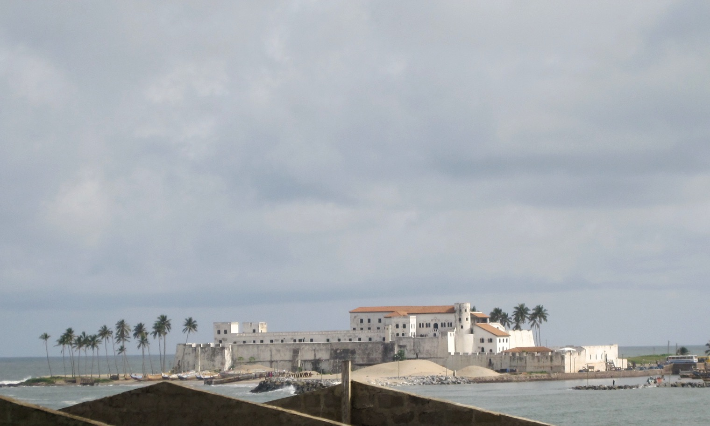
Elmina Slave Castle

Slide 5
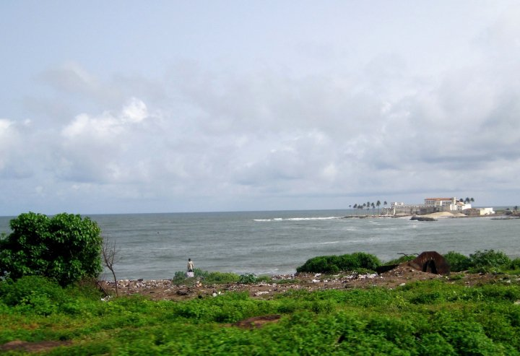
Elmina Slave Castle

Slide 6
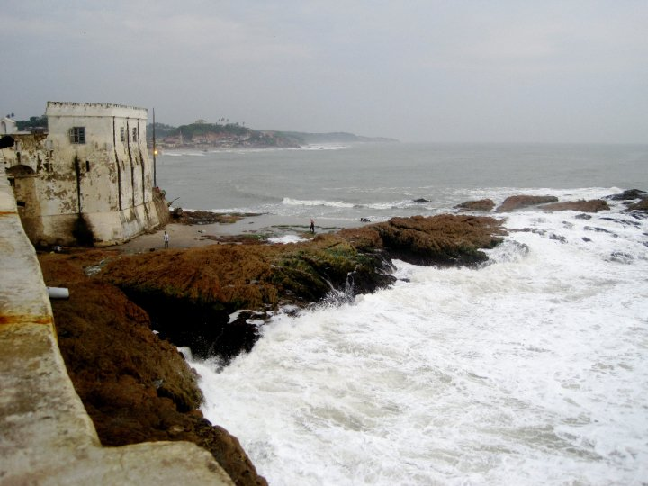
Elmina Slave Castle

Slide 7
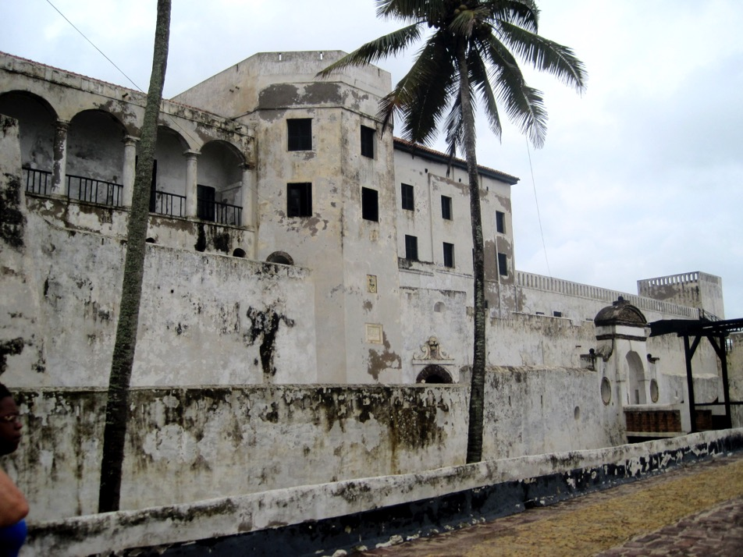
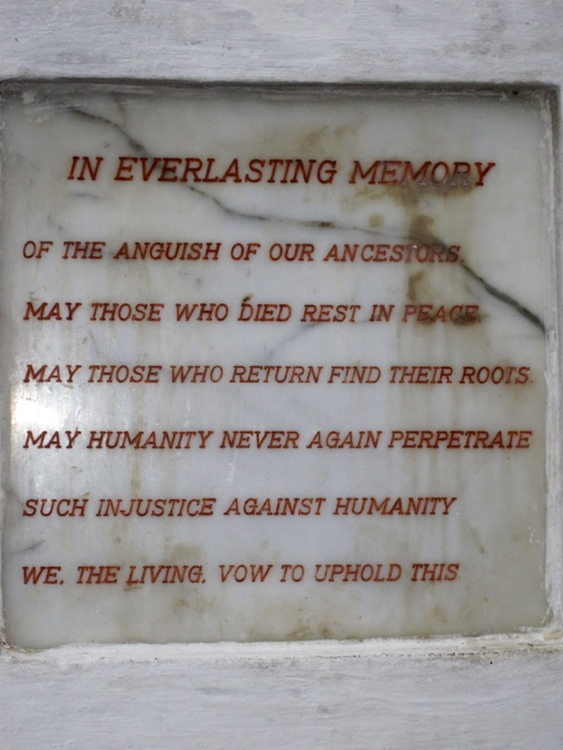

Slide 8
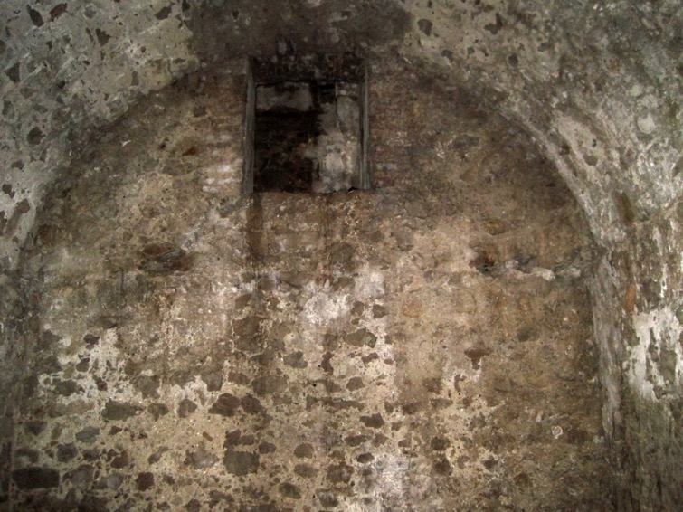
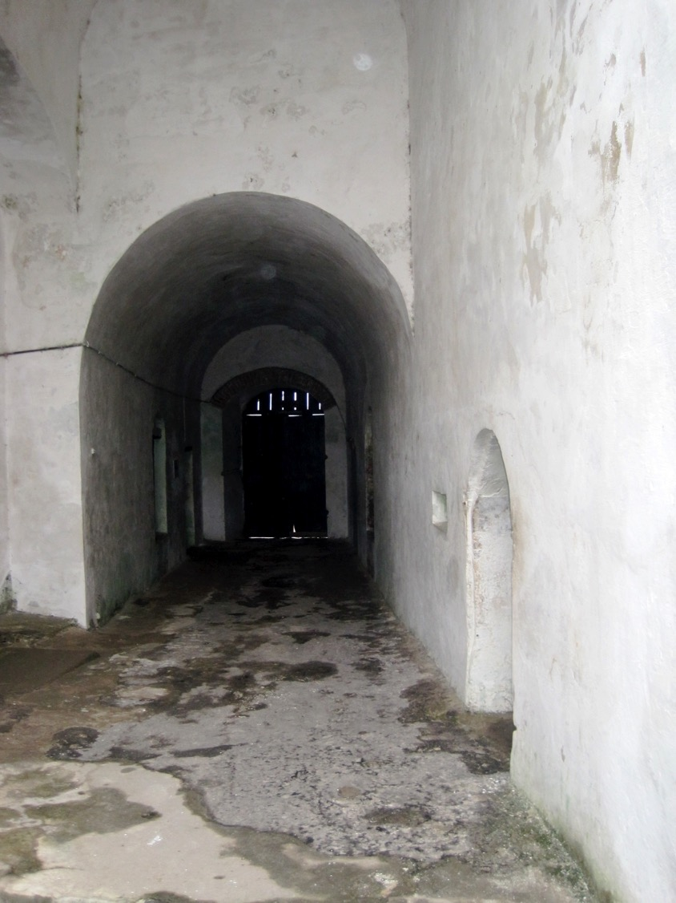
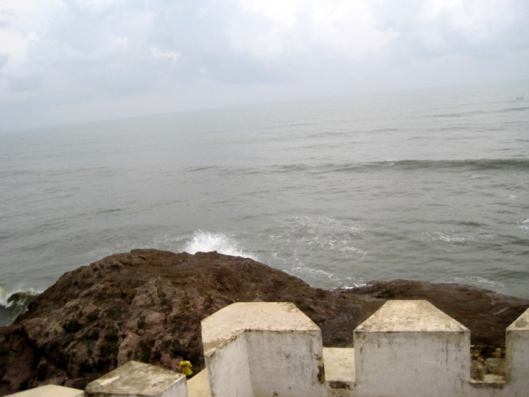

Slide 9
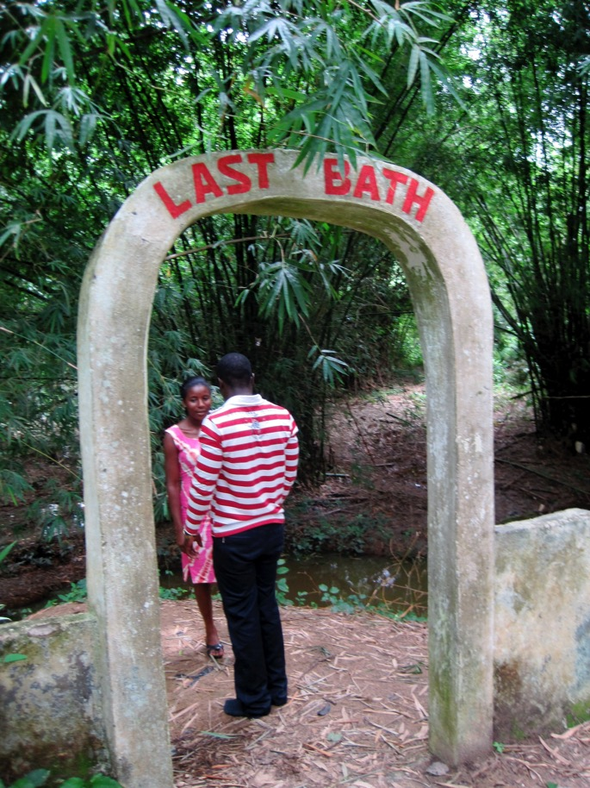
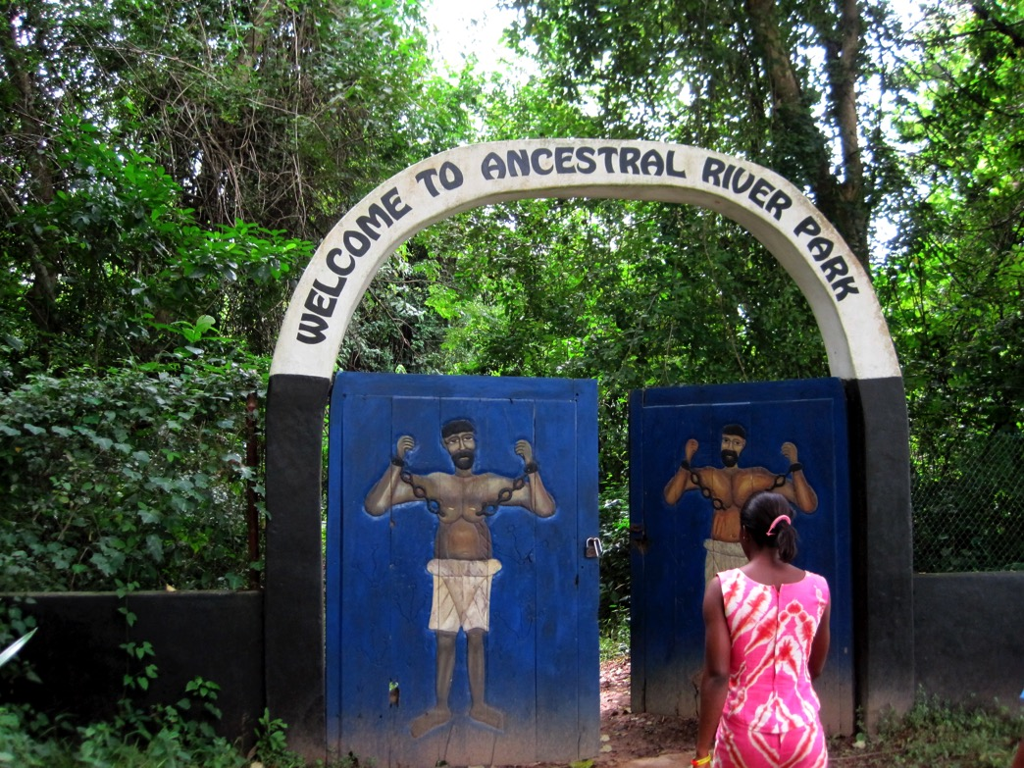
Before going to slave castles slaves were shackled and forced to walk many miles

Slide 10
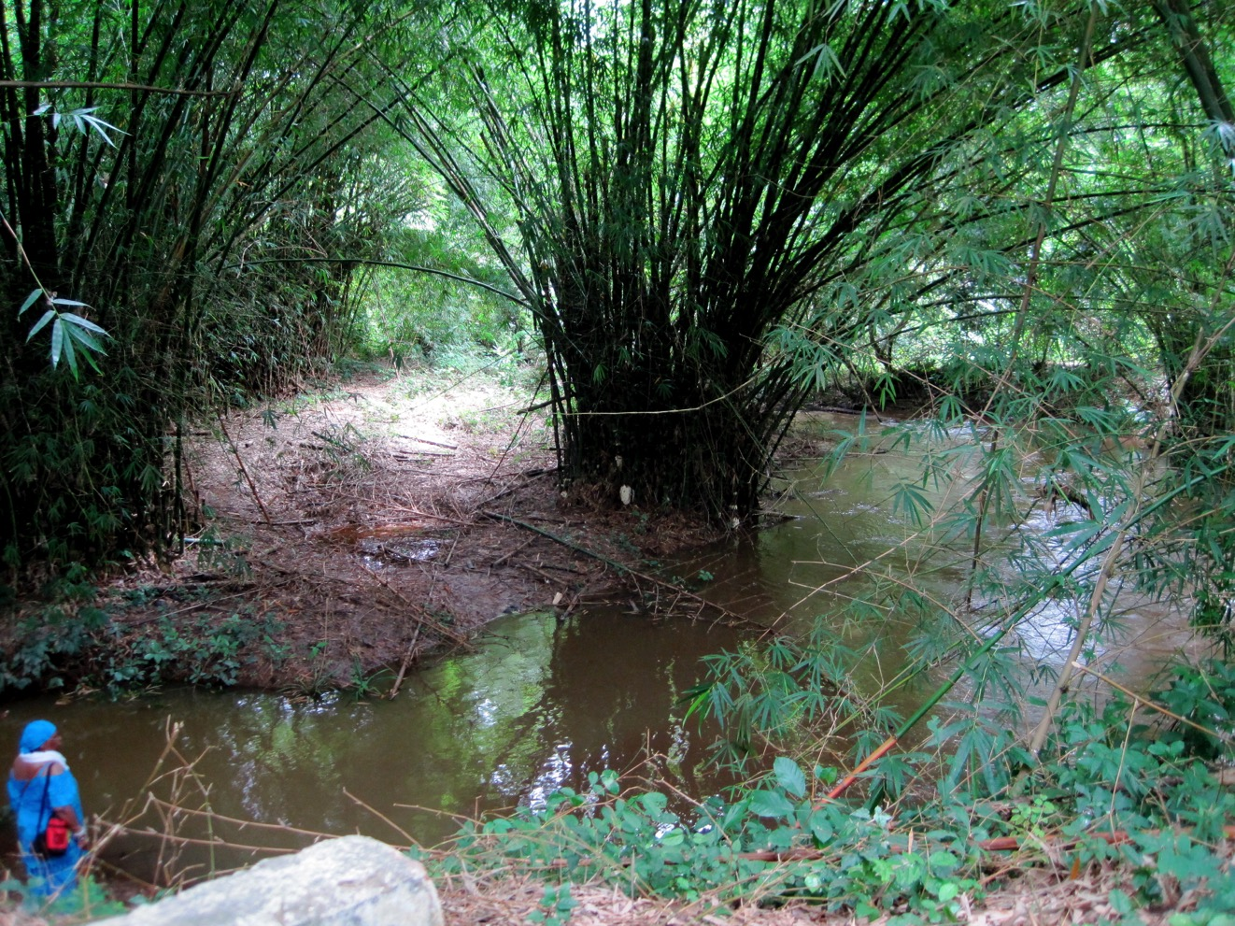
Last Bath

Slide 11
What is absolutism?
Absolute = All powerful
Monarch = King or Queen
Absolute Monarch = An all powerful king or queen

Slide 12
Essential Understandings
The Age of Absolutism takes its name from a series of European monarchs who increased the power of their central governments.
Characteristics of Absolute Monarchies:
Centralization of power
Concept of rule by divine right

Slide 13
Power of a Monarch
In the 17th Century, people looked to the monarch for political stability
Absolute monarchs had tremendous powers
Make laws
Levy taxes
Administer justice
Control the state’s officials
Determine foreign policy
No written Constitution or Bill of Rights
Most people did not have any rights at all

Slide 14
Cooler Ruler research
Objective: Use historical info and creativity to make your ruler “cooler” than all of the other rulers in their day and age through a rap/poem!
Create a rap/poem that includes information about your ruler’s life/reign.
Competition will be done through a rap off/poetry slam tomorrow.
You will have the rest of class to work on your research along with an additional 30-35 minutes in class tomorrow.

Slide 15
Cooler Ruler research Requirements
Major achievements in the ruling country during reign (must include minimum of 2 – make sure it is clear what the person did)
Relationships - who they loved, were married to, and/or other members of their family
Major problems/challenges to overcome; think about issues the ruler ran into
Major events of the rulers reign (at least 4 major events – these can be positive or negative)
The ruler’s lasting legacy or impact on their country and/or the world

Slide 16
Homework
Finish working on your research
You will have 30-35 minutes in class tomorrow to create your rap/poem and prepare for the battle!

