Slide 1
Get out your NCFE review
Happy Tuesday

Slide 2
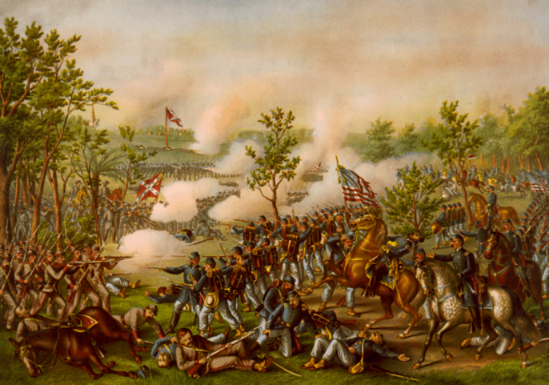
1864-1865: Bringing the War to an End
Notes:
Start 1st here

Slide 3
Election of 1864
Republicans VS Democrats
Lincoln VS McClellan
Wartime election
Notes:
With the war raging and the fate of the country hanging in the balance, the 1864 election had particular significance. Abraham Lincoln sought reelection in his campaign against former Union General George B. McClellan.
Image information:
Right– Democratic Candidates
Left– Republican Candidates

Slide 4
Election of 1864
George McClellan argued that the war had gone on long enough and that the South should be allowed to secede in order to save American lives. This meant that slavery would continue in the Southern states.
Abraham Lincoln argued that the war must be won, the slaves freed, and the Union preserved at all costs.
Notes:
Abraham Lincoln argued that the war must be won, the slaves freed, and the Union preserved at all costs.
Republicans were also against immigrants, alcohol,
McClellan argued that the war had gone on long enough and that the South should be allowed to secede in order to save American lives. This meant that slavery would continue in the Southern states.
Democrats more welcome to immigrants and pro alcohol,

Slide 5
Election of 1864
During this time in the war, many Americans asked why the war was being fought and whether it was worth it
Image courtesy of the Library of Congress
Notes:
At this time in the war, many Americans asked why the war was being fought and whether it was worth it.
Was it worth fighting for? North/South perspective
Image – left Lincoln, middle McCllelan, right Jefferson Davis
“No peace without abolition” The Union must be preserved at all hazards” “No leave without separation”

Slide 6
Confederate Surrender
The armies of the Union were able to coordinate successfully with each other and Lee surrendered at Appomattox, Virginia on April 9, 1865.
Image courtesy of the National Park Service

Slide 7
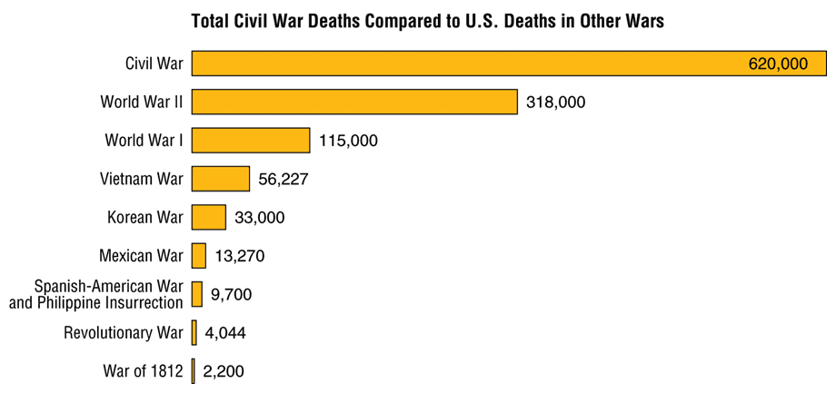
Results of the Civil War
Deaths: Union ~360,000 Confederacy ~260,000 dead
Wounded: Union ~275,000 Confederacy ~225,000
Billions of dollars spent by both sides
Inflation – worse in the south than the north

Slide 8
Political/Economic Outcomes
Threat of secession is over
Increased power of the federal government
New paper currency used
Federal power shown through conscription and blockades
Southern economy destroyed
13th, 14th, and 15 amendments

Slide 9
Rebuilding
After the surrender, the difficult task of rebuilding and reunifying the country began.
AKA Reconstruction (Unit 7)
Image courtesy of the National Archives
Notes:
Image information:
Richmond in ruins.
Finish tomorrow

Slide 10
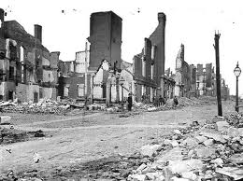
Reconstruction (1865-1877)
The term used to describe the period in which the US began rebuilding after the Civil War from 1865-1877
It was also the process used to readmit Confederate states back into the Union

Slide 11
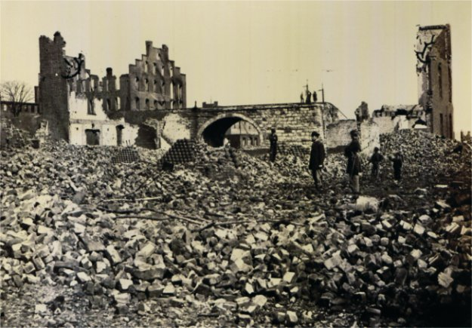
Reconstruction
What were the plans for Reconstruction after the Civil War?
Notes:
Radical – extreme decision/action, typically out of the norm
What do you see?
What do you think because of what you see?
https://www.youtube.com/watch?v=8buF2t0VMFs

Slide 12
Reconstruction: Historical Context
What should the government do to support the transition of former slaves into free American citizens?
Remember – slaves often had no education and no job training.

Slide 13
Reconstruction: Historical Context
Should the states who rebelled and their citizens be let back into the nation with no restrictions, or should they be “punished” in some manner for rebelling and starting a civil war?
Pay a fine? Be readmitted? Pledge loyalty? What should happen to the citizens in the Confederacy who fought or those who didn’t fight against the US?

Slide 14
Reconstruction Plans
Lincoln’s Plan- (10% Plan)
Amnesty for Oath of Loyalty
Emancipate the Slaves
New Gov’t after 10% take oath
No Confed. officers or officials
Mod/Radicals- Wade Davis Bill (51% of population)
Majority of voters must take oath
New States must abolish slavery
Must reject Confed. War debts
Deny officers/officials vote & office
Johnson’s Plan (Presidential Reconstruction)
Amnesty for all except wealthy
Revoke ordinance of secession
Ratify the 13th Amendment (abolish slavery)
Reject Confederate War debts
Notes:
Lincoln: Lenient Reconstruction policy. The government would pardon all confederates who swore allegiance to the Union, except high ranking officials – After 10% of those who voted in 1860 took the oath and wrote a constitution they could form a new state government and gain representation in Congress –immediate restoration
Radical Republicans (Lincolns side but more extreme): majority of white male citizens declare their allegiance and that only those who swore an “ironclad” oath could vote or serve in the state constitutional conventions. Abolish slavery, deny political rights , reject war debts.
Johnson: Native to the South. No pardons for high Confederate officials and those owning more than $20,000 in property. Each confederate state could be readmitted to the Union if it would meet several conditions – each would have to withdraw its secession, swear allegiance to the Union, annual Confederate war debts, and ratify the 13th amendment.

Slide 15
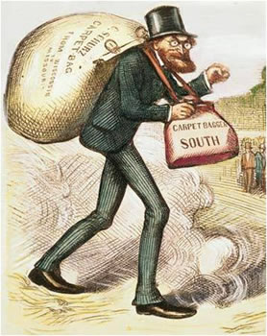
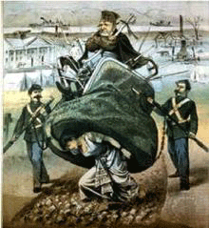
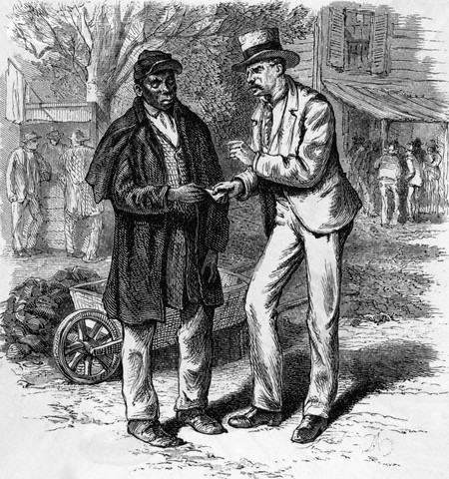
Carpetbaggers & Scalawags
1. A Northerner who went to the South after the Civil War for political or financial advantage.
2. An outsider, especially a politician, who seeks a position or success in a new locality.
1. a scamp; rascal.
2. A white Southerner who supported Republican policy during Reconstruction, often for personal gain.

Slide 16
Civil War Amendments
The US government decided to help the south and make some changes that would help the freed slaves and make America a better place to live after the civil war.
Amendment = a change to the constitution

Slide 17
Reconstruction Era Amendments
13th amendment
14th amendment
15th amendment

Slide 18
Causes and Effects for amendment activity
Causes
Abolition movement
Civil War
Emancipation Proclamation
Radical Reconstruction
Plantation System became a strong economic system
Effects
African Americans granted full citizenship
Slavery was banned
African American men could vote
Women’s rights movements
Plantation were disbanded
Sharecropping
KKK
Jim Crow Laws
Voter suppression
Notes:
Sharecropping
KKK
Jim Crow Laws
Voter suppression

Slide 19
Reconstruction Era Amendments
List the appropriate causes and effects for each amendment (you may use a cause or effect more than once and add your own if you want)
Explain why this was a cause or effect of the listed amendment using complete sentences.

Slide 20
Reconstruction Era Amendments
13th amendment
14th amendment
15th amendment

Slide 21
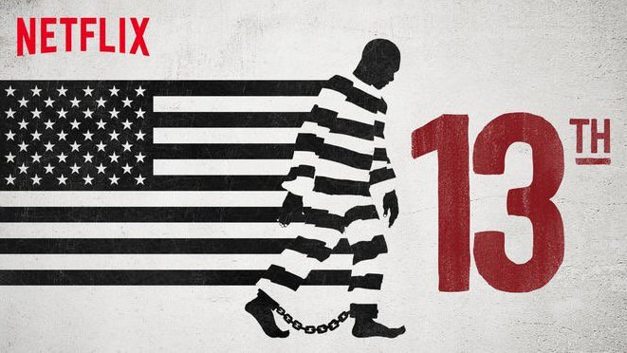
13th documentary
How does the 13th amendment impact society today?
Neither slavery nor involuntary servitude, except as a punishment for crime whereof the party shall have been duly convicted, shall exist within the United States, or any place subject to their jurisdiction.
Notes:
Show 13th trailer

